Slide 1
Great Activities
Make Your Class Interesting
贵阳市第七中学 刘婷婷
2024.05.23

Slide 2
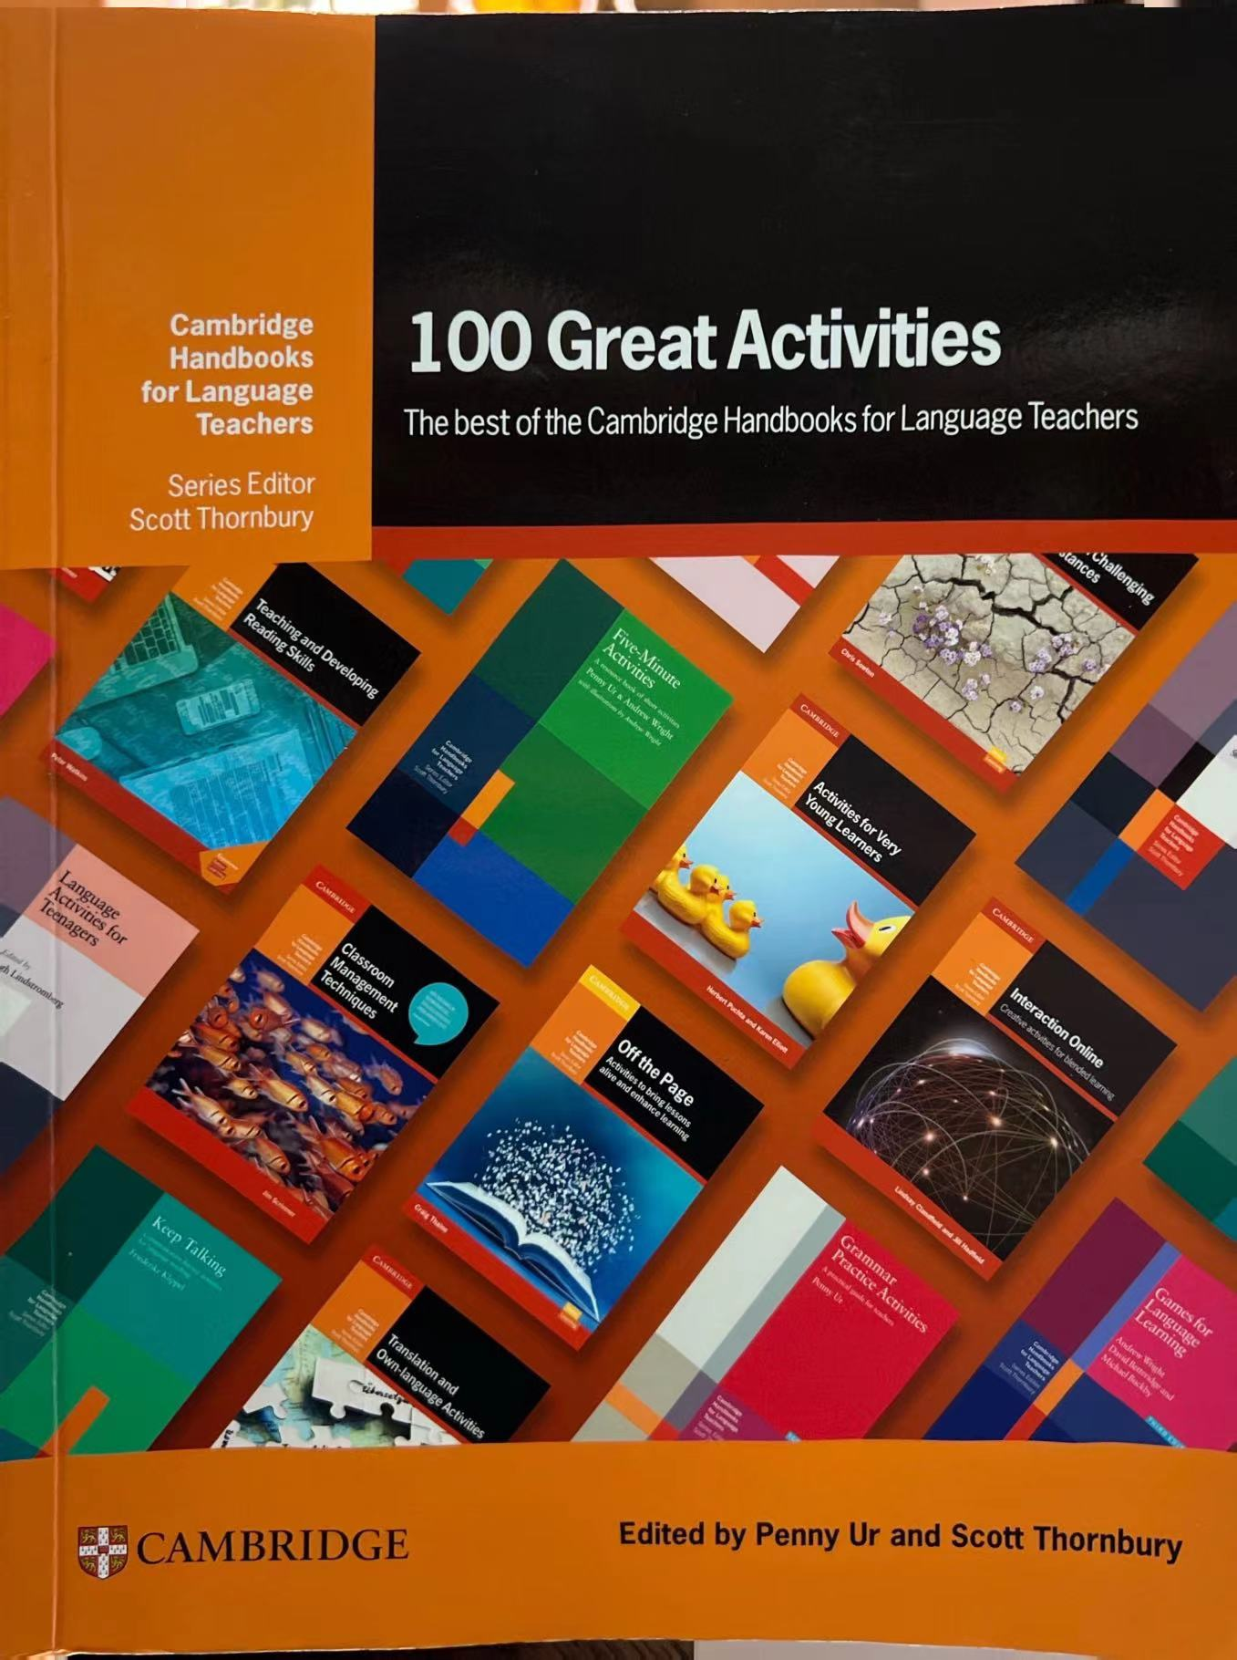
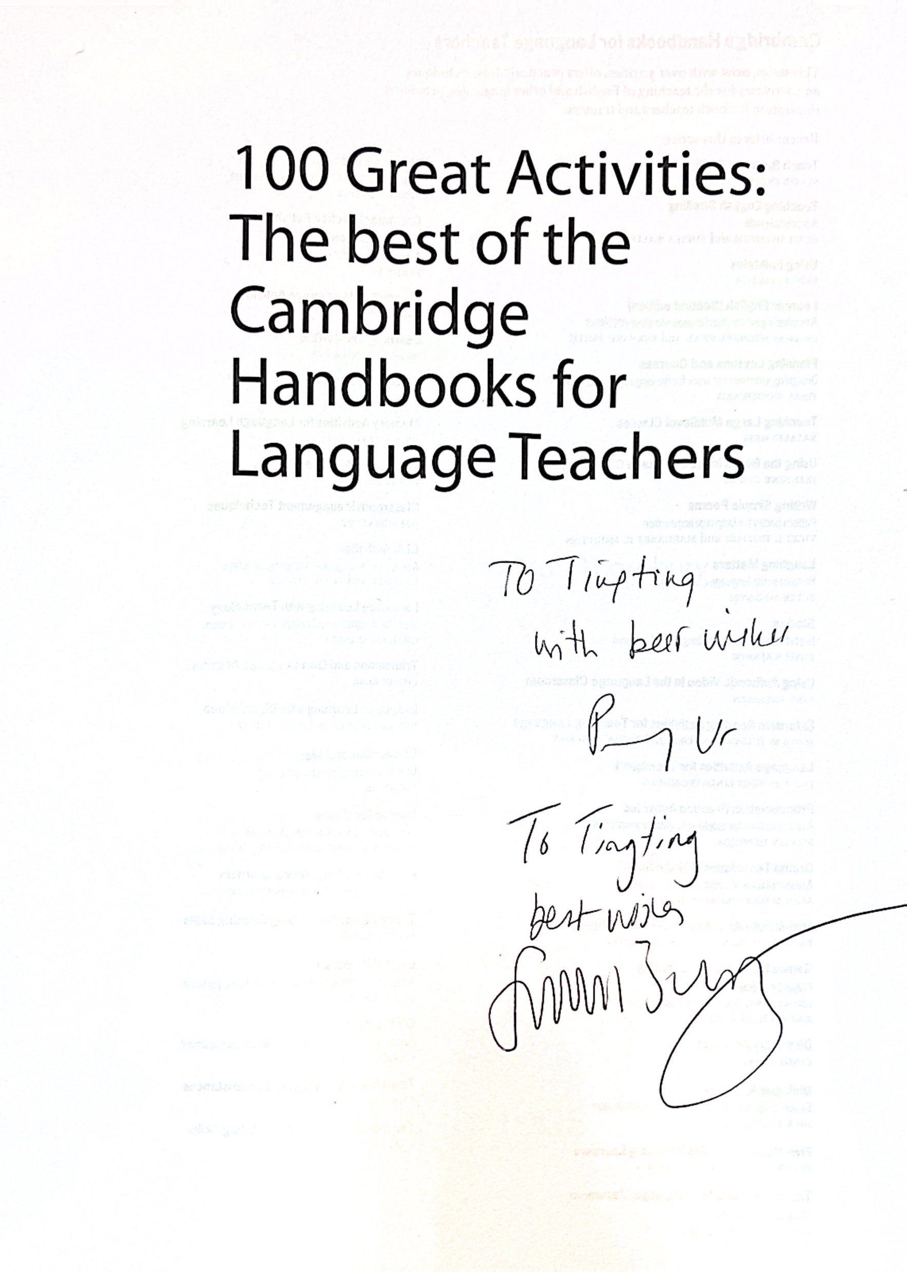

Slide 3
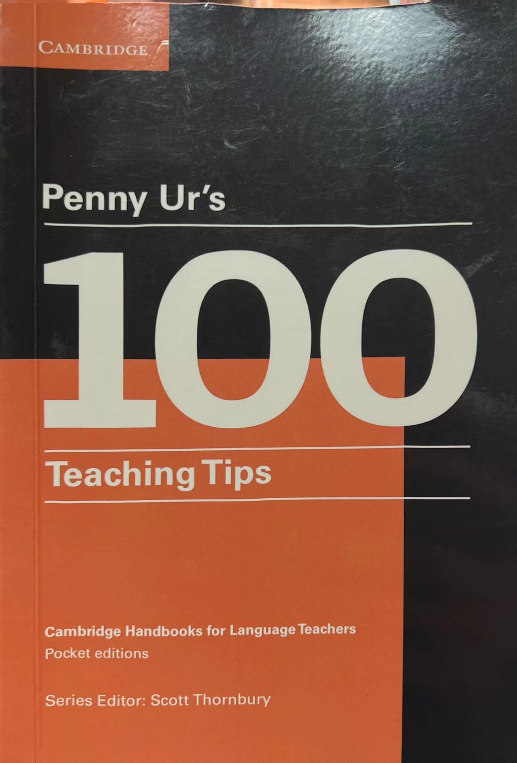

Slide 4
Content
Speaking
Listening
Reading
Writing
Vocabulary
Grammar

Slide 5
Speaking & Listening : moving routines
Flashing
Contrast with mother-tongue sounds.
2 Truths & 1 lie
Give tasks rather than topic.
Describe & draw
Use dictations.
Chinese whisper
Give topic and task in advance.
Fortunately … unfortunately …

Slide 6
2 Truths & 1 Lie
I am a mom of 2 boys.
I never do chores at home.
I am going to a party this evening.

Slide 7
Reading: thinking routine
Venn diagram
K W L
Don't make students read aloud.
Read and re-read.
Timeline
Pyramid

Slide 8
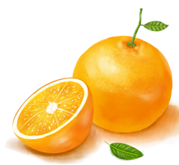
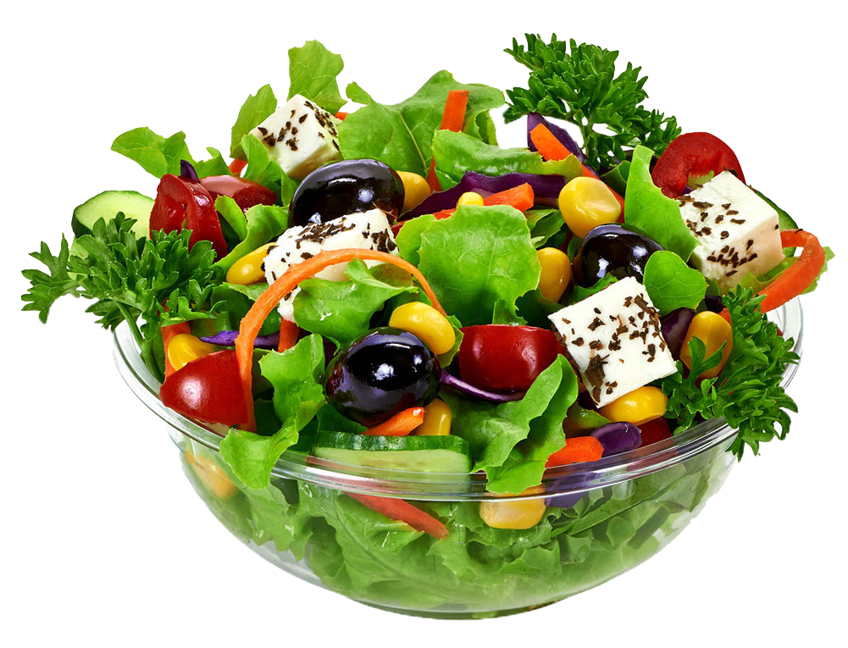
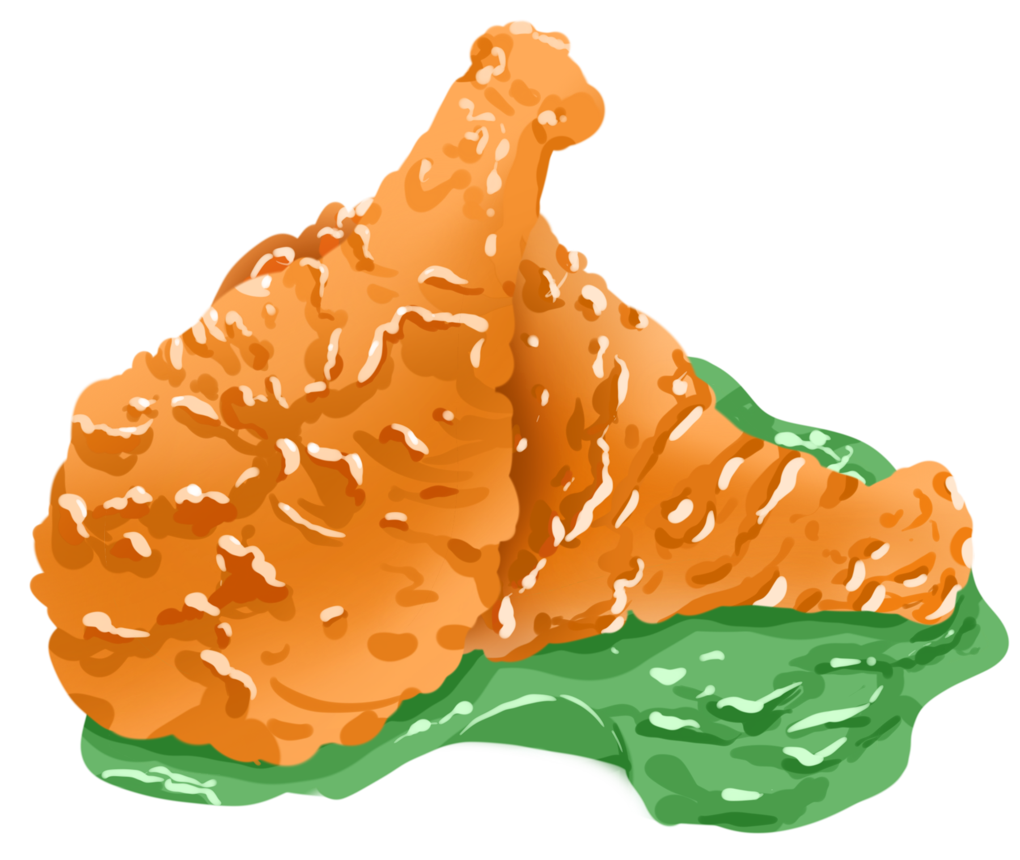
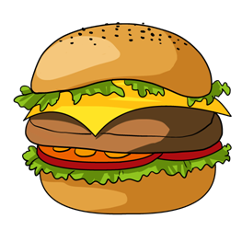
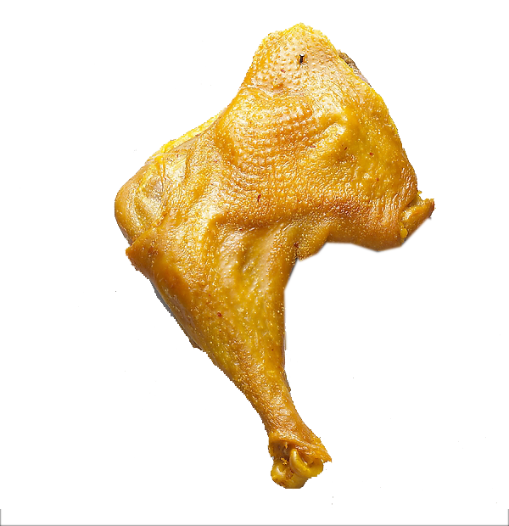
Post-reading
Are they healthy or unhealthy?
It depends on the way you cook them.
uncertain
unhealthy
healthy

Slide 9
How much do you know about the news ?
News
K (What I know) | W (What I want to know) | L (What I have learned)

Slide 11
Writing: creating routines
Acrostic
Extended Sentence
Do writing in class.
Modeling
Make collaboration worthwhile.
Emoji writing

Slide 13
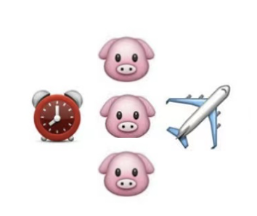
A mini-break: Help me decode the emojis !
A |  | B
C |  | D
Notes:
1. That was cold. 2 read it and weep. 好好读读吧，够你哭的. 3. not my cup of tea 4.when pigs fly 永无可能；决不可能

Slide 14
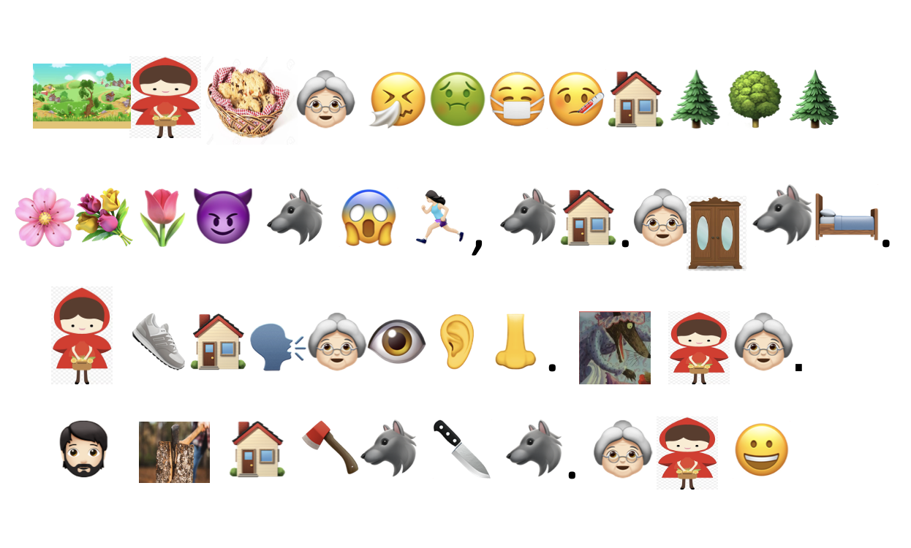
Creative writing practice: use narrative tense

Slide 15
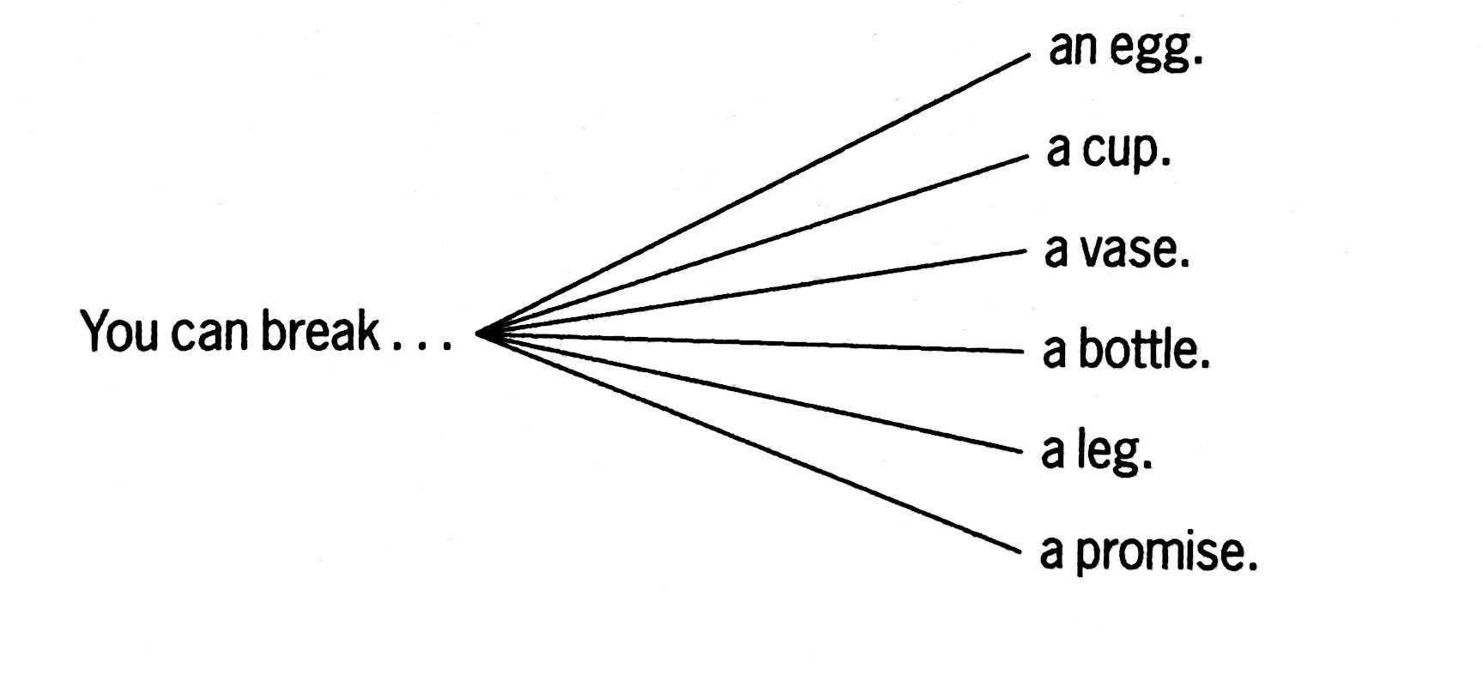
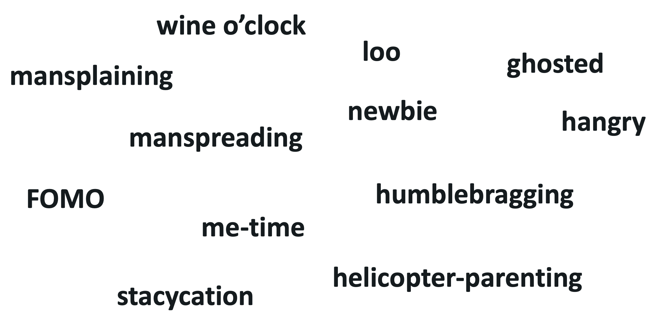
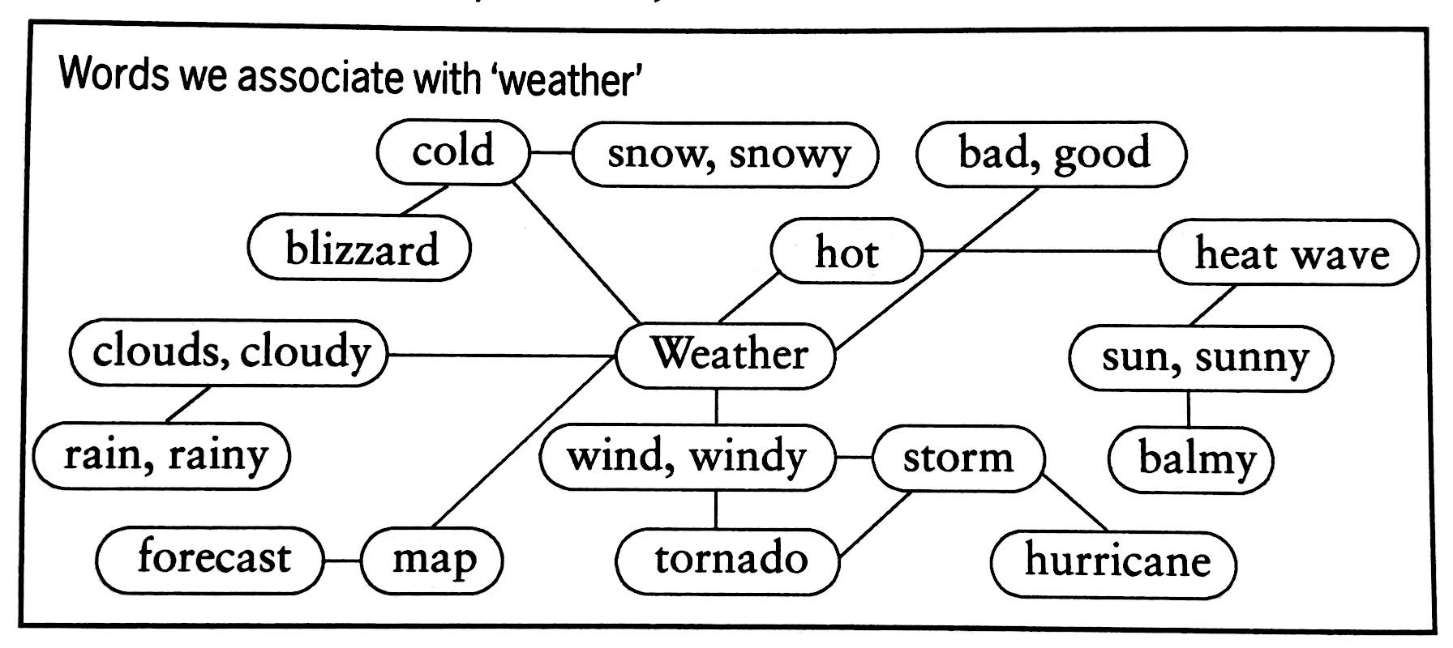
Vocabulary:
Treasure hunt
Teach multi-word chunks.
Association Webs
Do plenty of review.
Odd one out
Pass it round

Slide 16
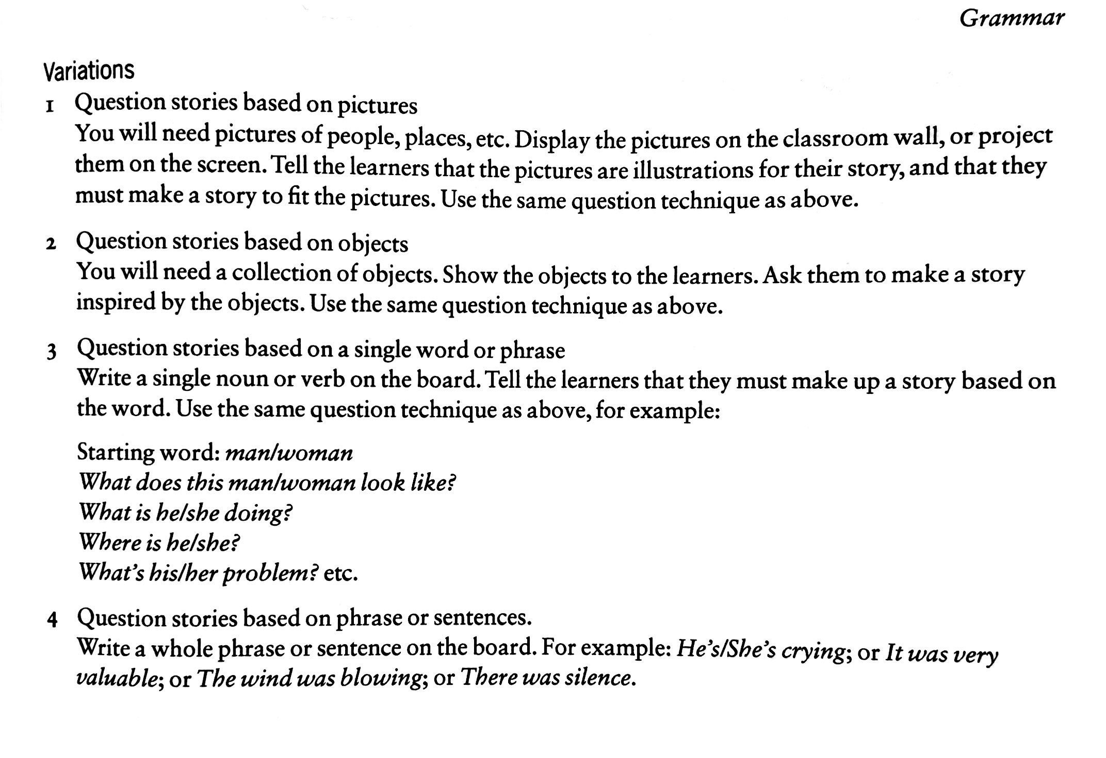
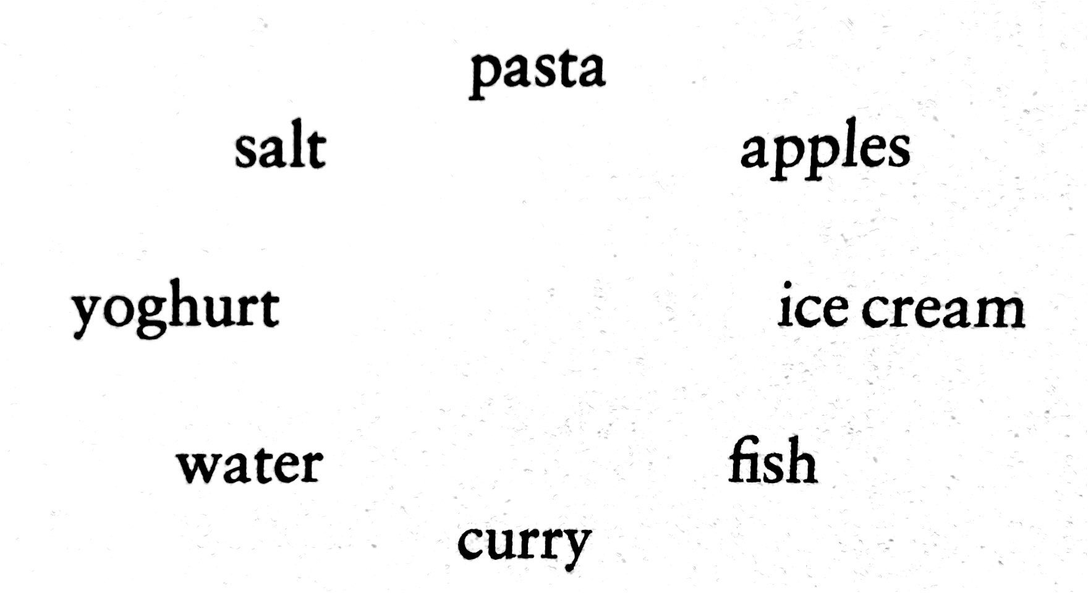
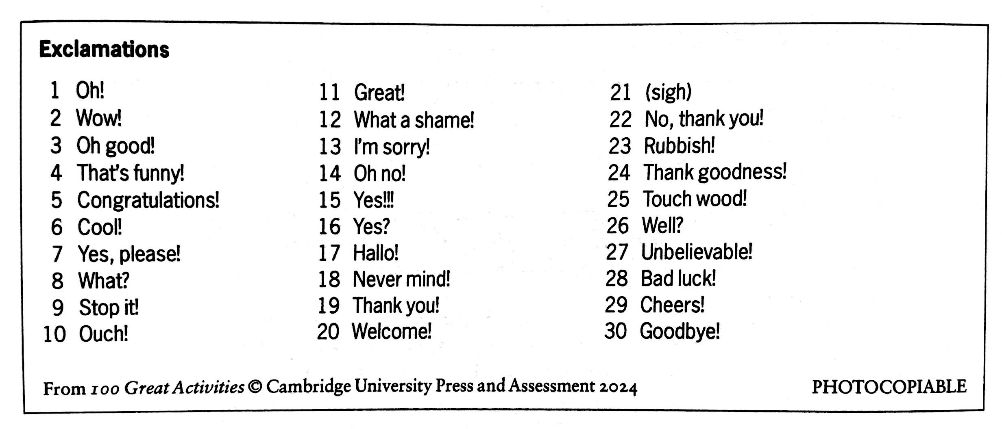
Grammar
Circle comparisons
Keep explanations short.
Draw my natural world
Use mother tongue to explain.
Oh!
Question stories

Slide 17
Testing and assessment
Assess not only through tests
Use(also) student self-assessment
Use tests as a teaching tool
Add optional sections to tests
Prepare students for the test
Assess yourself

Slide 18
THE NEW COLLABORATIONS
Thank you!

