Slide 1
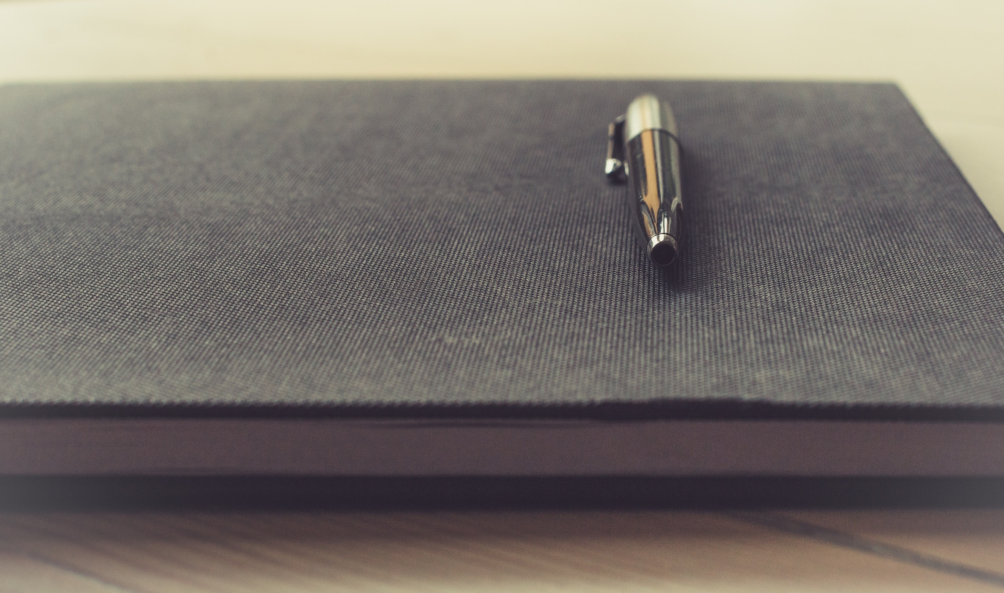

Writing
Be thankful to you!
Li Bin
No. 33 Middle School

Slide 2

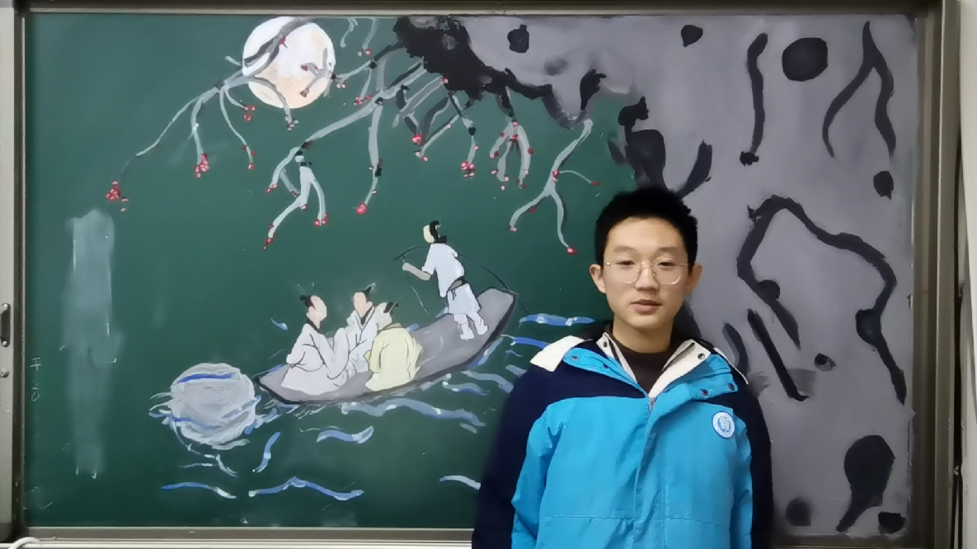




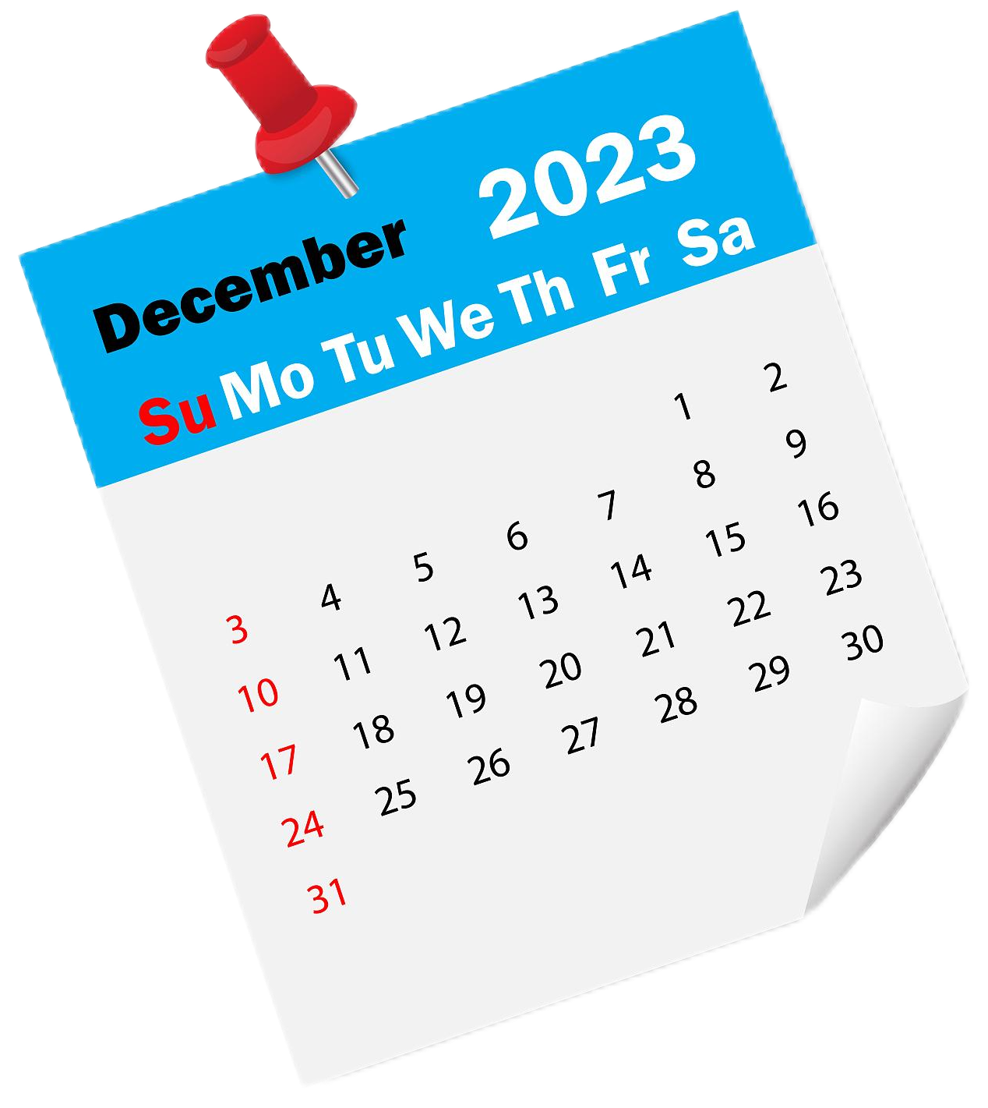

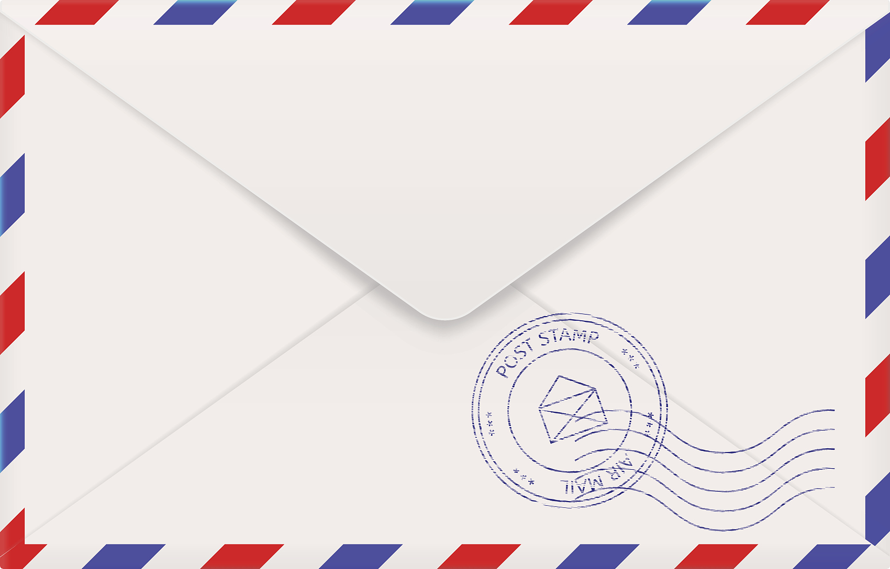
T
I
M
Thanks,
My Teacher!
E
From: Zhao

Slide 3
Dear Mr Li, The one person from my junior school days that I will never forget is you. When I first started Grade 7, my English was not very good. I was shy and did not dare to answer questions in class even though I knew the answers. I felt quite unhappy with myself. One day you spoke to me after class. You encouraged me to speak slowly. You also told me that you believed I could speak well if I practiced more. I was touched by what you said and it made me work harder on my speaking skills. For the past two years, you have encouraged me and I have changed a lot. I improved so much that I won an English speech contest this year! Now, I can answer questions in class confidently. Besides, I get good grades in English. I will always be thankful to you for your advice and support. Yours,
Zhao Yiming
What problem did Zhao have in Grade 7?
How was the problem solved?
Why did Zhao thank Mr. Li?

Slide 4
What problem did Zhao have in Grade 7?
How was the problem solved?
Why did Zhao thank Mr. Li?
Storyline
1
2
3

Slide 5
Storyline
1
2
Feeling line
3

Slide 6
Dear Mr Li, The one person from my junior school days that I will never forget is you. When I first started Grade 7, my English was not very good. I was shy and did not dare to answer questions in class even though I knew the answers. I felt quite unhappy with myself. One day you spoke to me after class. You encouraged me to speak slowly. You also told me that you believed I could speak well if I practiced more. I was touched by what you said and it made me work harder on my speaking skills. For the past two years, you have encouraged me and I have changed a lot. I improved so much that I won an English speech contest this year! Now, I can answer questions in class confidently. Besides, I get good grades in English. I will always be thankful to you for your advice and support. Yours,
Zhao Yiming

Slide 7
Storyline
1
2
Feeling line
3
Logic line

Slide 8







Dear Mr Li, The one person from my junior school days that I will never forget is you. When I first started Grade 7, my English was not very good. I was shy and did not dare to answer questions in class even though I knew the answers. I felt quite unhappy with myself. One day you spoke to me after class. You encouraged me to speak slowly. You also told me that you believed I could speak well if I practiced more. I was touched by what you said and it made me work harder on my speaking skills. For the past two years, you have encouraged me and I have changed a lot. I improved so much that I won an English speech contest this year! Now, I can answer questions in class confidently. Besides, I get good grades in English. I will always be thankful to you for your advice and support. Yours,
Zhao Yiming
Storyline
Feeling line
What
shy
unhappy
touched
confident
thankful
Logic line
How
Why

Slide 9

Who would you like to thank?
What would you like to say to him or her?

Slide 10
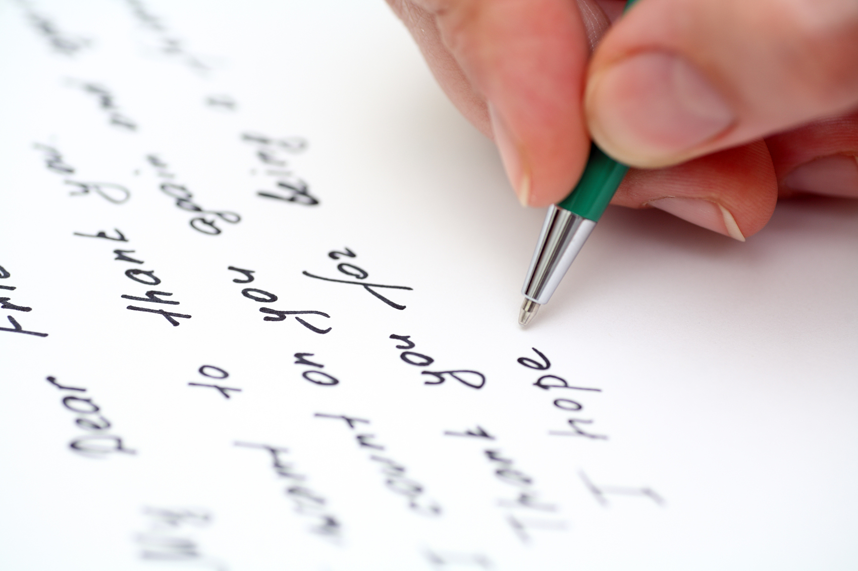
What problem did you have in the past?
How was the problem solved?
Why did you thank him or her?
1
Storyline
2
Feeling line
touched, happy...
3
Logic line

Slide 11
Self-evaluation
Peer-evaluation

Slide 12
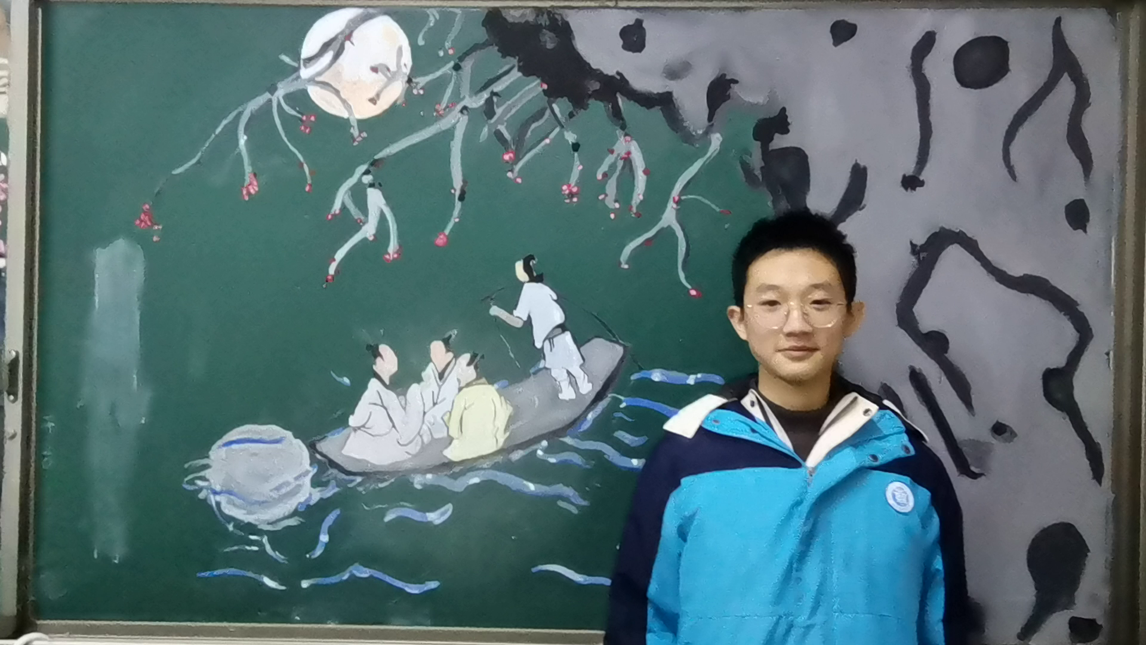


L
O
V
E

Slide 13
See you!

