Slide 1
Unit7 What’s the highest mountain in the world?
Section B Reading
No. 16

Slide 2
Let’s watch a video about pandas.

Slide 3
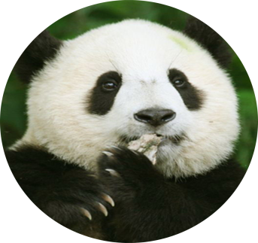
Brainstorming:What do you know about pandas?
Where do they live?
What do they eat?
What color are they?
How about baby pandas?
What do you think of pandas?

Slide 4
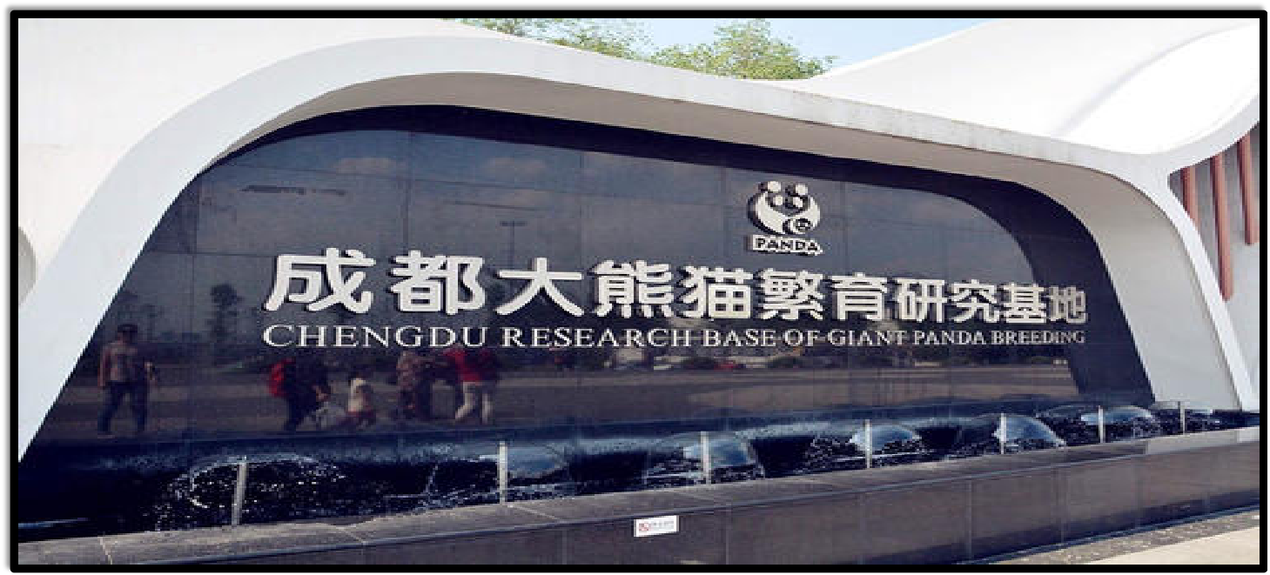

Slide 5
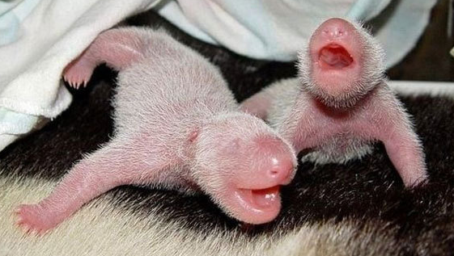
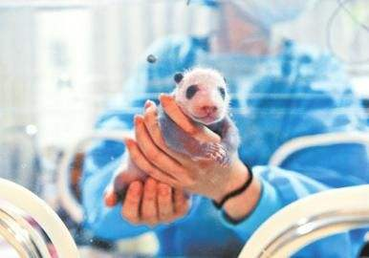
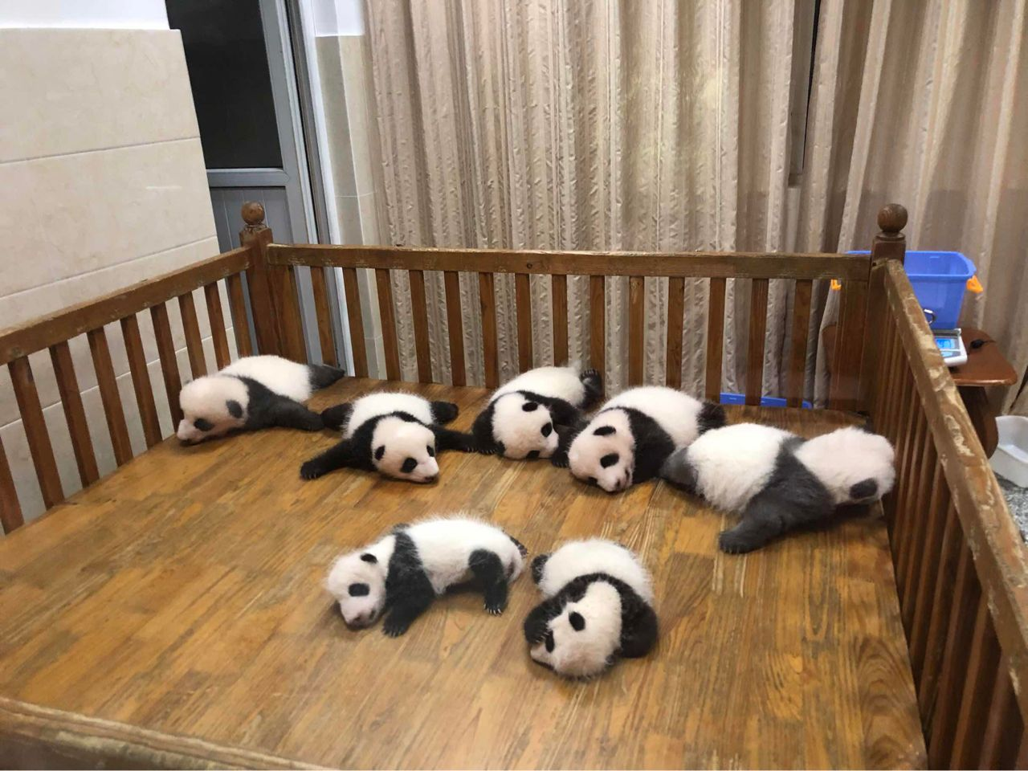
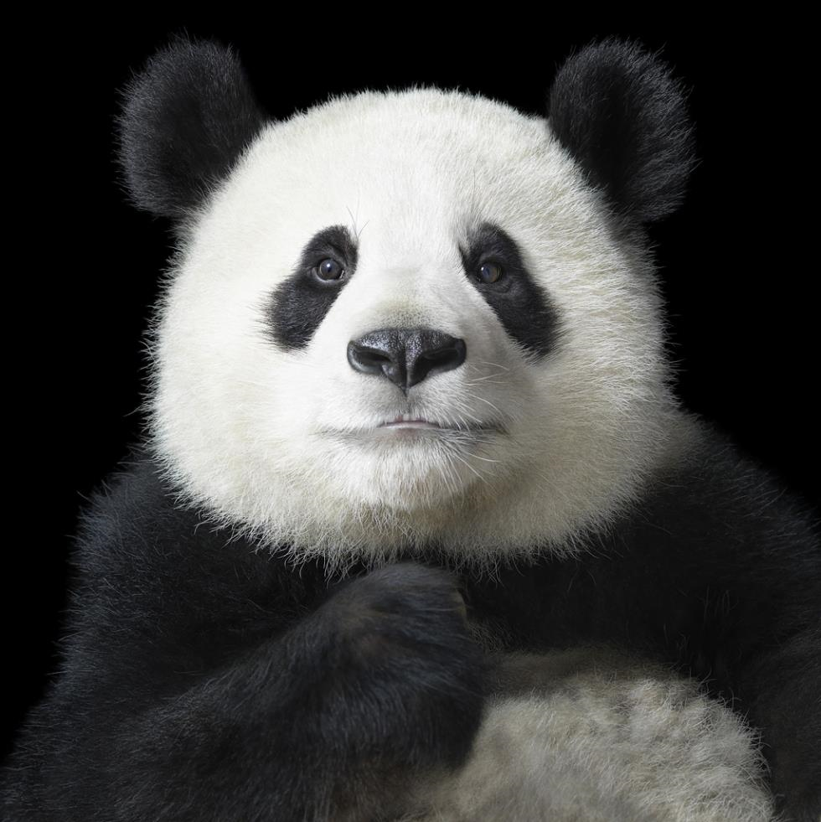
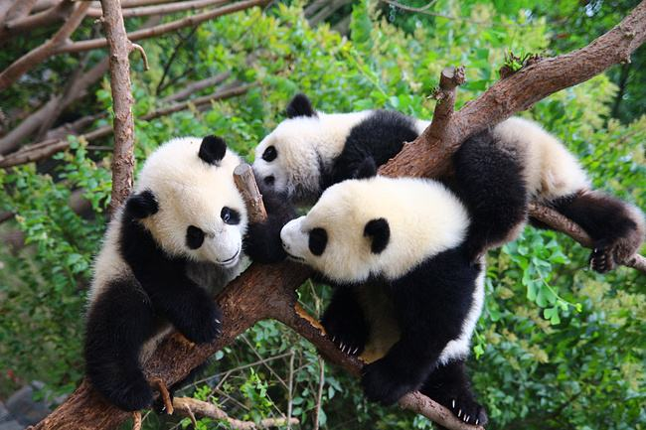
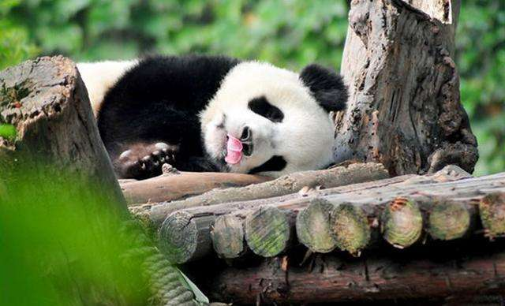

Slide 6
Read the passage and answer the question.
What kind of text it is?
A. a play B. a letter C. a story D. a report

Slide 7
Read the first paragraph and match.

Slide 8
Complete the matching questions based on the text.
walk into their friends, even fall over
prepare milk for the baby pandas
awake and hungry ; run over to the keepers with excitement
The baby pandas
The young pandas
The panda keepers

Slide 9
Read the second paragraph and fill in the blanks.
.

Slide 10
Reading strategy
(阅读策略)
Using context （上下文）
Using the sentence context may help you understand the passage well and get the correct words of the blank.

Slide 11
Fill in the blanks.
takes care of
Lin Wei _____________baby pandas. like his own babies
1
wash
Lin Wei _________ _________ and _______________ everyday.
feed
play with them
Pandas have become so popular that they are now _____________China.
a symbol of
3
around the world
Many people ______________love pandas.
4
are special to
Pandas ____________ him.

Slide 12
Read the third paragraph and find out what the numbers mean: 10, 12, 300, 2000.

Slide 13
Meanings of these numbers.
10
12
Adult pandas eat 10 kilos of bamboo every day.
Adult pandas spend more than 12 hours a day eating.

Slide 14
Meanings of these numbers.
300
2000
About 300 pandas live in zoos or research centers in China and other countries.
Scientists say there are now fewer than 2000 pandas living in the forest.

Slide 15
Reading strategy
(阅读策略)
Guessing the meaning when reading something, do not
worry about the words you don’t know. Use the context（上下文） to help you guess the meaning.

Slide 16
Read the third and fourth paragraphs and fill in the form.
.

Slide 17
Fill in the form, one word for each blank.
many
Para.3 The ______ why pandas are endangered | 1. Pandas do not have ___________ babies. 2. The babies often die from_____________. 3. Human started to______________ these forests.
reasons
illnesses
cut down

Slide 18
Fill in the form, one word for each blank.
bamboo
forests
Para.4 The________ ___________ to save pandas | 1.Plant more________ _________. 2.Teach children about the _____________of saving them. Maybe we can/ could/ should/ must_________________________.
Hopes | We all hope that in the future there will be __________ _______ _______pandas than now.
Chinese
importance
government
a
lot
more

Slide 19
Group work

Slide 20
1. Group discussion:
What kind of endangered wild animal do you like best? What can we do to protect them?
2. Draw a picture of your favorite animal.
3. Make a beautiful poster.

Slide 21
Make a summary.

Slide 22
Homework
You must do :
1) Read the text twice after the tape.
2) Research: What are the habits of whales? What difficulties do they face? How can humans save whales?
You can choose one to do:
1) Complete the reading exercise 2c on page 54 and the writing exercise 2e on page 55;
2) If you are the ambassador of the Wild Endangered Animals Protection Association, please shoot a video to promote the protection of wild endangered animals, and send it to Tiktok and your teacher.

Slide 23
Thank you for your listening!

