Slide 1
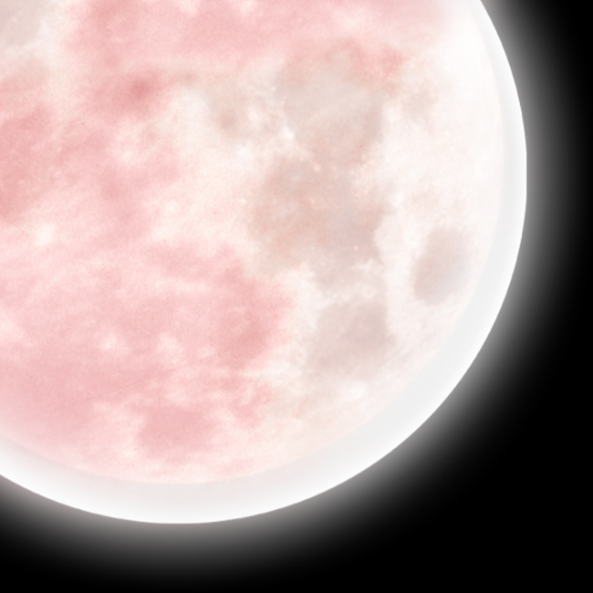
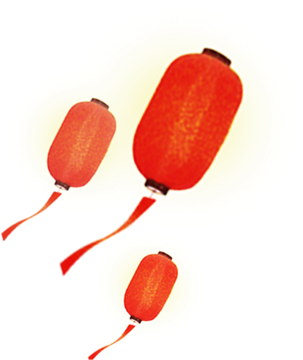
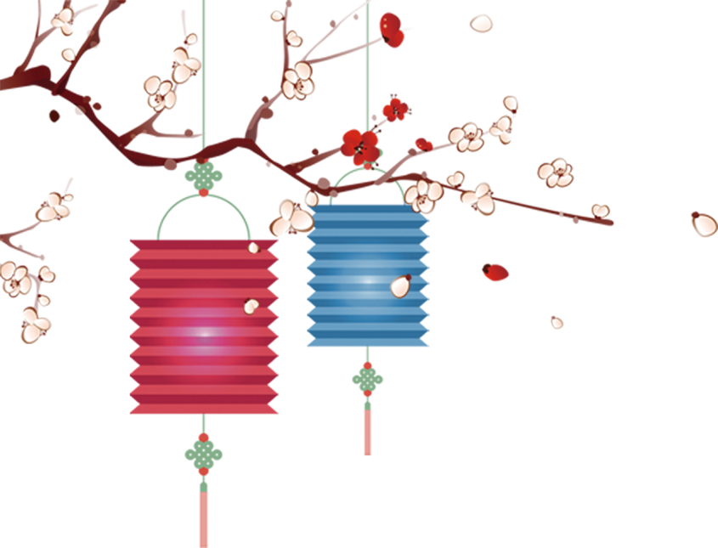
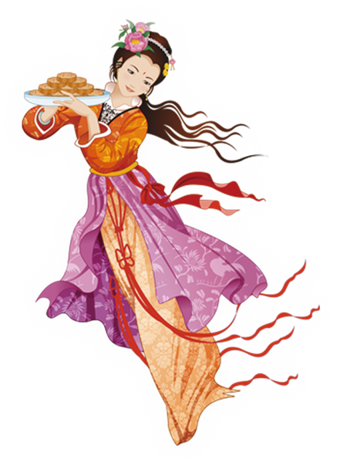
Unit 2
I think that mooncakes are delicious!
Section B 3a-3b
Writing

Slide 2
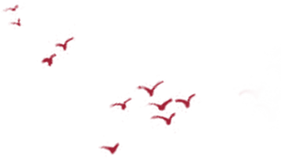
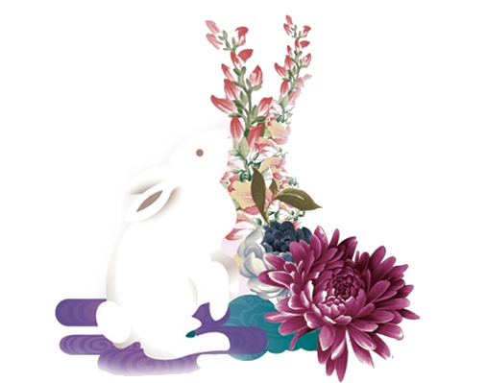
Teaching Objectives
To write a letter about Chinese traditional festivals.
To be able to grasp and master multiple writing strategies in writing activities.
To be able to assess the writing with each other.

Slide 3
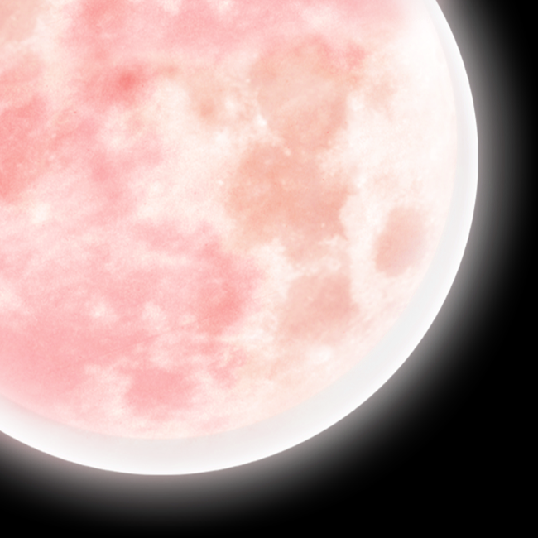
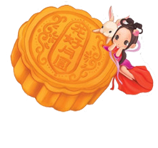
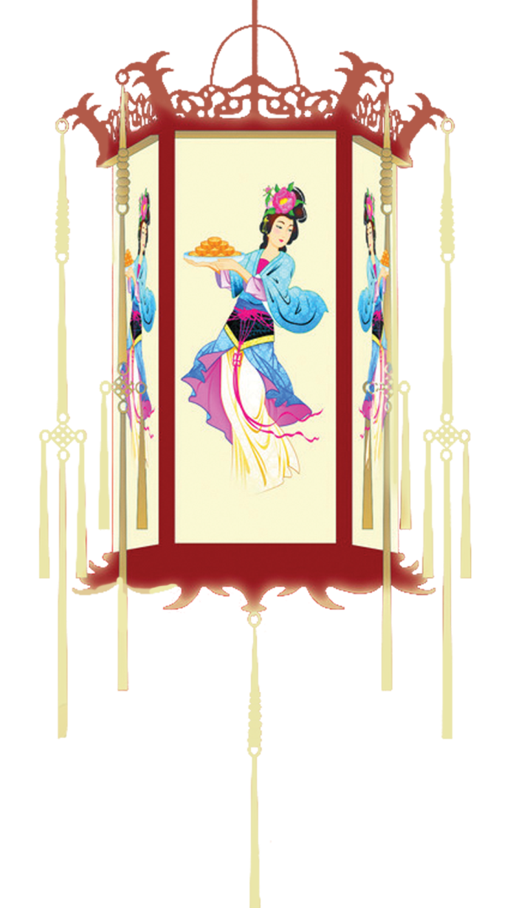
Warming up
A guessing game
Watch the picture and guess which classical Chinese poetry and Chinese traditional festival it shows.

Slide 4
As the bright moon shines over the sea,
From far away you share this moment with me.
海上生明月，天涯共此时
Mid-autumn Festival

Slide 5
But in the crowd once and again，I look for her in vain，When all at once I turn my head, I find her there where lantern light is dimly shed.
众里寻他千百度，蓦然回首，那人却在，灯火阑珊处。
Lantern Festival

Slide 6
Pre-writing
Read the passage and put some questions according to the underlined sentences, then circle the sentences you like.
1. What is the name of the festival?
2. When is it?
1.The Dragon Boat Festival is a traditional festival in our country. 2.It's on May fifth. In that day, People all over China celebrate it in different ways, such as 4.having a big dinner, watching the dragon boat races, telling the story of Qu Yuan and so on. At the same time , they all 3.eat rice dumplings.
This year, I watched the dragon boat races. It is the most traditional event of the Dragon Boat Festival in South China. Each community took part in the races on the Yangtze River. The winner got a chance to perform abroad. The dragon boat race shows Chinese traditional culture. I like the Dragon Boat Festival because 5.it makes the relationship between people closer.
I'm going to study Chinese traditional culture hard because I want more people to know about China.
4.What do people do?
3. What do people eat?
5. Why do you like it so much?

Slide 7
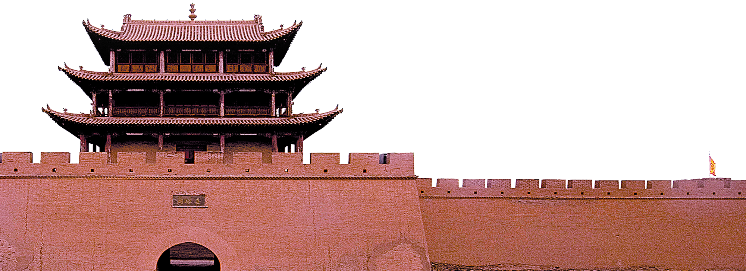
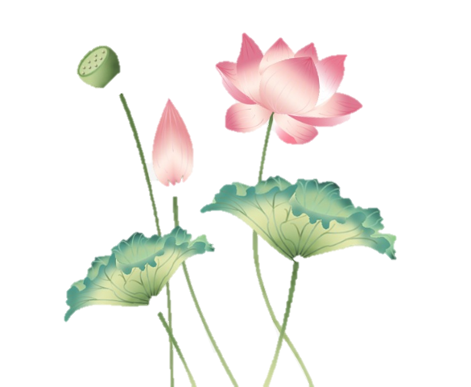
Pre-writing
Questions
1. What is the name of the festival?
2. When is it?
3. What do people eat?
4. What do people do?
5. Why do you like it so much?

Slide 8
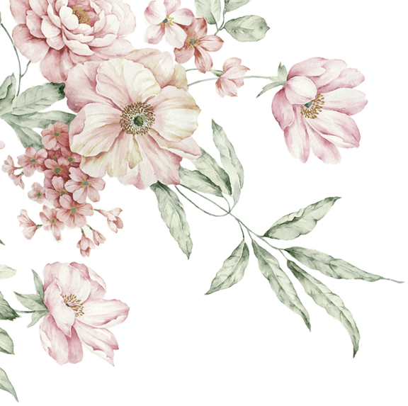
While-writing
Writing task
Suppose you are Li Hua, you pen pal wants to know about your favorite Chinese traditional festival. Please write her back to introduce your favorite Chinese traditional festival.

Slide 9
While-writing
Mind map
My favorite festival
What is the name of the festival?
When is it?
What do people eat?
What do people do?
Why do you like it so much?
Tips: You can draw a mind map before writing.

Slide 10
While-writing
Write an Outline
beginning
body
ending
Tips: The outline should contains the five questions and necessary greeting and endings.

Slide 11
While-writing
Useful sentences collecting
Beginning:
1．我最喜欢的中国节日是春节。并且我很高兴地告诉你一些关于春节的事情。
2．春节是传统中国节日之一。
The Spring Festival is one of the traditional Chinese festivals.

Slide 12
While-writing
Useful sentences collecting
Body:
3. 每年的一月或二月庆祝春节。
4. 在除夕夜，人们喜欢吃饺子并且观看电视节目。
The Spring Festival is celebrated in January or February every year.

Slide 13
While-writing
Useful sentences collecting
Ending：
8．这是我最喜欢的节日，因为我可以跟我的家人聚在一起。
9．总之，春节是一个重要的中国传统节日。
It's my favorite festival because I can get together with my family.
Tip : You can collect beautiful sentences or phrases for writing.

Slide 14
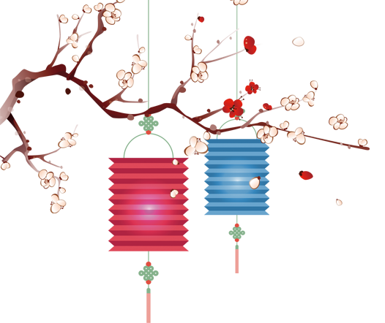
While-writing
Please write your letters.

Slide 15
After writing
Writing assessment
Assess your letters for each other according to the following table. Draw a star（ ） if you did it.
Items（项目） |  | 自我评价 | 同伴评价
Handwriting（书写）
Writing format(格式)
Content (内容) | What is the name of the festival?
 | What do people eat?
 | When is it?
 | What do people do?
 | Why do you like it so much?
Notes:
模板来自于风云办公 www.ppt118.com

Slide 16
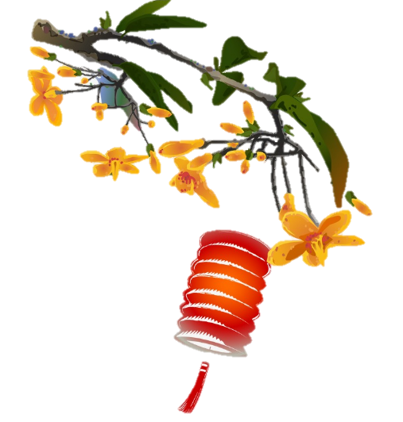
After writing
summary
Writing tips:
1. You can collect beautiful sentences or phrases for writing.
2.You can draw a mind map before writing.
3.You can write an outline before writing.
4. You should pay attention to your spelling, grammar and handwriting while writing.

Slide 17
Homework
1) Rewrite the letter carefully.
2) Research: Choose a Chinese traditional festival and a western festival. What are the differences between them? Make a comparison.
You can choose to do the following exercises.
Please shoot a video to compare a Chinese traditional festival and a western festival and send it to Tiktok and your teacher.

Slide 18
Thank you!

