Slide 1
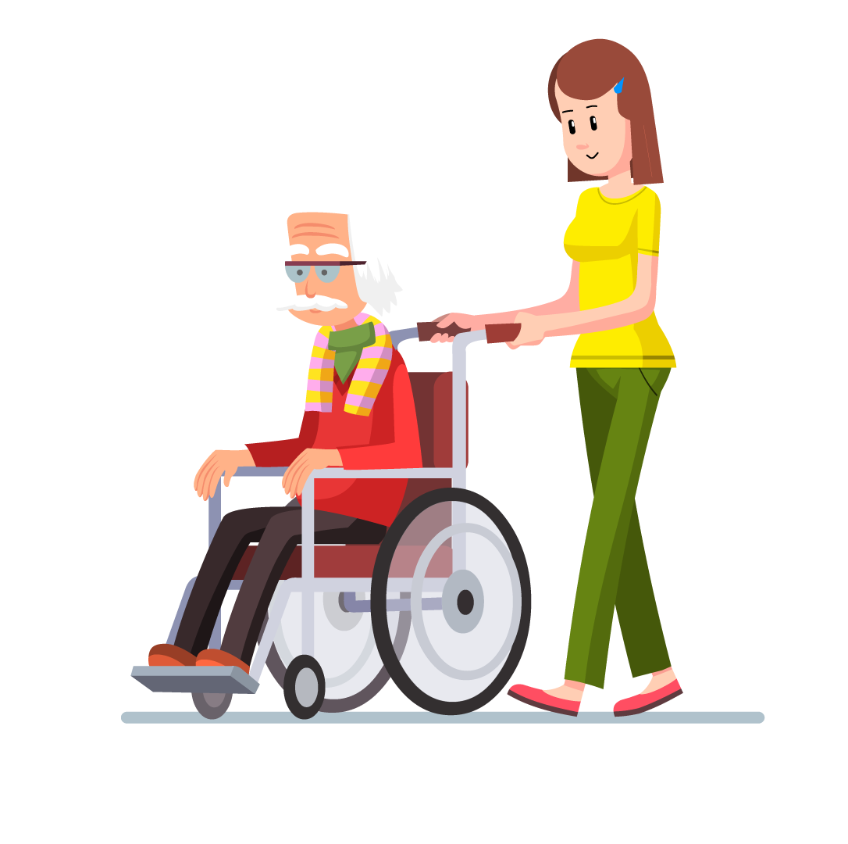
Unit2 I’ll help to clean up the city parks.
Section B 3a-3b Writing
No. 7 Middle School Tan Min

Slide 2
Unit2 I’ll help to clean up the city parks. Writing
Warming up
Let’s chant!
Which volunteer job do you want to do?
As an animal doctor, as an English teacher.
What are your interests and hobbies?
Be good at singing, be strong in reading.
How can these interests and hobbies help you to do the job?
By cheering up the old, by helping the disabled.
Why do you want to do the volunteer work?
Because it’s helpful, because they’re meaningful.
When are you free to do the volunteer work?
On Sunday morning, on Saturday evening.

Slide 3
Unit2 I’ll help to clean up the city parks. Writing
Volunteers Wanted
Do you want to do something interesting and meaningful? Yes? Come and join us! We need plenty of volunteers to work in different places such as old people’s homes, museums, after-school programs, animal hospitals, libraries and so on. E-mail Ms. Tan at love@volunteer.com.

Slide 4
Unit2 I’ll help to clean up the city parks. Writing
To learn to write an application(申请) letter to apply for a volunteer job

Slide 5
Unit2 I’ll help to clean up the city parks. Writing
Pre-writing
Mary was on the newspaper because of her wonderful volunteer job at an after-school reading program.

Slide 6
Unit2 I’ll help to clean up the city parks. Writing
Read the report and put some questions according to the underlined sentences, then circle the sentences you like.
(3minutes)
① What’s her interest or hobby?
Mary is a book lover. ① She is good at reading. She loves
reading all kinds of books. In her free time, she likes spending
time in bookstores and libraries. ② She volunteers as a teacher
at an after-school reading program, ③ because she wants to do something meaningful to help others. ④ She helps the kids by teaching them how to read. She does the volunteer job twice a week, ⑤ on Friday evening and on Sunday morning. “The kids are sitting in the library, but you can see in their eyes that they’re going on a different journey with each new book. Volunteering here is a dream come true for me. I can do what I love to do and help others at the same time.” Yes , helping others makes us happy.
If everyone helps out a bit, we’ll have a better world to live in.
② Which volunteer job does she do?
③ Why does she want to be a volunteer?
④ How does she do the volunteer job?
⑤ When does she do the volunteer job?
Tip: Collect beautiful sentences or phrases for writing.

Slide 7
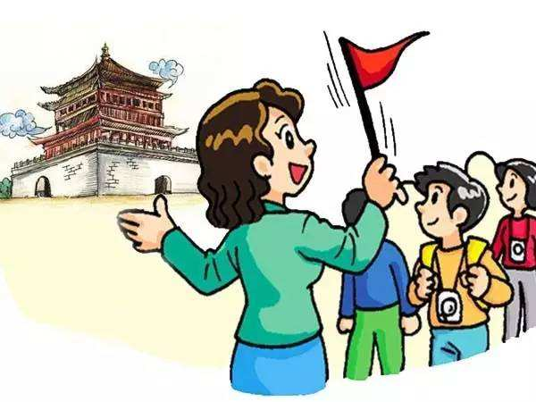
Unit2 I’ll help to clean up the city parks. Writing
Brainstorming
Which volunteer job do you want to do?
I’d like to volunteer as… /I want to volunteer as…
jobs

Slide 8
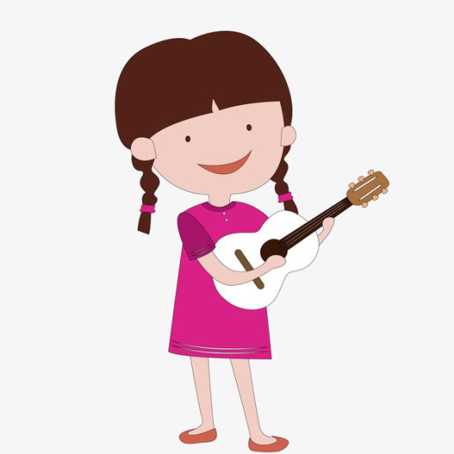
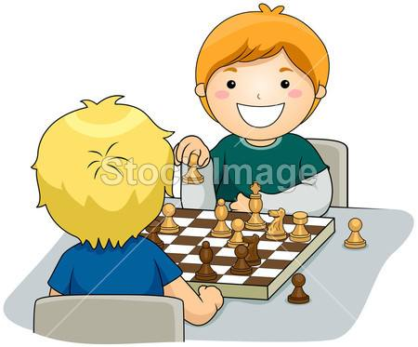
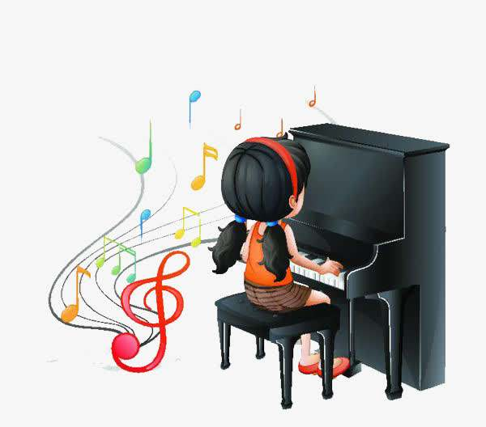
Unit2 I’ll help to clean up the city parks. Writing
Brainstorming
What are your interests and hobbies?
I’m good at.../I’m interested in.../I’m strong in…
hobbies

Slide 9
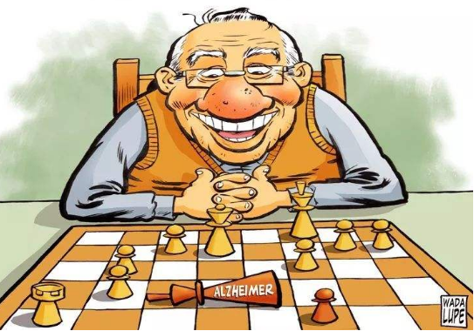
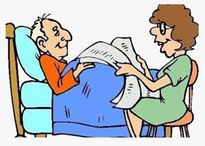
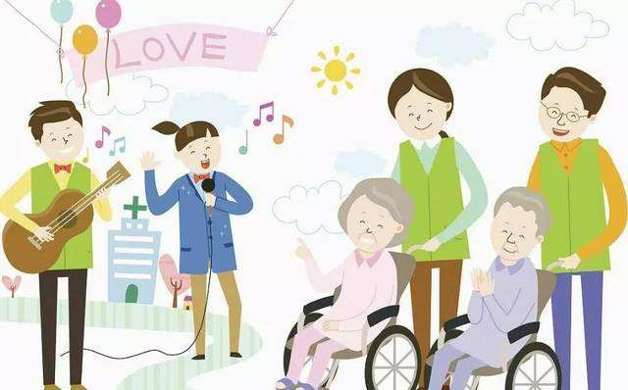
Unit2 I’ll help to clean up the city parks. Writing
Brainstorming
How can these interests and hobbies help you to do the job?
I can help by …
play chess with the old
read newspaper to the old
teach English
how
help kids with their homework
sing and dance for the old

Slide 10
Unit2 I’ll help to clean up the city parks. Writing
Brainstorming
Why do you want to do the volunteer job?
I want to help out as a volunteer because …

Slide 11
Unit2 I’ll help to clean up the city parks. Writing
Brainstorming
When are you free to do the volunteer work?
I am free to help out in/on…

Slide 12
Unit2 I’ll help to clean up the city parks. Writing
Pairwork
Work in pairs to make a conversation which contains the five questions.(1 minute)

Slide 13
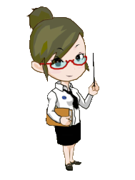
Unit2 I’ll help to clean up the city parks. Writing
Writing tip: Draw a mind map.
What
Which
How
volunteer
When
Why

Slide 14
Unit2 I’ll help to clean up the city parks. Writing
Writing tip: Write an outline.（提纲）
,
Dear____ ,
Beginning
Greetings and purpose
Which
What
How
Why
When
Mainbody
Ask for the job again with strong feelings.
Ending
,
Yours truly/ sincerely,
________
Writing tip: While writing, pay attention to your spelling, grammar and handwriting.

Slide 15
Unit2 I’ll help to clean up the city parks. Writing
Writing assessment 1
Assess your letters for each other according to the following table. Draw a star（ ） if you did it.
Items（项目） |  | 自我评价 | 同伴评价
Handwriting（书写）
Writing format(格式)
Content (内容) | Which volunteer job do you want to do?
 | What are your interests and hobbies?
 | How can these interests and hobbies help you to do the job?
 | Why do you want to do the volunteer job?
 | When are you free to do the volunteer work?

Slide 16
Unit2 I’ll help to clean up the city parks. Writing
Summary
Work in groups to summarize the three parts of the letter and the writing tips. Add more tips if you can. (2 minutes)

Slide 17
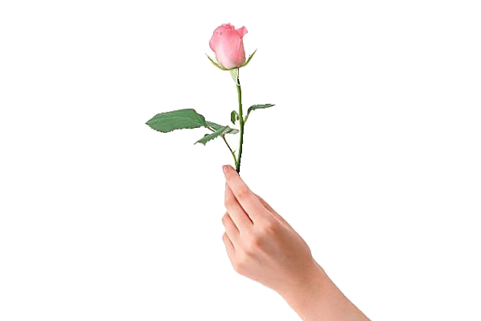
Unit2 I’ll help to clean up the city parks. Writing
The rose’s in her hand, the flavor in mine.

Slide 18
Unit2 I’ll help to clean up the city parks. Writing
Must do
Please rewrite your application letter and e-mail Ms. Tan at love@volunteer.com..
Choose to do
Make a survey about the volunteer work that your group members want to do.

Slide 19
Thanks for listening!

