Slide 1
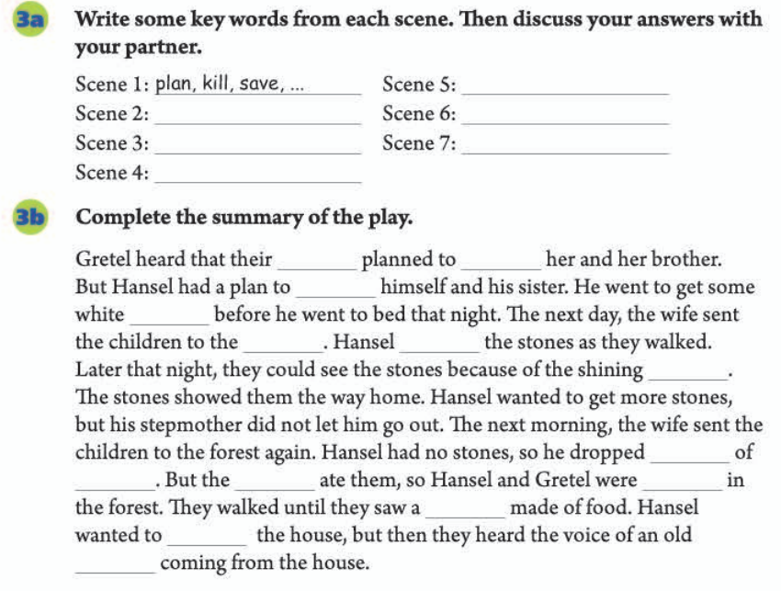
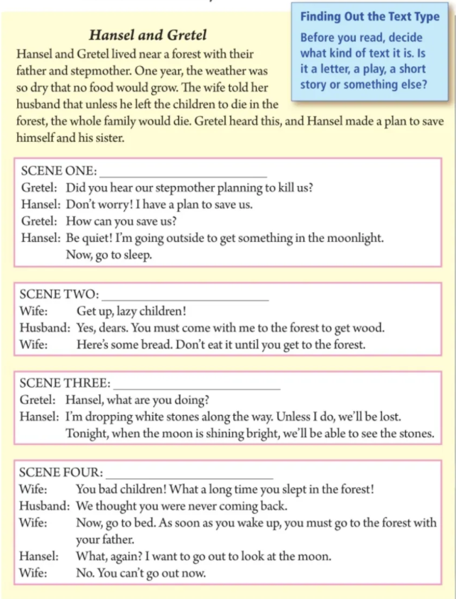
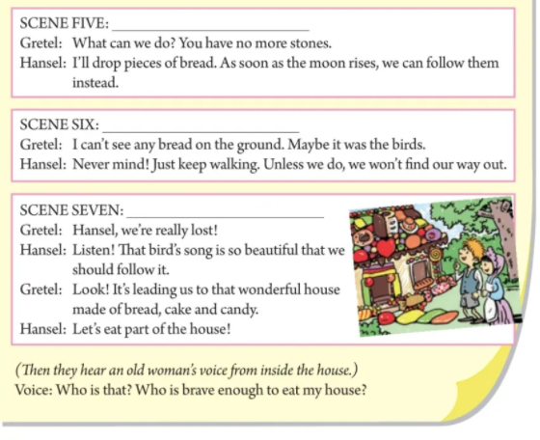
Learning Objectives
Unit 6
By the end of the class, we’ ll be able to:
1. retell the story of Hansel and Gretel using the simple past
tense;
2. figure out the key elements in writing a story summary and create a continuous story through group work;
3. independently write an ending for the story employing
proper individual imagination.
Writing
Candidate No.17

Slide 2
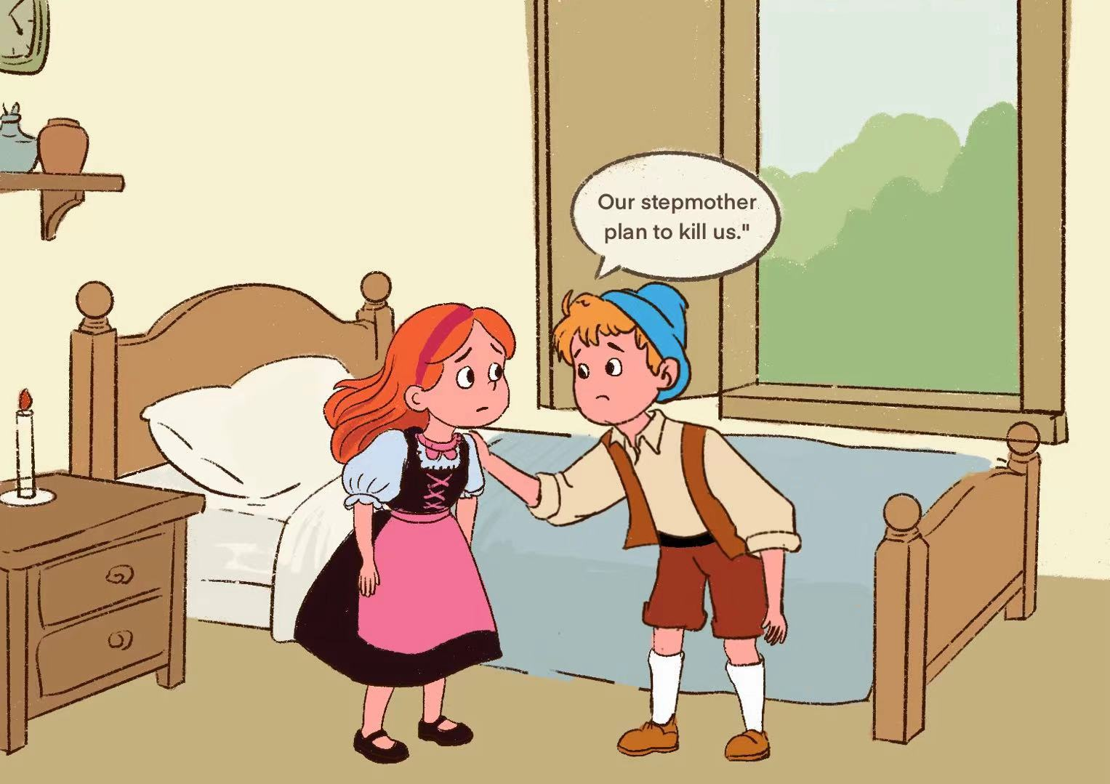
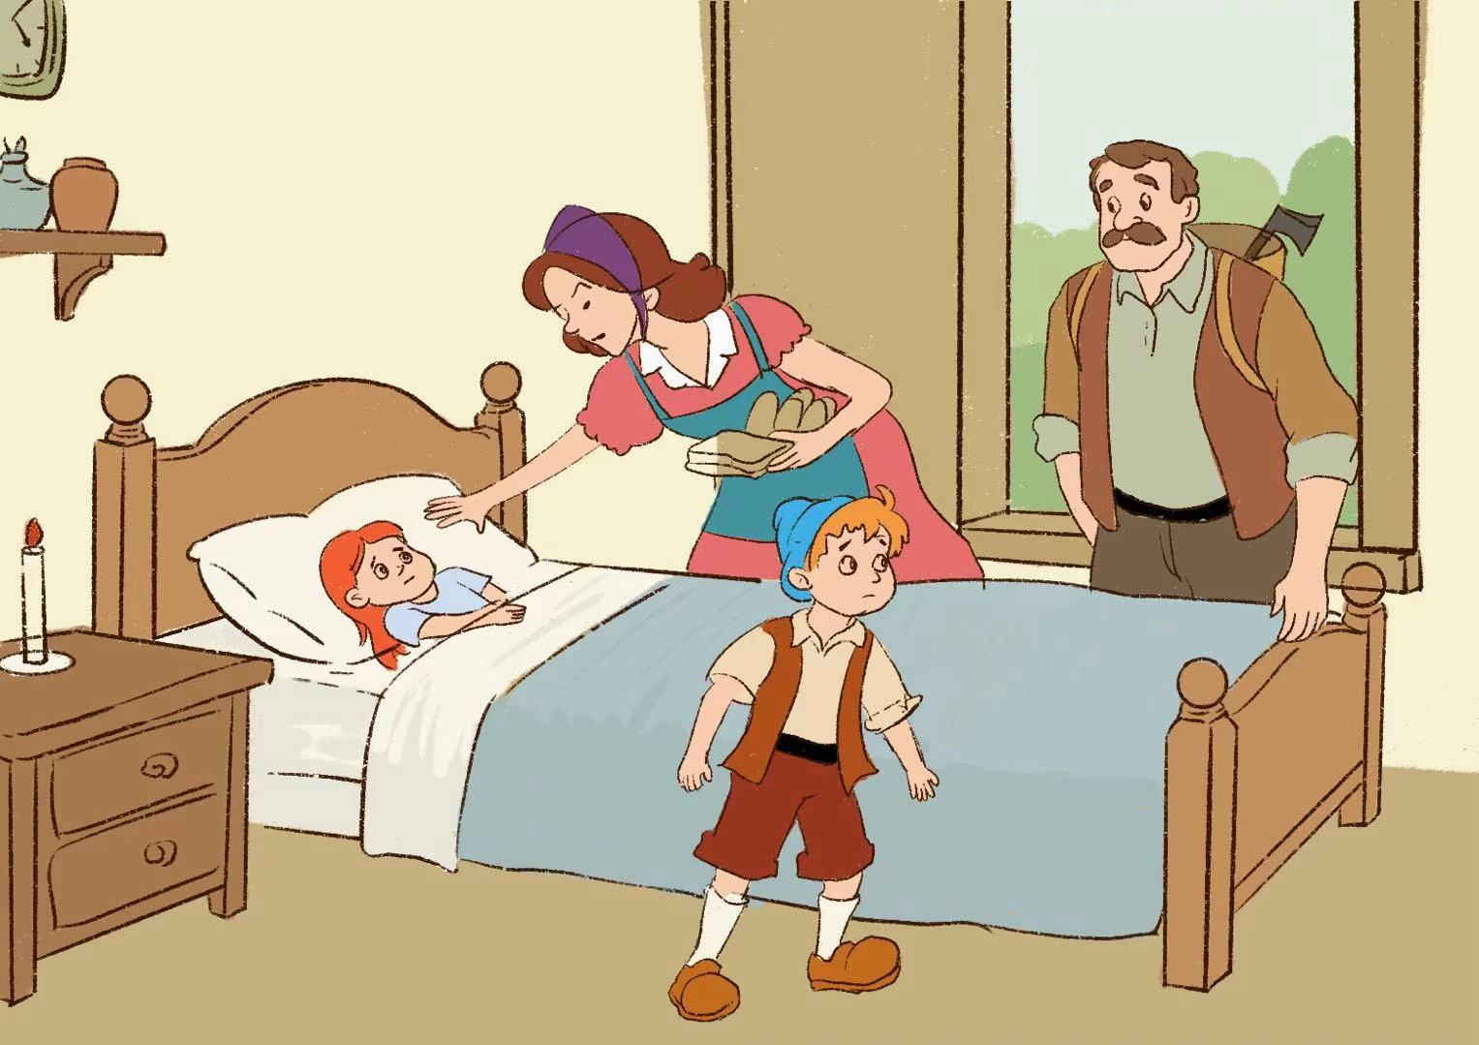
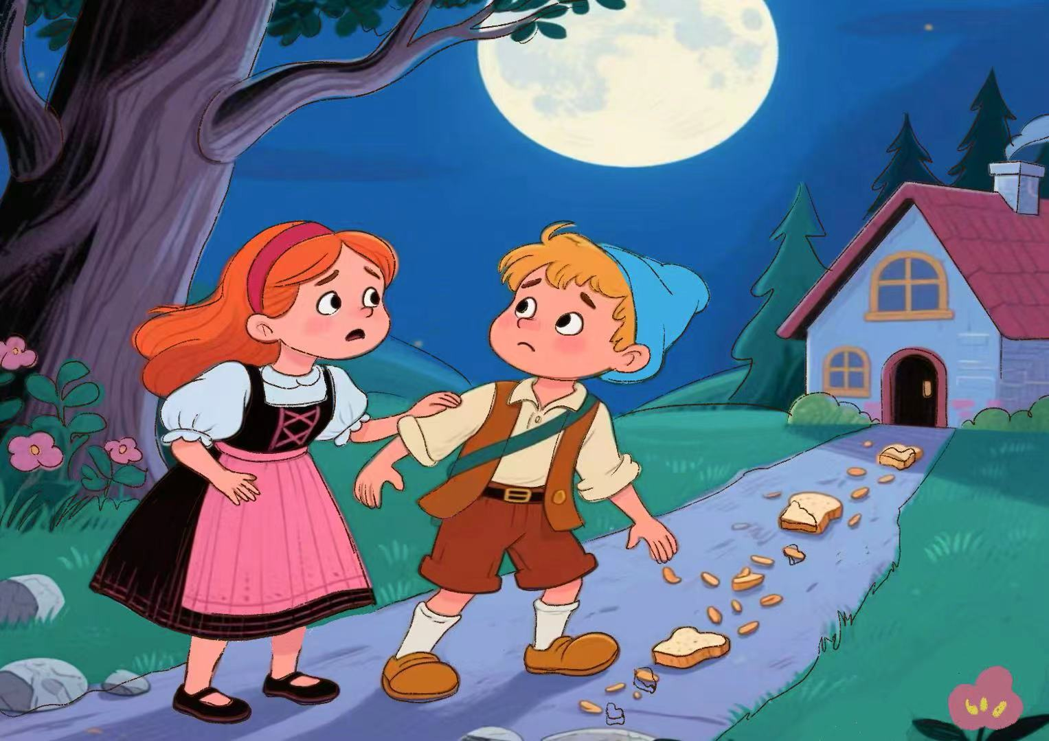
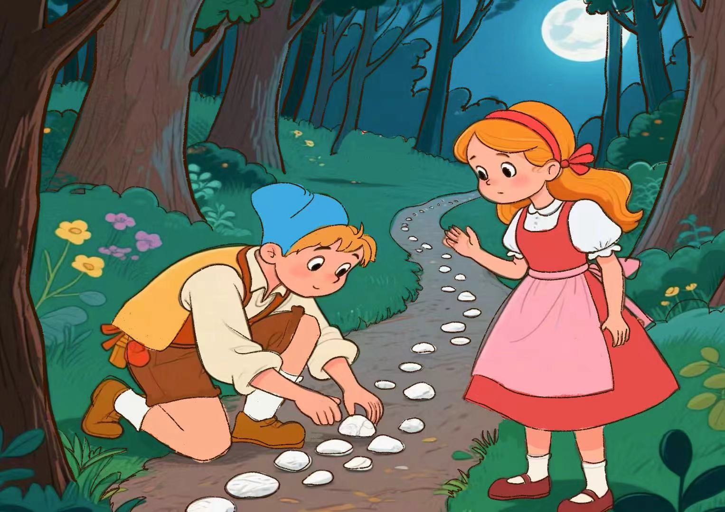
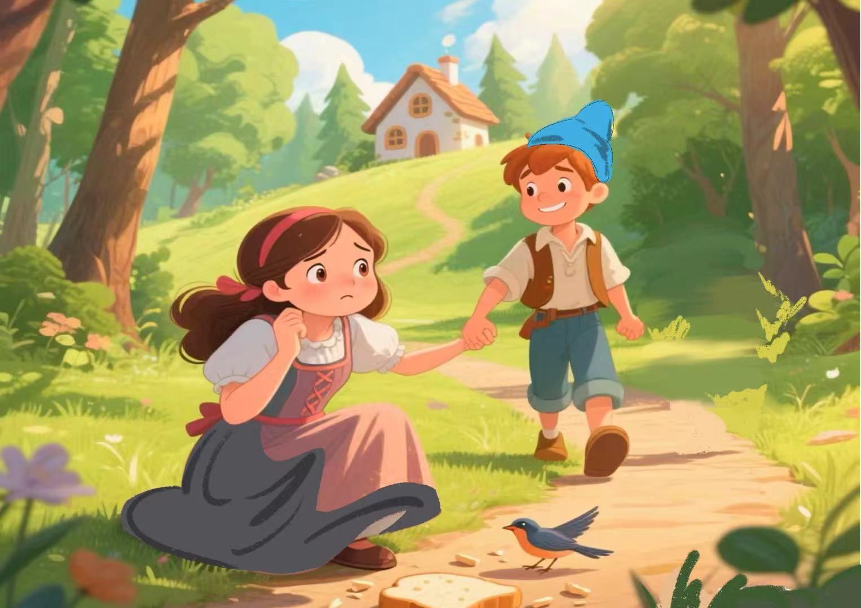
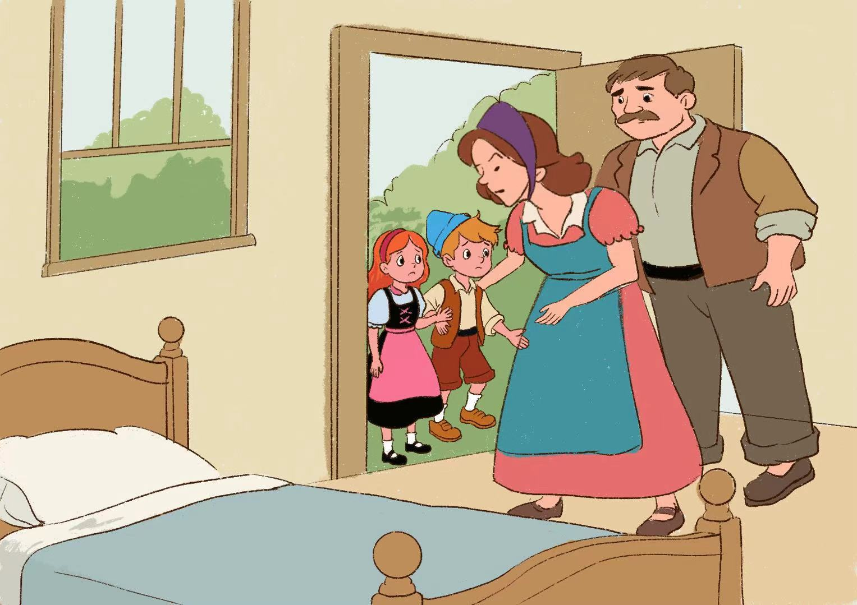
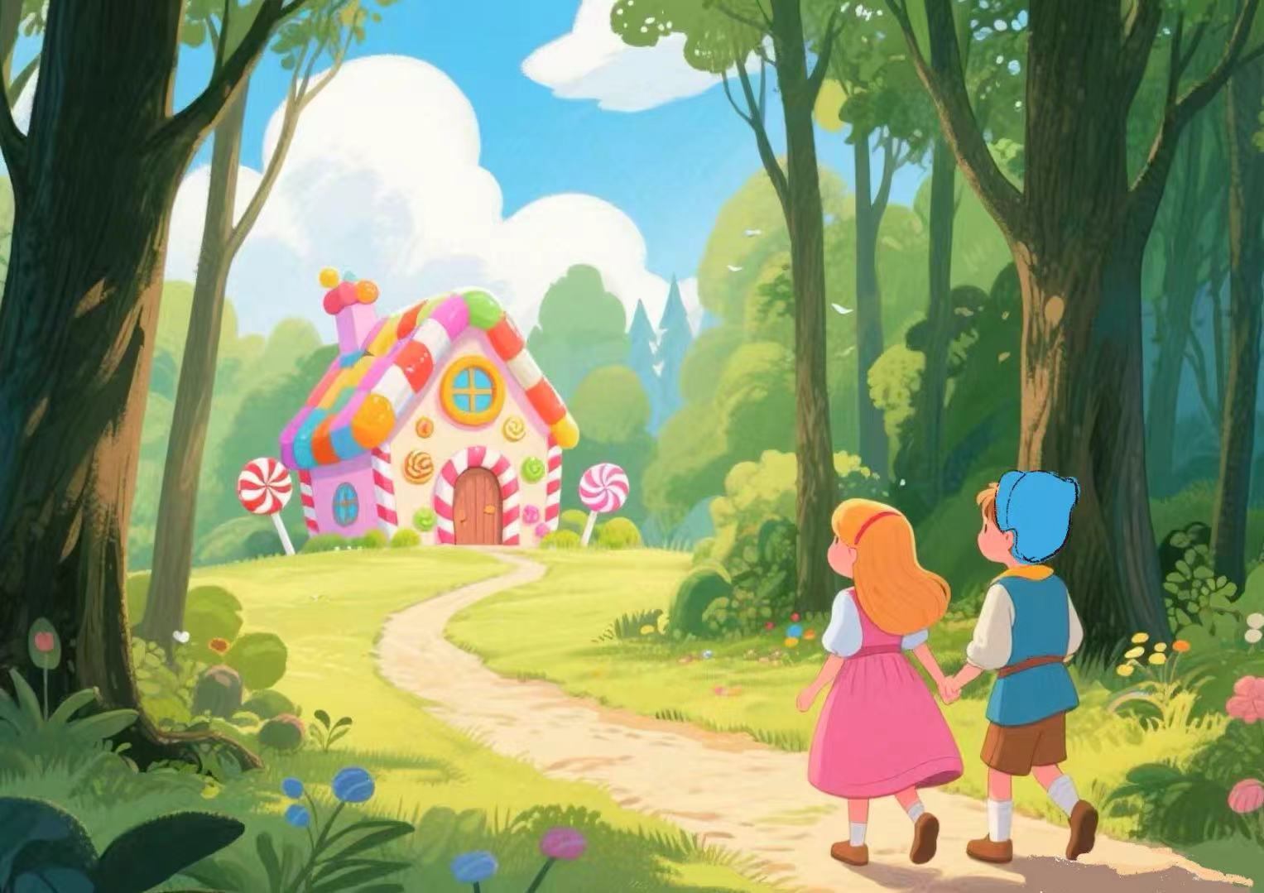
Responding: Look and fill in the blanks on your “Green Card”.
Scene 1:
They learned that their stepmother
_________ kill them.
planned to
Scene 2:
Their stepmother asked them to
________ in the forest.
Scene 5:
They ___________stones so
they dropped pieces of bread .
had no more
get wood
Scene 3:
They _________ white stones
and they got home successfully.
Scene 6:
They ___________ because the birds ate the pieces of bread.
dropped
were/got lost
Scene 4:
The stepmother asked them to
____________ again with their
father.
Scene 7:
They ________________ made of food.
saw/found a house
go to the forest/
get wood

Slide 3
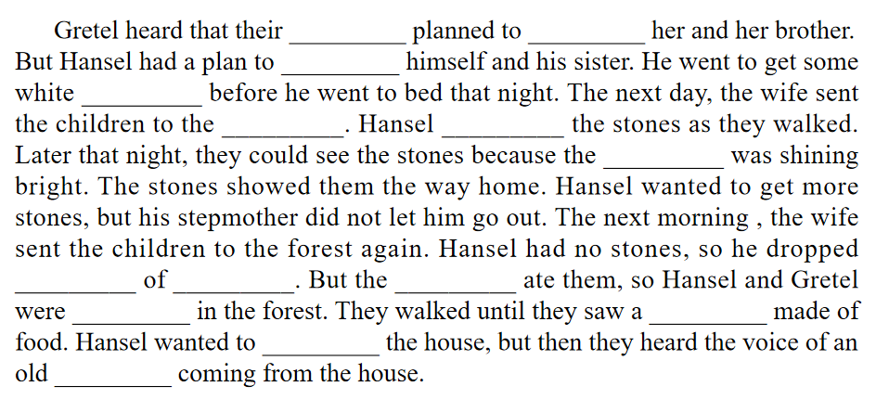
解构范文
Analyzing：Read and fill in the blanks on your “Blue Card”.
stepmother
kill
save
stones
forest
dropped
moon
pieces
bread
birds
lost
house
eat
woman

Slide 4
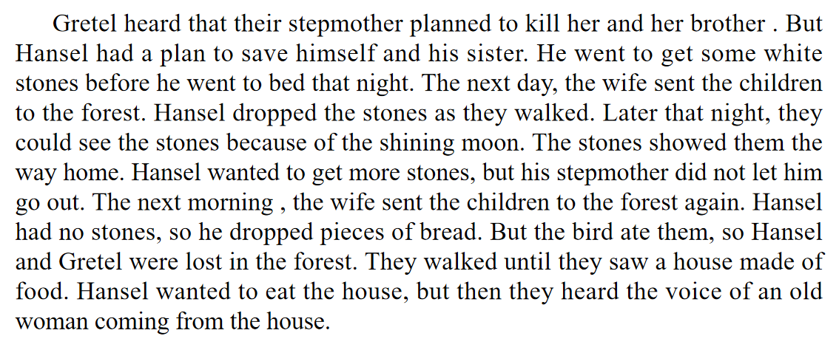
解构范文
Analyzing：Read again and figure out the key elements.
1. Can you find out the key elements (要素)?
2. What are they?

Slide 5
Interacting: Tick a role for yourself on your " Yellow Card".

Slide 6
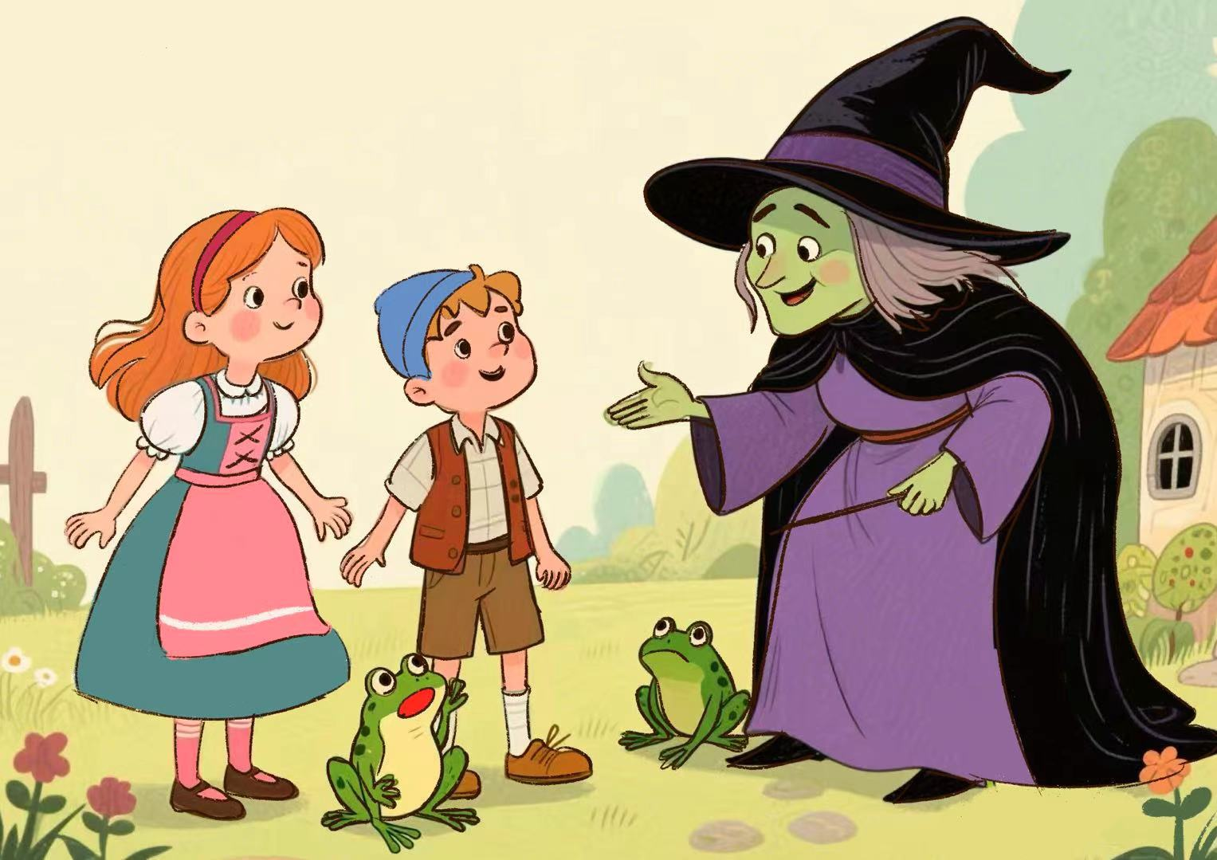
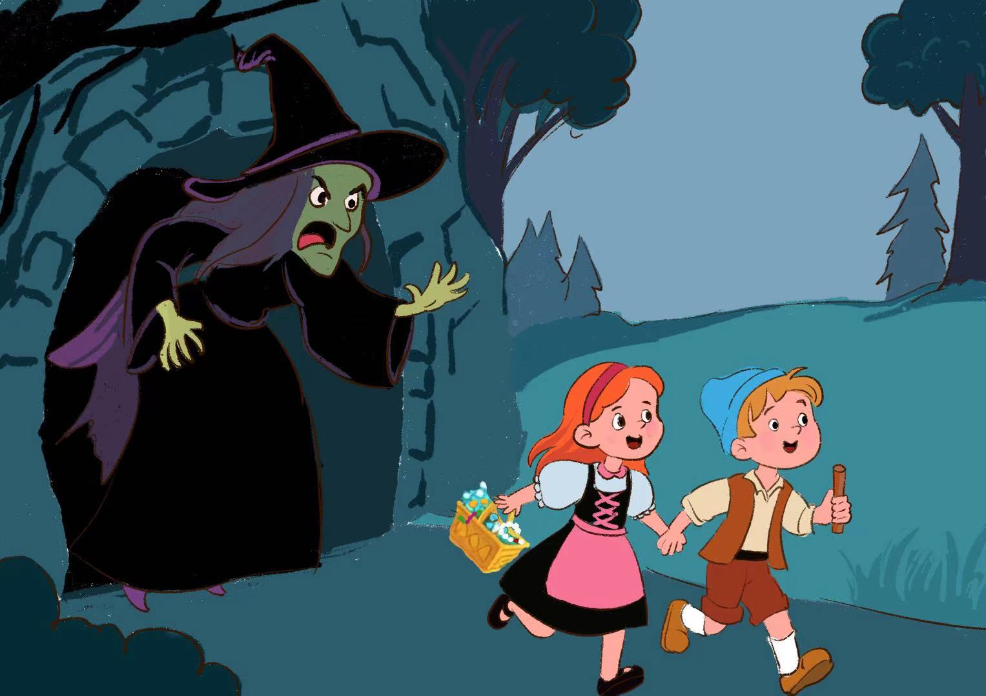
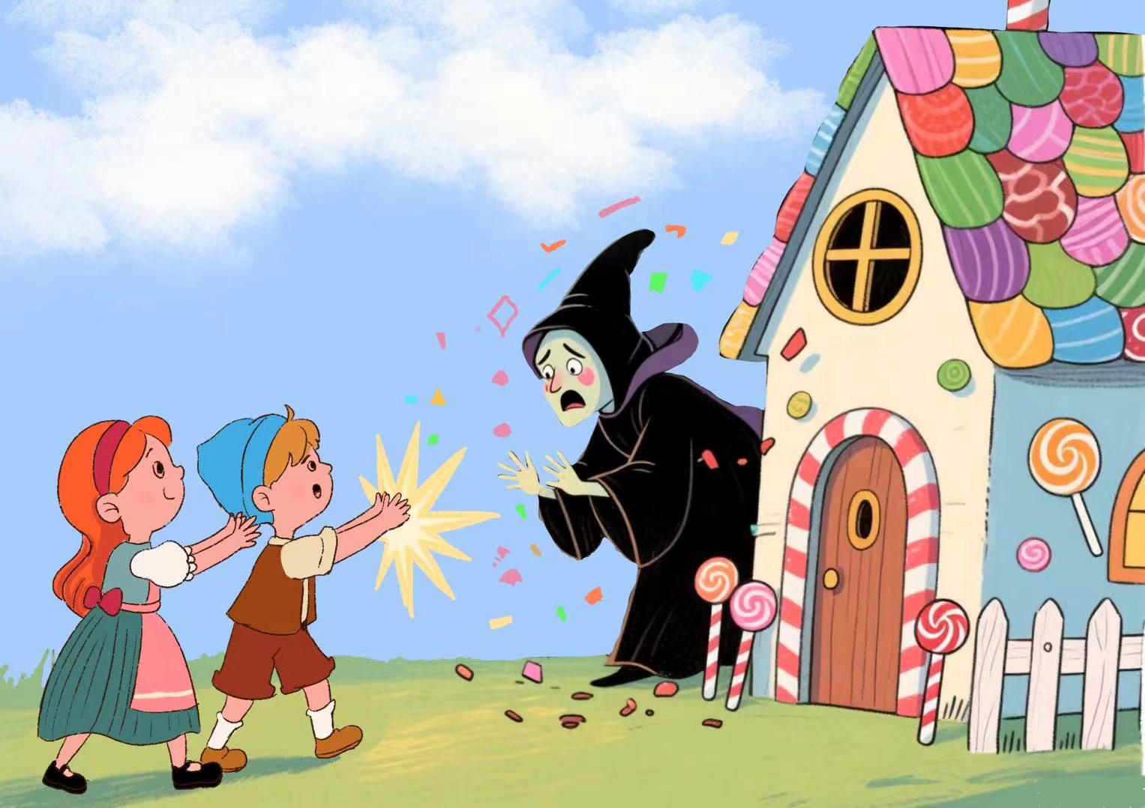
Interacting: Discuss and write in groups.
当汉赛尔和格莱特在糖果屋大快朵颐时，一个老妇人的声音突然响起，接下来会发生什么呢？老妇人是生气地赶他们走？还是她其实是好心人，邀请他们进屋分享更多美食？又或许，这个声音背后藏着一个神秘的秘密，等待他们去探索? 请大家展开想象，续写这个故事吧！请你给这个故事写一个结局吧！不少于5句话。
Ending 1:
experience n. 遭遇
parents n. 父母
turn into frogs 变成青蛙
live happily 幸福地生活
Ending 2:
children n. 孩子
treasure n. 宝藏
escape v. 逃跑
go home 回家
secret tunnel 地下暗道
Ending 3:
witch n. 女巫
magic n. 魔法
disappear v. 消失
live a happy life 幸福地生活下去
Ending 4:

Slide 7
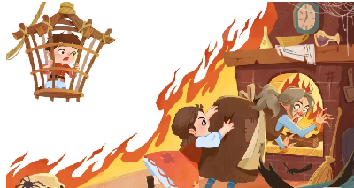
Narrating : Write an ending individually.
Verbs and phrases:
defeat
disappear
live
encounter
cast a spell
live a happy life
Nouns:
witch
magic
basement
happiness
experience
Adjectives:
compassionate

Slide 8
Narrating : Write an ending individually.
请你选择一个结局，将故事补充完整，你也可以发挥自己想象，重新思考一个结局。不少于5句话。
__________________________________________________________________________________________________________________________________________________________________________________________________________________________________________________________________________________________
__________________________________________________________________________________________________________________________________________________________________________________________________________________________________________________________________________________________
When Hansel and Gretel heard the voice, they...

Slide 9
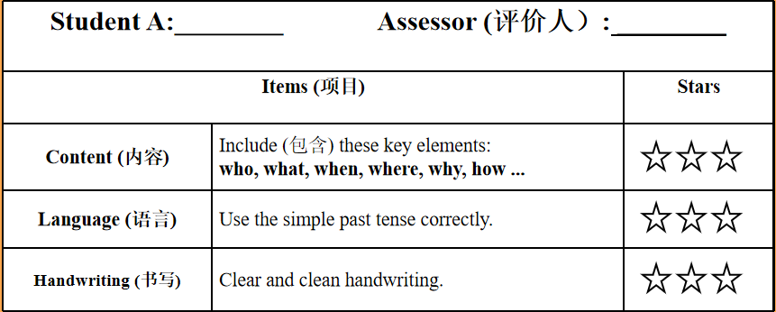
Bridging: Evaluate peers' work on your “Orange Card”.

Slide 10
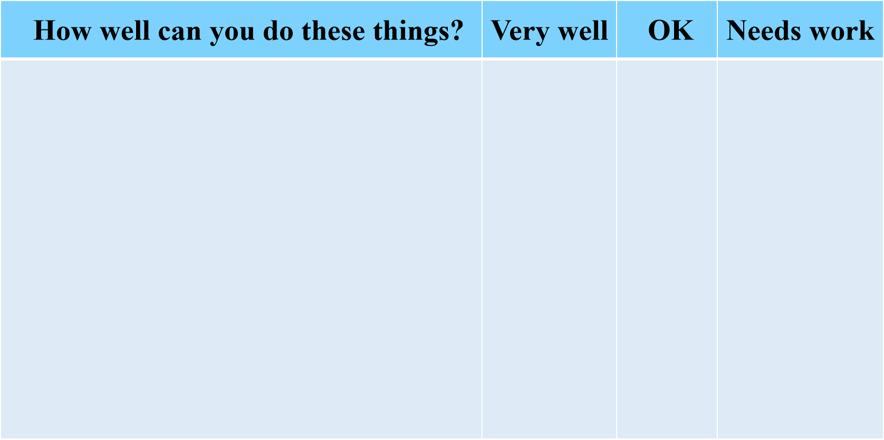
Observing: Think and summarize what we learned.
1. I can retell a story by using the simple past tense.
我能用一般过去时，复述故事的梗概。
2. I can figure out the key elements in writing a story summary.
我能提炼写故事需要的关键要素。
3. I can independently write an ending for the
story employing proper individual imagination.
我能发挥想象，独立为故事续写一个结局。

Slide 11
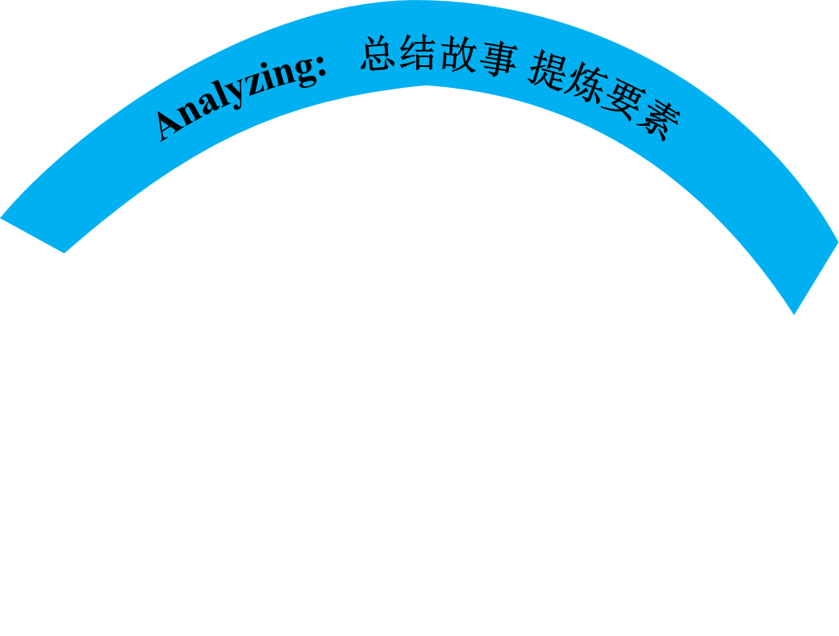
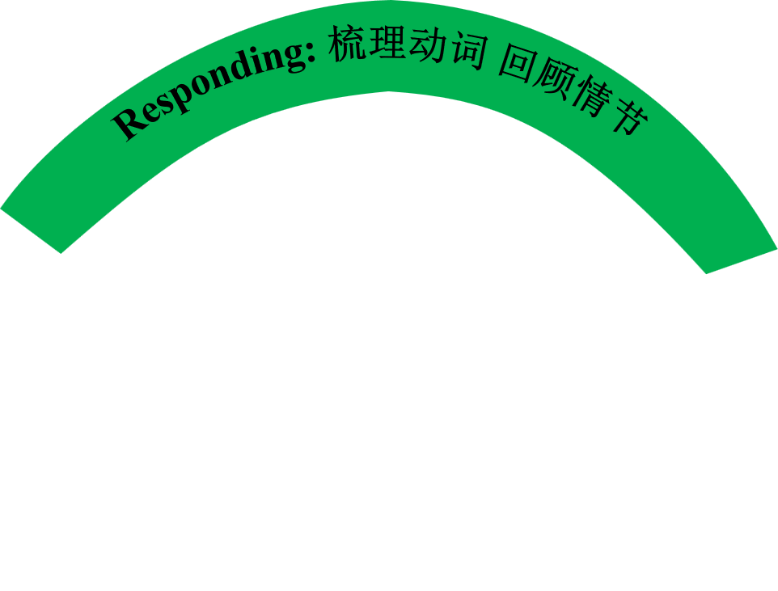
Observing: Think and summarize what we learned.
Baby steps can make a big difference.

Slide 12
Homework
1. Compulsory (必做):
Polish your imaginative ending of the story.
润色修改你写的故事结局。
2. Choose to do (选做):
Rewrite the play Hansel and Gretel using your imagination.
发挥你的想象力，改写《糖果屋》剧本。
Choose another story and rewrite an imaginary ending for it.
选择另外一个故事，给它改写一个充满想象力的结局吧。

Slide 13
The world of reality has its limits；
the world of imagination is boundless.
--Rousseau
现实的世界是有限度的，想象的世界是无涯际的。
——卢梭

