Slide 1
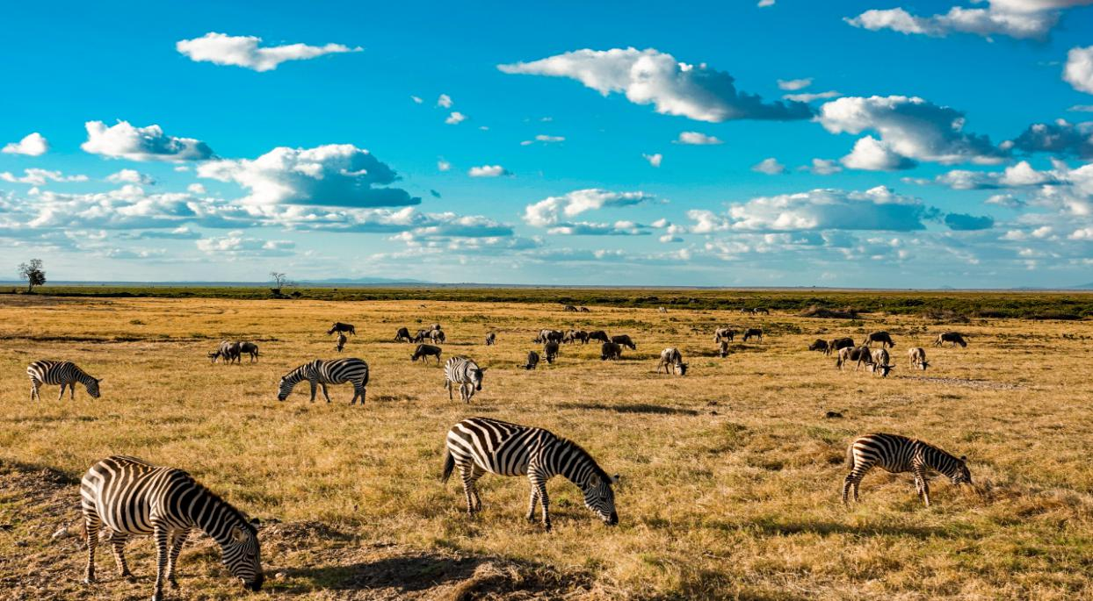
PEP Go for it！ Grade 7 Volume II
Unit 7 It’s raining!
Period 5 Writing
课例 3

Slide 3
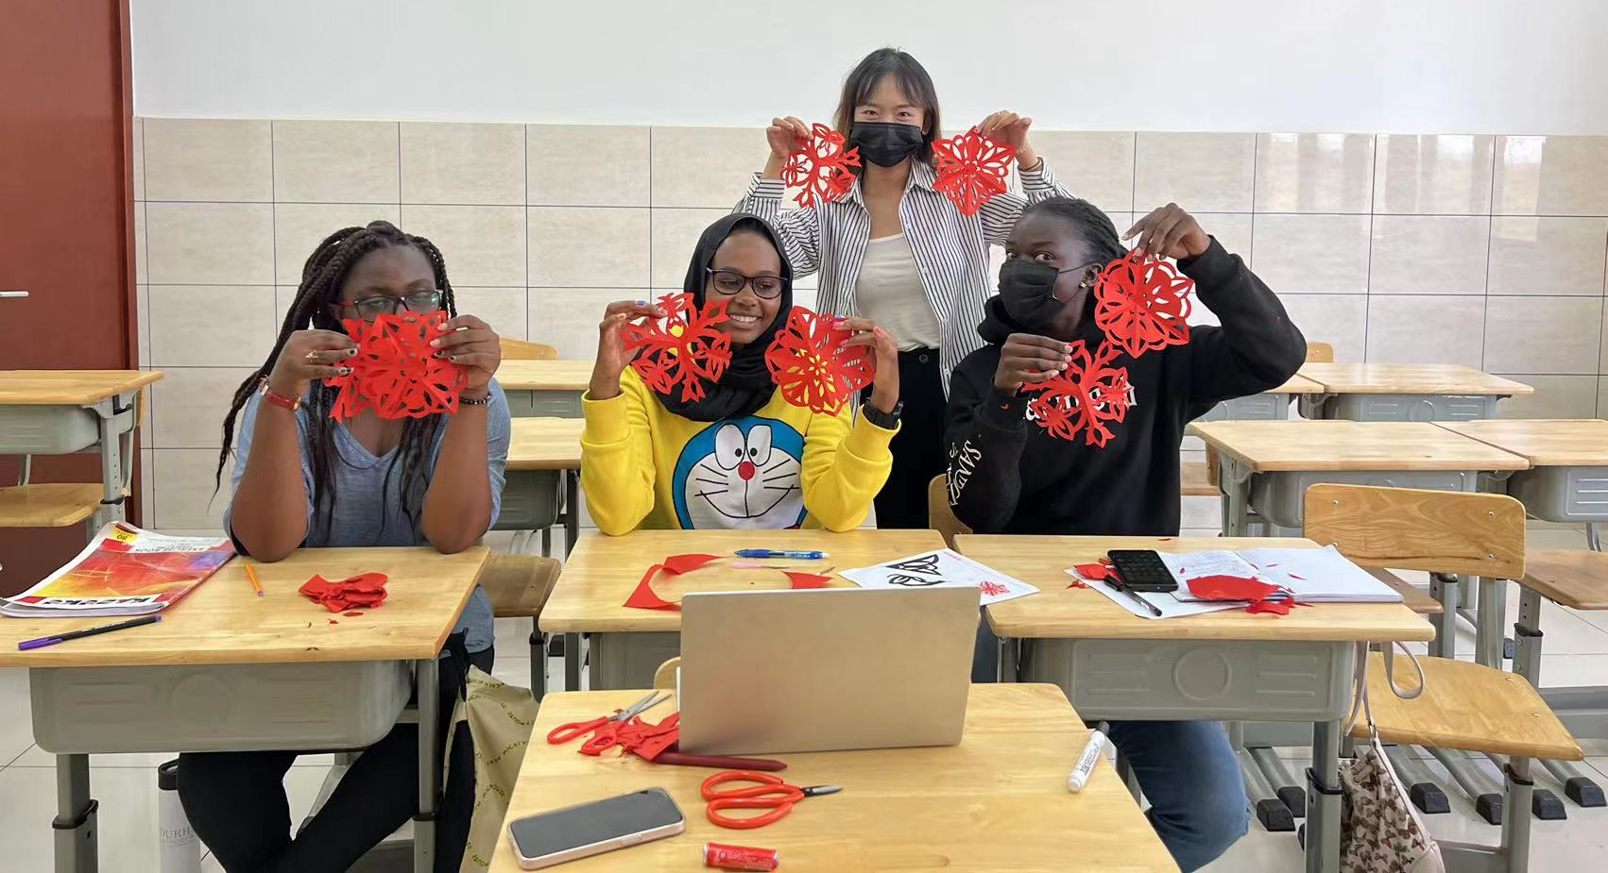
Who is Judy?
此处输入标题

Slide 4
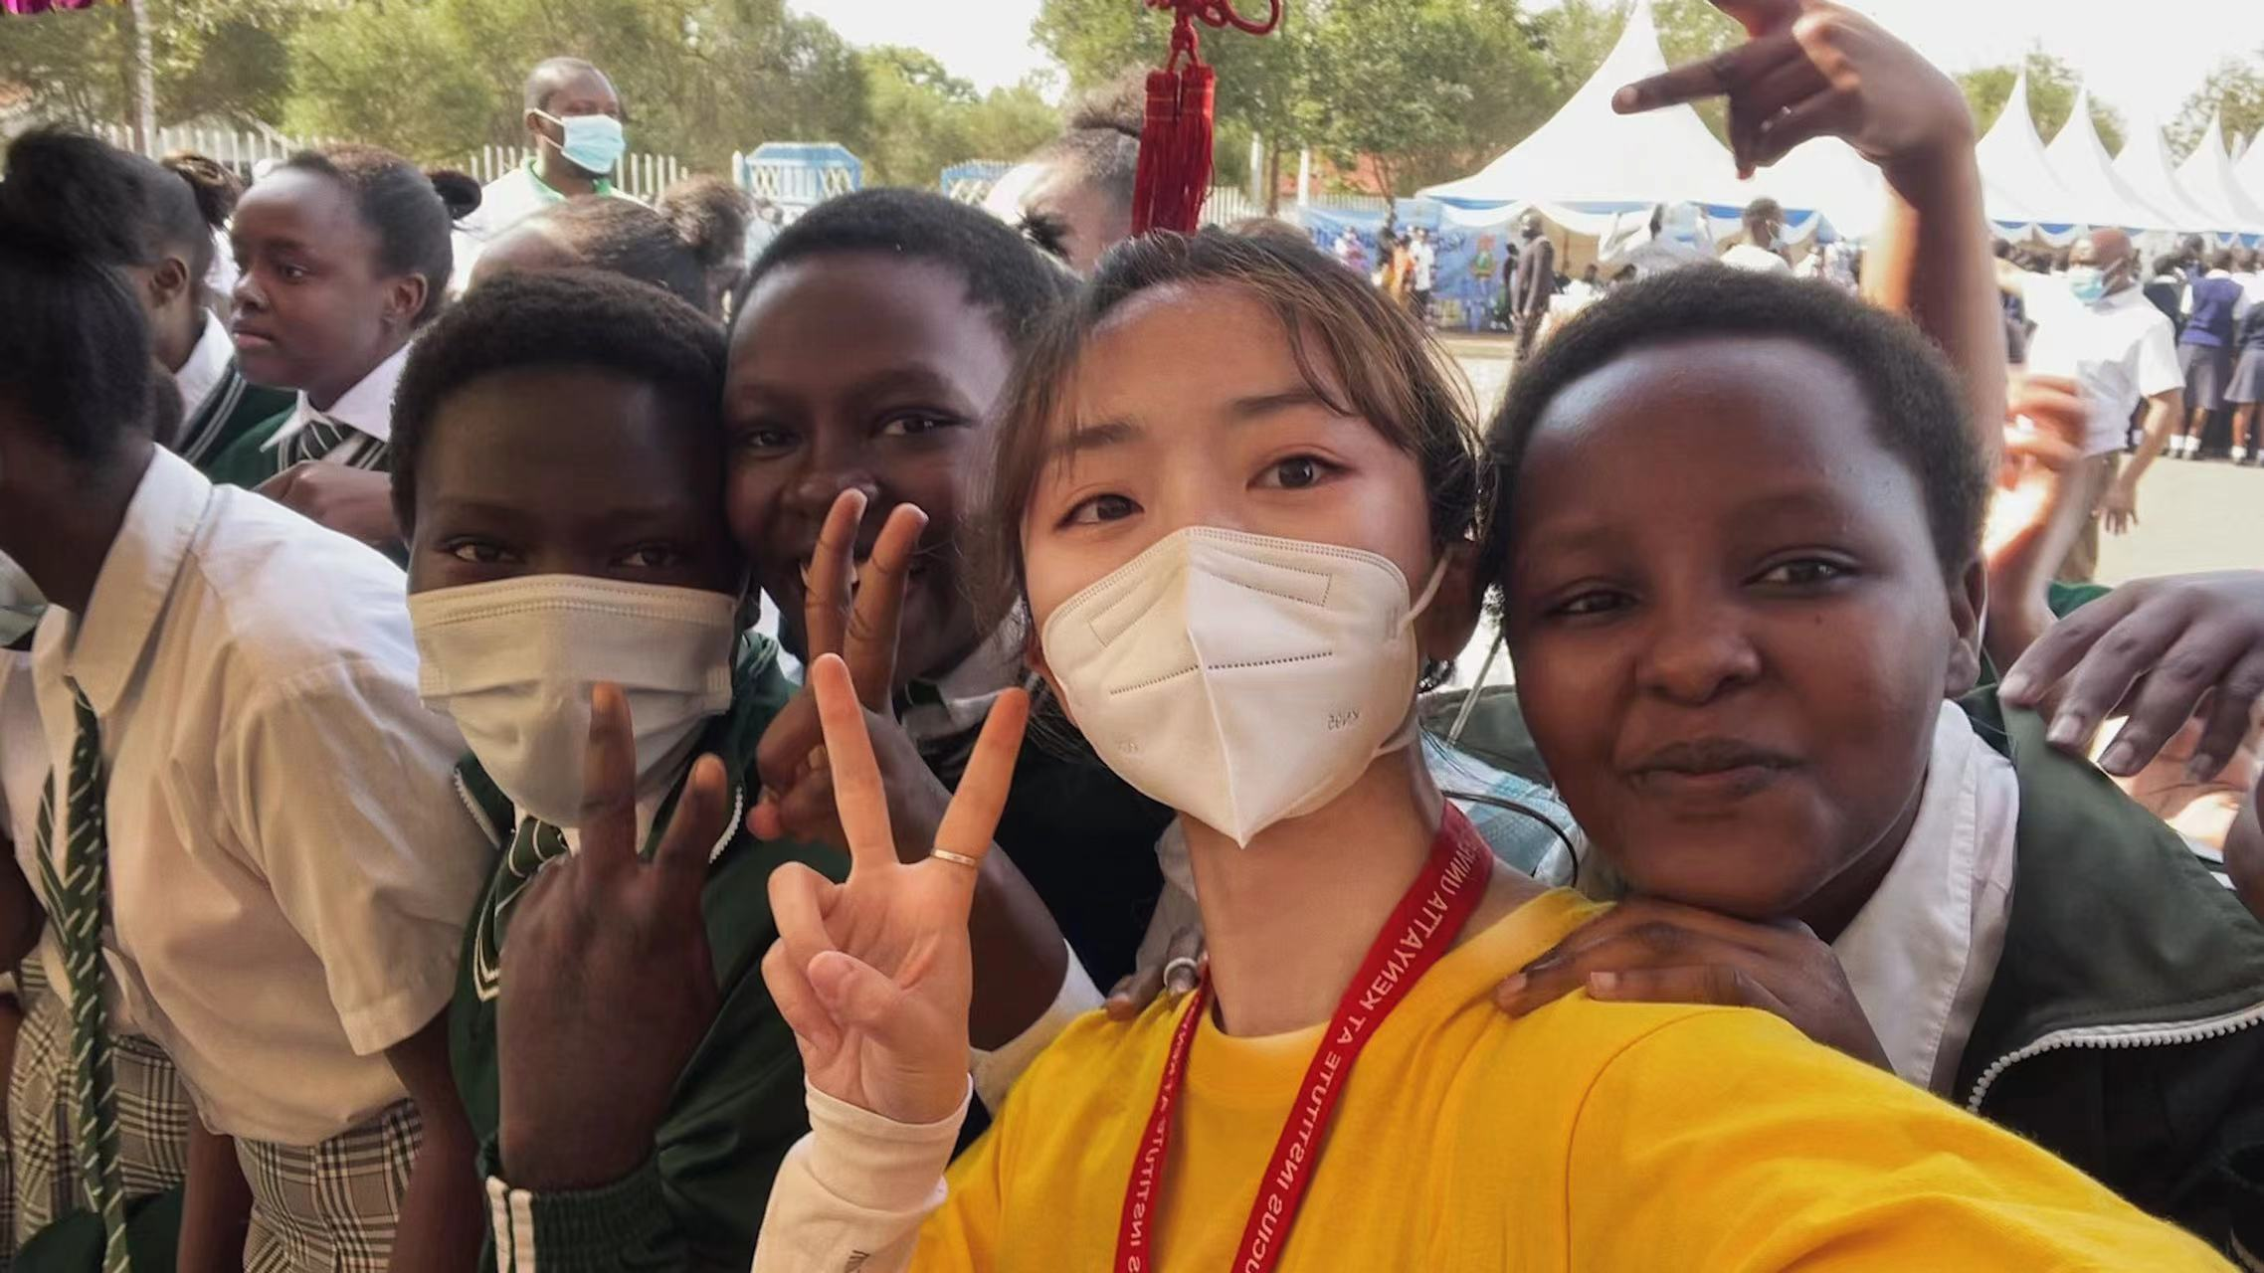
Volunteer Project

Slide 5
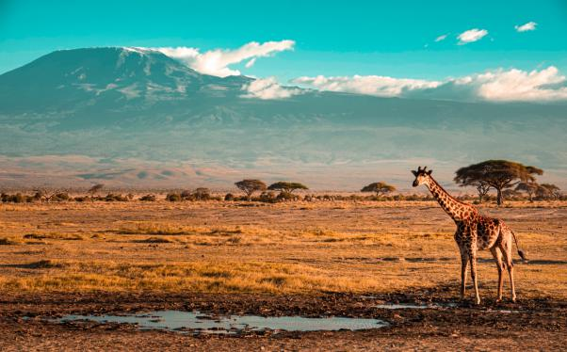
Postcard
此处输入标题
Dear Zoe,
How’s it going? I’m having a great time in Kenya. It is a beautiful country and right now the weather here is very hot and dry.
Are you still busy with school or are you on vacation now? I’m participating in a volunteer project. I’m teaching children to learn Chinese. They are lovely and friendly. And they are also interested in Chinese traditional art. They think it is interesting to learn Chinese paper cutting. Apart from this, I am happy to see many different kinds of animals living freely in the wild. You can’t imagine what life is like here. It is amazing, wonderful and unbelievable.
What about you? Would you like to share your exciting life with me? I’m looking forward to your reply soon.
Judy
To: Zoe
Yucai Middle School

Slide 6
Postcards
01. Format
02. Content

Slide 7
Let's learn the format (格式) of the postcard first!
Tip 1: Use the right format
Dear Zoe,
How’s it going? I’m having a great time in Kenya. It is a beautiful country and right now the weather here is very hot and dry.
Are you still busy with school or are you on vacation now? I’m participating in a volunteer project. I’m teaching children to learn Chinese. They are lovely and friendly. And they are also interested in Chinese traditional art. They think it is interesting to learn Chinese paper cutting. Apart from this, I am happy to see many different kinds of animals living freely in the wild. You can’t imagine what life is like here. It is amazing, wonderful and unbelievable.
What about you? Would you like to share your exciting life with me? I’m looking forward to your reply soon.
Judy
Salutation（称谓）
Body
To:
Yucai Middle School
Signature（署名）

Slide 8
Let's talk about the body of postcards.
Dear Zoe,
How’s it going? I’m having a great time in Kenya. It is a beautiful country and right now the weather here is very hot and dry.
Are you still busy with school or are you on vacation now? I’m participating in a volunteer project. I’m teaching children to learn Chinese. They are lovely and friendly. And they are also interested in Chinese traditional art. They think it is interesting to learn Chinese paper cutting. Apart from this, I am happy to see many different kinds of animals living freely in the wild. You can’t imagine what life is like here. It is amazing, wonderful and unbelievable.
What about you? Would you like to share your exciting life with me? I’m looking forward to your reply soon.
Judy
How many paragraphs are there?
Three.
What are different paragraphs talking about?
greetings and the topic of the postcard
supporting details
closing sentence
Tip 2: Write the body in 3 or more paragraphs.

Slide 9
Pair work
Tip 3 You should include four elements in this part.
How’s it going? I’m having a great time in Kenya. It is a beautiful country and right now the weather here is very hot and dry.
Are you still busy with school or are you on vacation now? I’m participating in a volunteer project. I’m teaching children to learn Chinese. They are lovely and friendly. And they are also interested in Chinese traditional art. They think it is interesting to learn Chinese paper cutting. Apart from this, I am happy to see many different kinds of animals living freely in the wild. You can’t imagine what life is like here. It is amazing, wonderful and unbelievable.
What about you? Would you like to share your exciting life with me? I’m looking forward to your reply soon.
Where is Judy?
She is in Kenya.
What’s the weather like?
It's very hot and dry.
To: Zoe
Yucai Middle School
What is she doing?
She is participating in a volunteer project and teaching Chinese.
How does she like there?
She thinks children in Kenya are lovely and friendly. The life in Kenya is amazing, wonderful and unbelievable.

Slide 10
Let’s talk about the closing part.
Dear Zoe,
How’s it going? I’m having a great time in Kenya. It is a beautiful country and right now the weather here is very hot and dry.
Are you still busy with school or are you on vacation now? I’m participating in a volunteer project. I’m teaching children to learn Chinese. They are lovely and friendly. And they are also interested in Chinese traditional art. They think it is interesting to learn Chinese paper cutting. Apart from this, I am happy to see many different kinds of animals living freely in the wild. You can’t imagine what life is like here. It is amazing, wonderful and unbelievable.
What about you? Would you like to share your exciting life with me? I’m looking forward to your reply soon.
Judy
She is asking questions.
You can also close your postcard like this:
1. I miss you.
2. See you next week.
3. Hope to see you soon.
4. ...
Tip 4 Use a correct and proper closing.

Slide 11
Writing Instructions
Salutation
_____________,
____________________________________
____________________________________
____________________________________
____________________________________
_________
greetings
Body
supporting details
To ___
Judy
closing
Signature

Slide 12
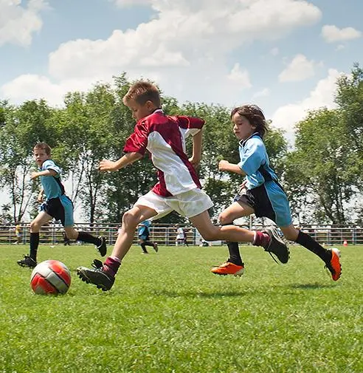
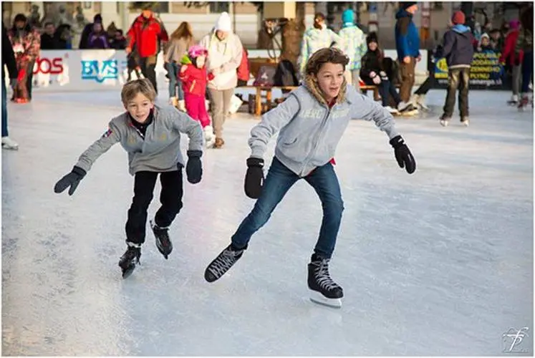
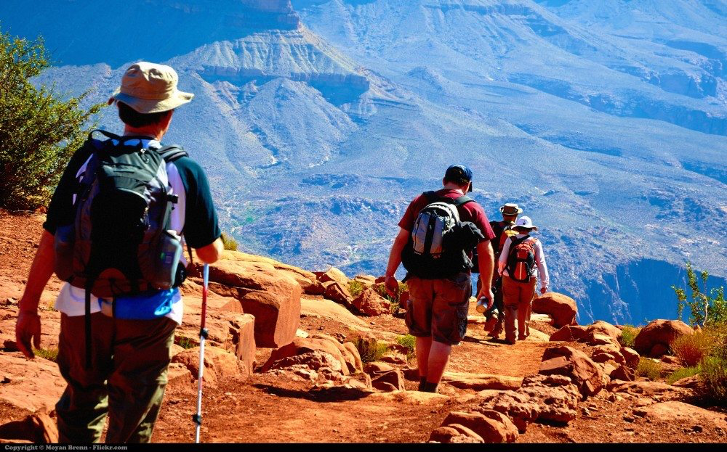
Brainstorming
I'm having a great time in.../I'm in...
Where are you?
Canada, Beijing, Toronto, Boston...
It's.../The weather here is...
What’s the weather like?
warm, sunny, rainy/raining, hot, cold, dry wet, humid, windy, cloudy, snowy...
be+doing...
What are you doing?
playing basketball, hiking, skating, playing soccer, reading books...
It's.../I think it's...
How do you feel?
relaxing, interesting, exciting, boring...

Slide 13
Have a small talk with your partner. (Pair work)
A: How's it going?
B: Great!/Not bad./Terrible.
A: Where are you these days?
B: I’m in.../I'm having a great time in...
A: What's the weather like?
B: It's...
A: What are you doing right now?
B: I'm...
A: How do you like there?
B: It's.../I think it's...
Please try to use:
have fun doing sth.
have a great time doing sth.
have a great time in...

Slide 14
It’s your turn.

Slide 15
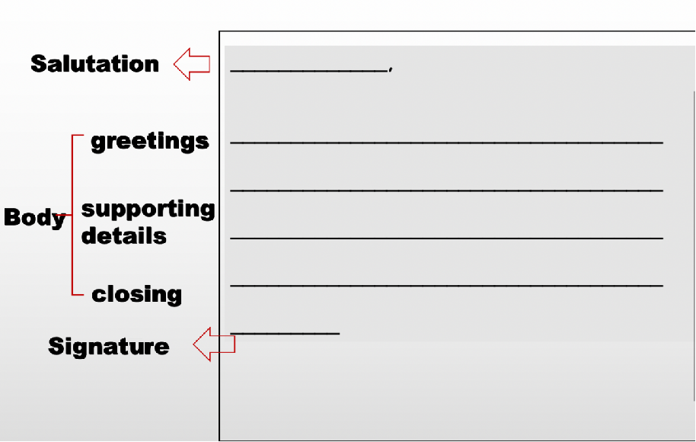
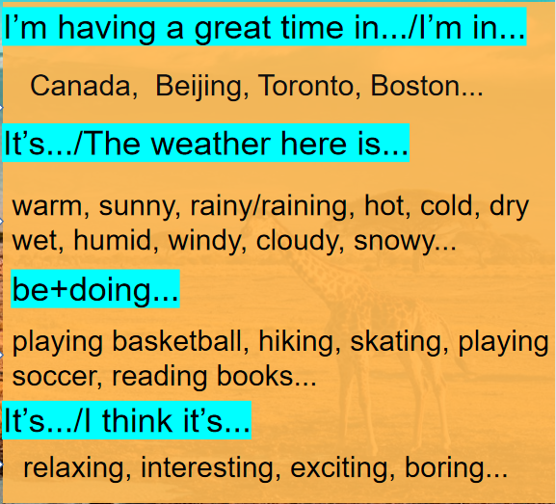
Write a postcard to Judy. (Group work)

Slide 16
Group work
Student A: Write
Student B: Check
Student C: Present
Student D: Polish

Slide 17
Check List
Assessment Checklist
Check (√) if you have completed the requirement. | Self-check | Peer-check
Use the right structure of postcards.
Write the body in 3 or more parts.
Write two or more points for your greetings.
Include place, weather, activities and feelings in your body part.
Use a correct and proper (合适的) closing.
1. Use the right structure of postcards.

Slide 18
Presentation

Slide 19
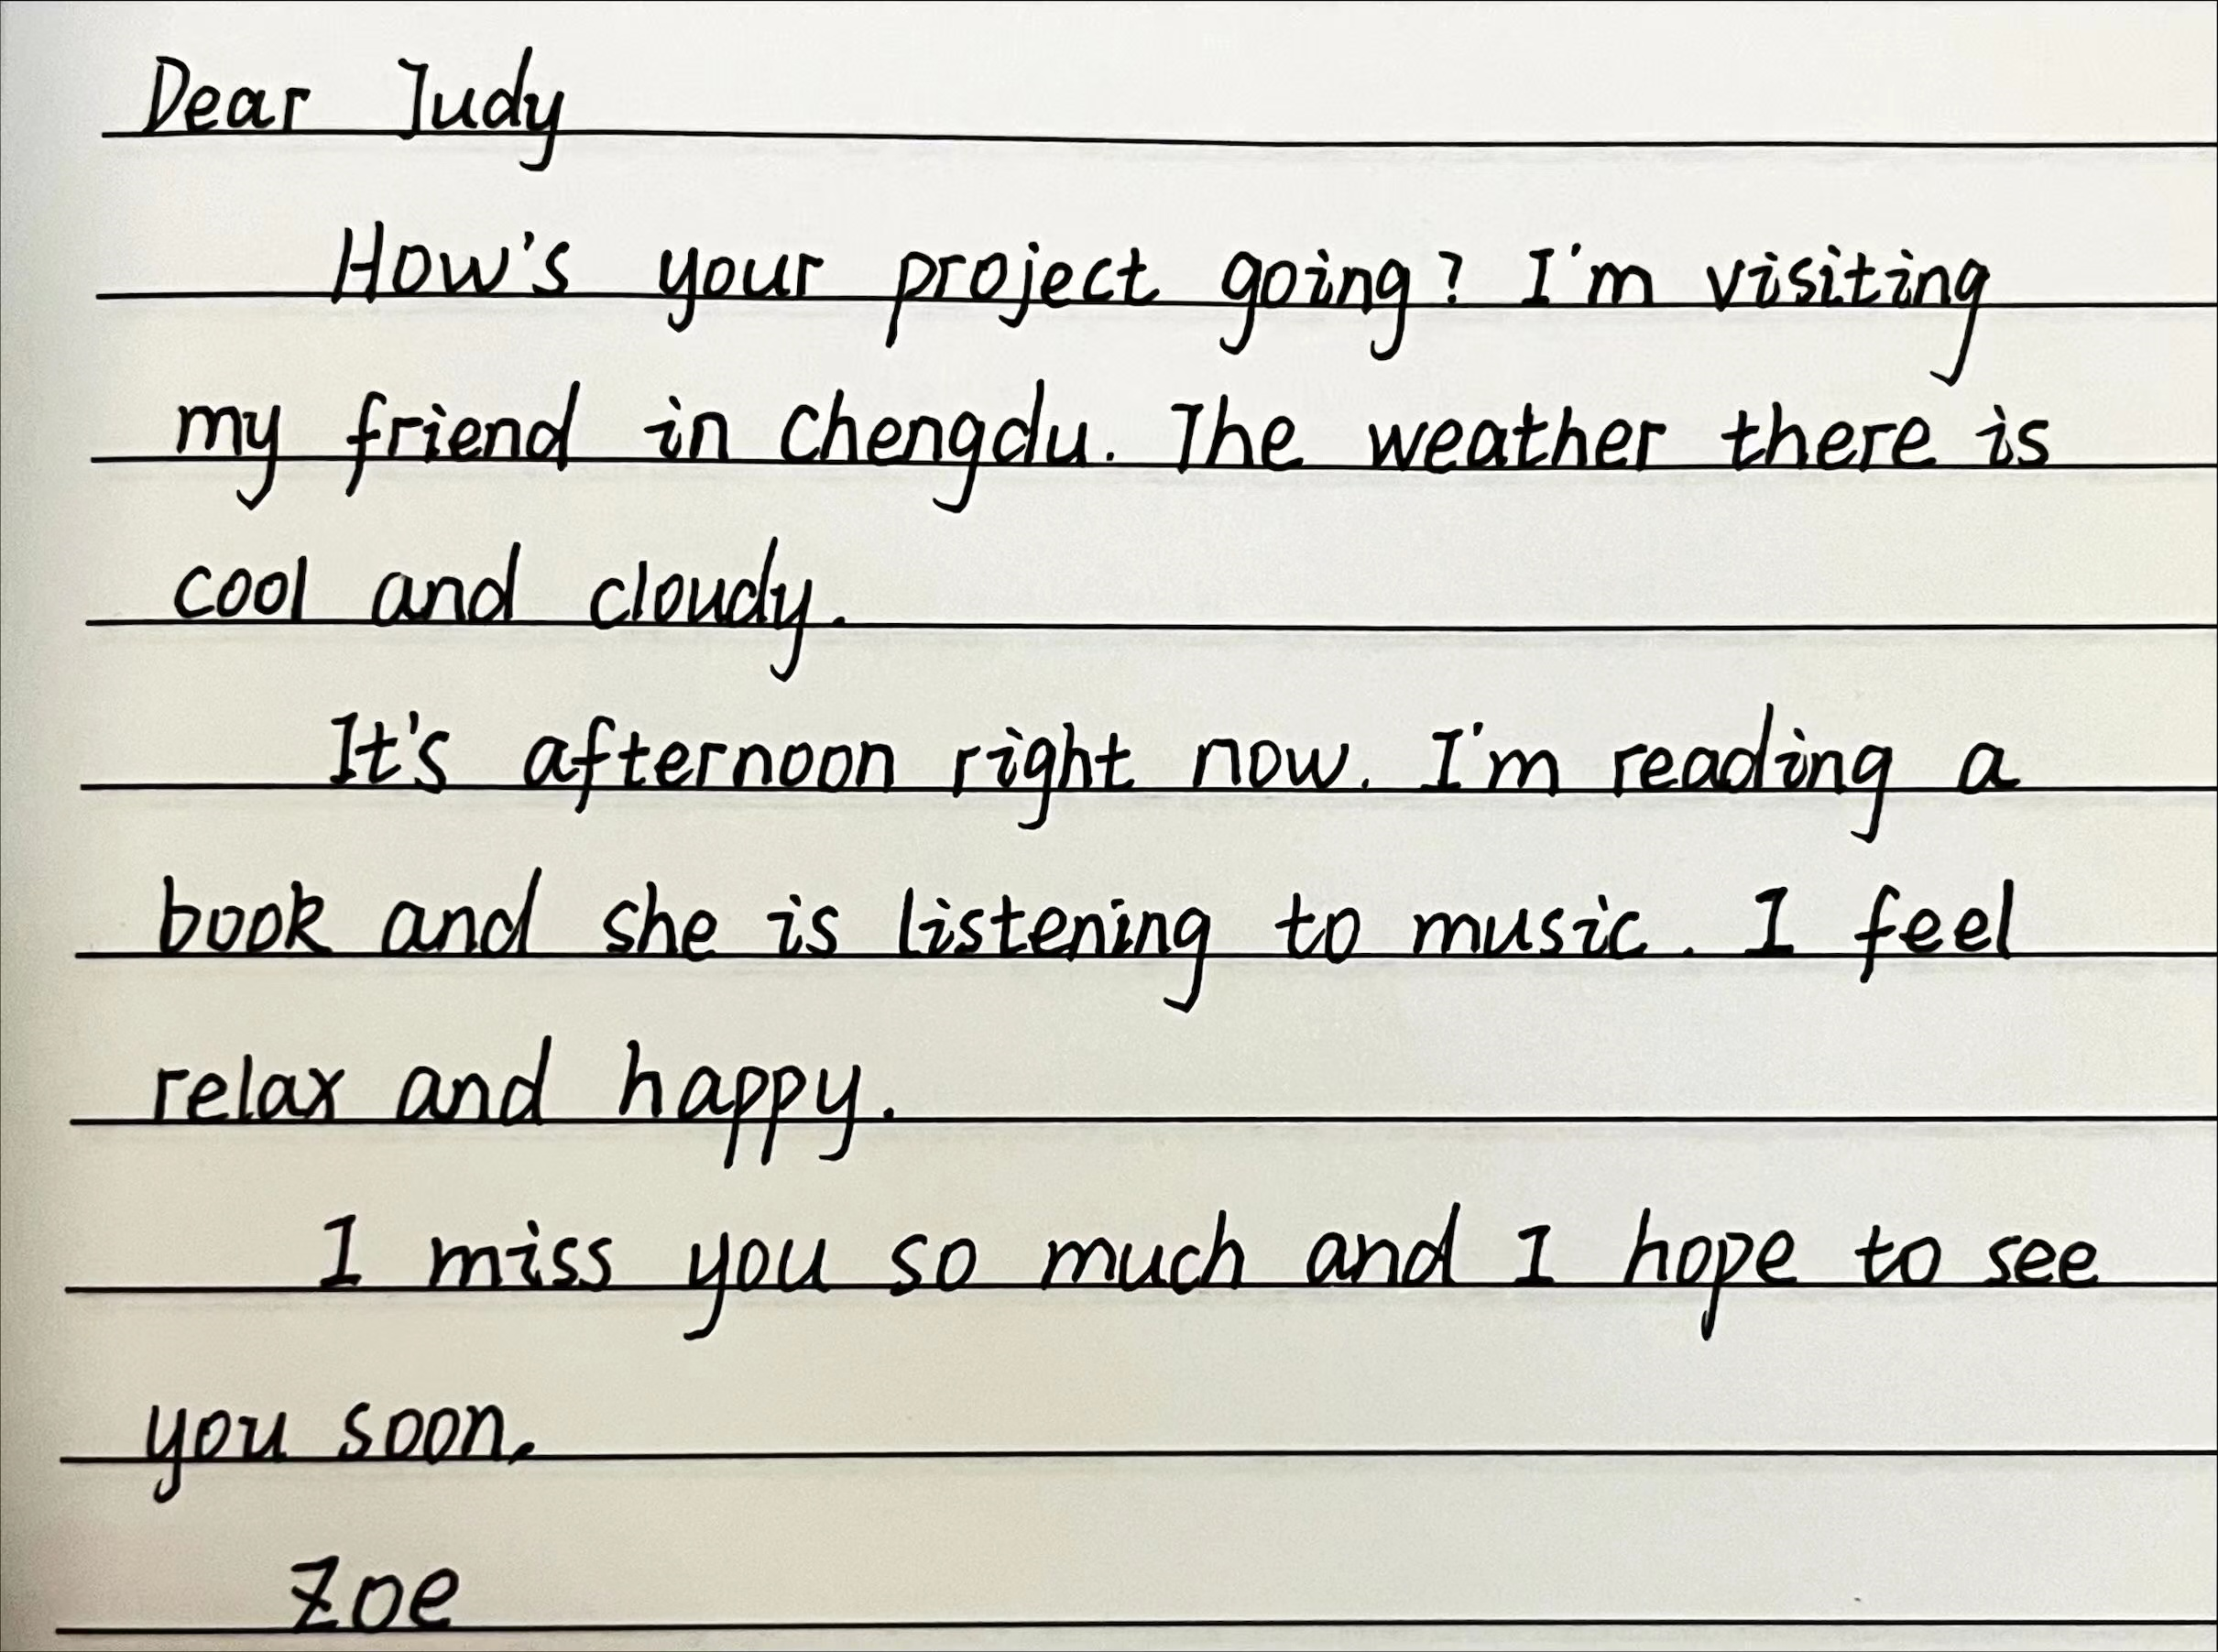
Check List
Salutation
place
greetings
weather
Body
supporting
details
activities
feelings
closing
Signature

Slide 20
Summary

Slide 21
Salutation
Dear+receiver
How’s it/your...going?
greetings
How’s everything?
How are you?
Postcard
place
Body
supporting details
weather
activities
feelings
closing
Signature
Your name

Slide 22
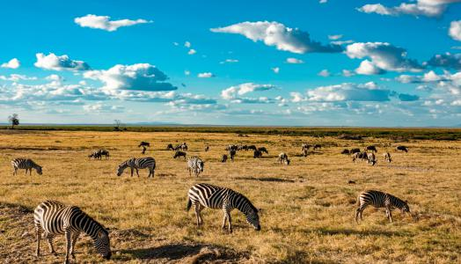
See the world on the way and know yourself on the way.

Slide 23
Homework
Compulsory
Polish the postcard (by revising, drawing and putting some stickers on it).
Optional
Write a postcard to your friend or family.

Slide 24
教学阐释 Teaching Interpretation
基于大观念的单元整体教学设计
Unit 7 It’s raining！
Period 5 Writing
课例 3

Slide 25
01. Teaching Philosophy
02. Background Information
目 录
CONTENTS
Analysis of Teaching Contents
03. Learning Activities
Analysis of Students
Teaching Objectives
Teaching & Learning Approaches

Slide 26
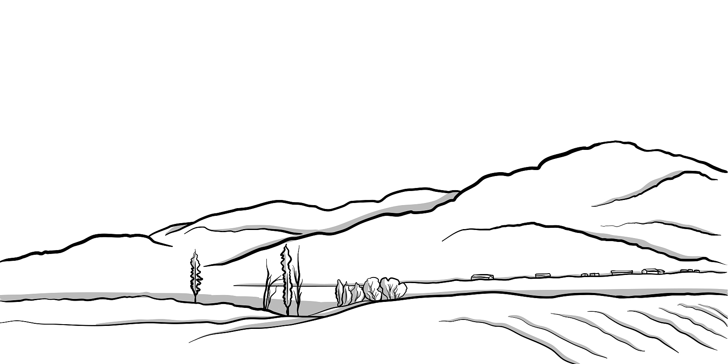
Part 1
Teaching Philosophy

Slide 27
Analysis of the Teaching Philosophy
序号 | 学业质量描述
3-10 | 能选用正确的词语、句式和时态，通过口语或书面语篇描述、介绍人和事物，表达个人看法，表意清晰，话语基本通顺。
3-11 | 能用所学英语，通过口头或书面语篇简单介绍中外主要文化现象（如风景名胜、历史故事、文化传统等），语义基本连贯。
3-13 | 进行书面表达时，能正确使用所学语言，格式较为规范。
3-14 | 能参照范例，仿写简短的文段（如回复信函等），语言准确，表意得体。
3-15 | 能结合图片、文字等提示信息，对语篇进行补充、续编或改编，语言基本准确。
3-16 | 善于通过多种渠道获取资料，尝试归纳学习素材中的语言和文化现象，从不同角度分析问题。
3-17 | 积极参与课堂活动，与同伴一起就相关主题进行讨论，合作完成学习任务。
表 24 三级（7〜9年级）学业质量标准

Slide 28
Analysis of the Teaching Philosophy
用
实
应
践
认知
主题
语言和技能
方法和策略
语
学
言
语言知识
习
迁
核心素养
综合表现
学
文化知识
技
策
移
态度
行为
习
能
略
创
理
语篇
思想观念
解
新
Unit-integrated teaching under the big ideas advocated in English teaching
An activity-based approach to English language learning

Slide 29
Analysis of the Teaching & Learning Philosophy
价值取向
教
学科基础
文化意识
发展条件
心智特征
语言能力
学
思维品质
评
学习能力
A Learning-Teaching-Assessing Cycle
Cultivating students’ core competences

Slide 30
Analysis of the Teaching Philosophy
Production-oriented approach（POA）
教学理念
教学假设
学习中心说
学用一体说
全人教育说
输出驱动
输入促成
选择性学习
教学流程
驱动
(Motivating)
促成
(Enabling)
评价
(Assessing)
以教师为中介

Slide 31
Part 2
Background Information

Slide 32
Analysis of the Teaching & Learning Content
生活与学习
人与自我
做人与做事
社会服务与人际沟通
文学、艺术与体育
人与社会
历史、社会与文化
科学与技术
自然生态
环境保护
人与自然
灾害防范
宇宙探索

Slide 33
Analysis of the Teaching & Learning Content
Core Competences | Teaching Objectives of the Unit
 | Language Ability | 1. be able to greet each other and discuss the weather with a partner in the language they have learned 2. be able to use the present progressive tense correctly to describe activities that people are being engaged in
 | Thinking Quality | 1. be able to summarize the style, structure and main content of a postcard 2. be able to use appropriate communicative language
 | Cultural Awareness | Understand that discussing the weather is an important part of “small talk” and an important strategy for a smoothened communication. Learn about the different weather and the different activities people do around the world and feel the regional differences.
 | Learning Ability | 1. be able to improve their communicative skills in English by actively talking in English with other students in group activities, discussing the weather conditions and the activities people carry out 2. be able to learn from each other how to plan and diversify their expressions and improve their writing and evaluation skills through sessions such as self-assessment and peer assessment
Ideological and Political Education | To capture students’ knowledge of climate differences around the world and to improve their intercultural communication skills through discussion of the weather
Adopt unit-integrated teaching under the big ideas
Encourage students to build structural knowledge

Slide 34
Analysis of the Students
Active learners with strong divergent thinking skills
The sensorimotor stage
Piaget's four-stage cognitive development
The preoperational stage
Grade 7-9 Students
The concrete operational stage
7-11 years
concrete thinking
11 years above
The formal operational stage
abstract thinking
Expressive skills: Draft & Polish the writing

Slide 35
Analysis of the Teaching & Learning Objectives
学习理解
应用实践
迁移创新
Students will be able to describe the weather condition and their immediate activities in writing, using weather-related expressions.
Students will be able to summarize the basic structure of writing a postcard through the model text.
Students will be able to write a simple postcard using appropriate opening and closing remarks.
感知与注意
描述与阐释
推理与论证
获取与梳理
分析与判断
批判与评价
概括与整合
内化与运用
想象与创造
基于语篇
建构知识
深入语篇
转化能力
超越语篇
形成素养

Slide 36
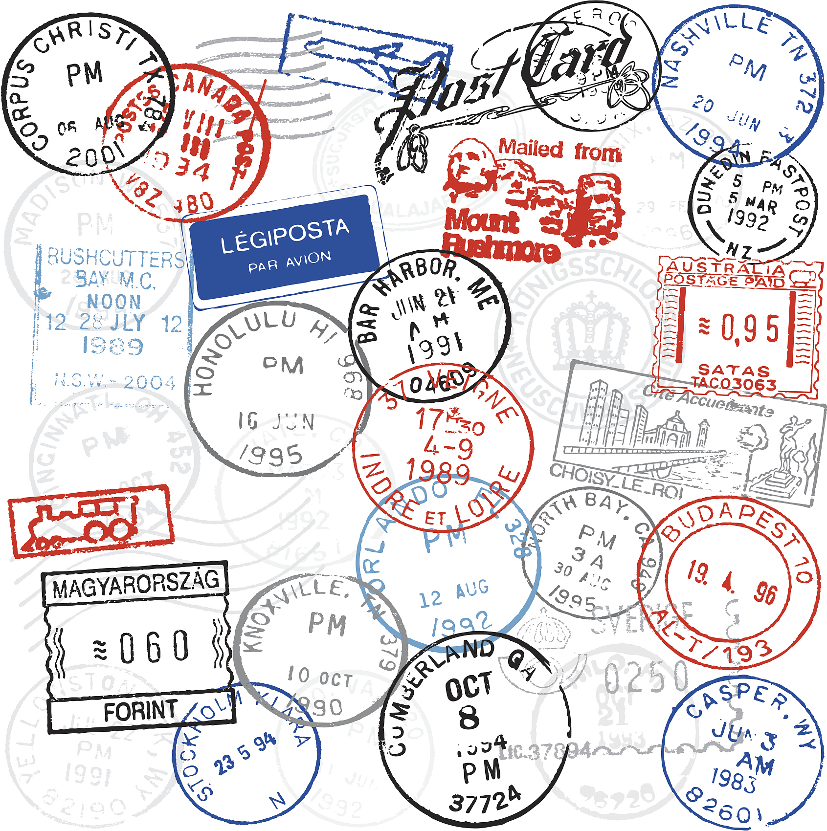
Key Point & Potential Difficulty
Key point：
Applying the intended writing style, structure, and content to write a postcard
Potential difficulty：
Correctly applying the present continuous tense to describe ongoing actions and different weather conditions

Slide 37
Analysis of the Teaching & Learning Approach
课程思政 立德树人
I. Collaborative learning approach
develops critical thinking skills
provides helpful feedback
reduces anxiety
helps
understanding

Slide 38
Analysis of the Teaching & Learning Approach
课程思政 立德树人
II. An activity-based approach to English learning
创造
Creating
Activity 7
迁移创新
评价
Evaluating
Activity 6
分析 Analyzing
应用实践
Activity 4-5
应用 Applying
Activity 3
理解 Understanding
学习理解
Activity 1-2
识记 Remembering
The New Version of Bloom’s Taxonomy (2001)

Slide 39
Part 3
Learning Activities

Slide 40
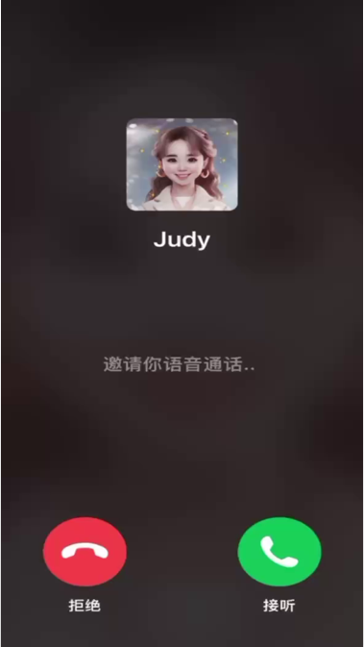
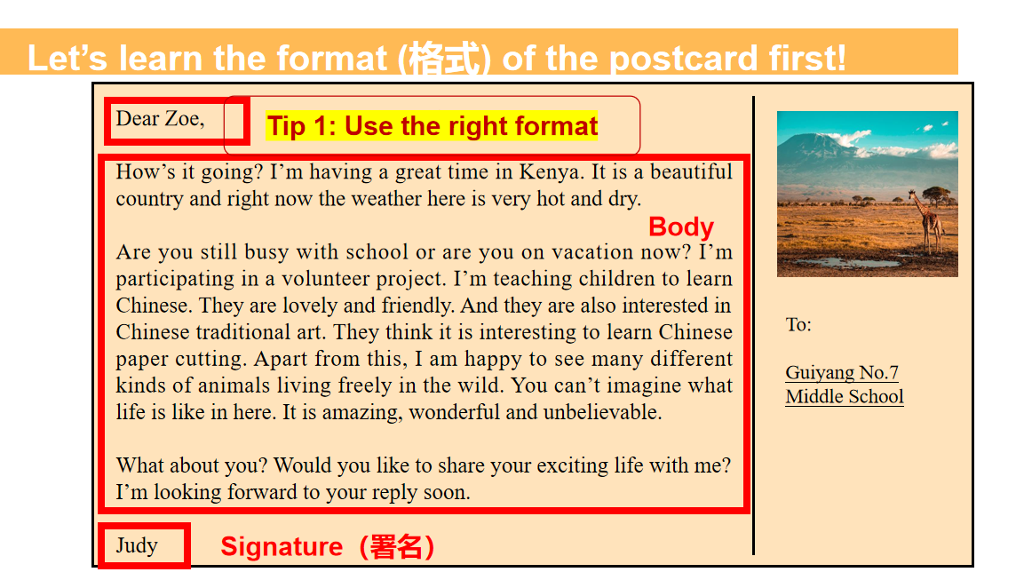
Learning Activities
Creating
Evaluating
Analyzing
Applying
Understanding
Remembering
Using authentic texts to set a scene and context
Recognizing and identifying the specific format of writing a postcard

Slide 41
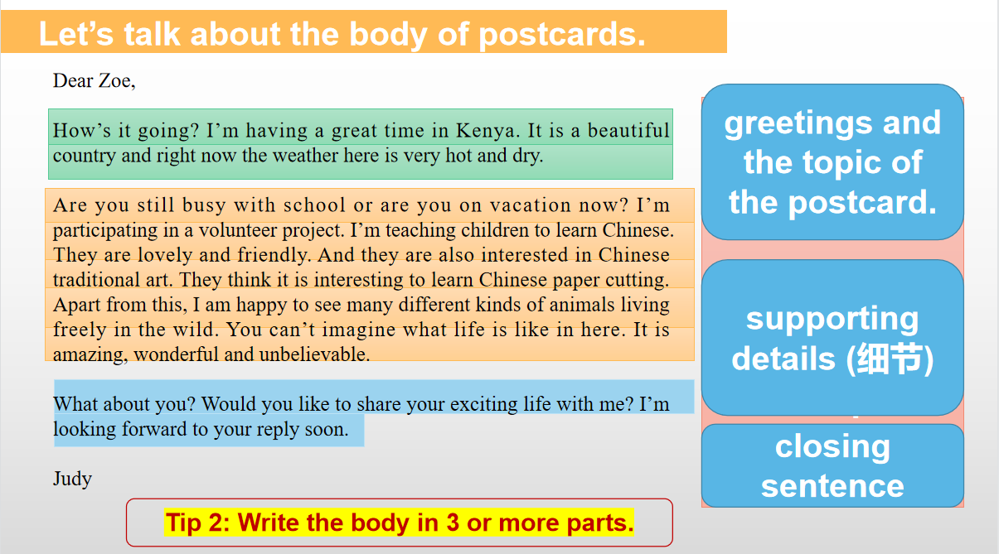
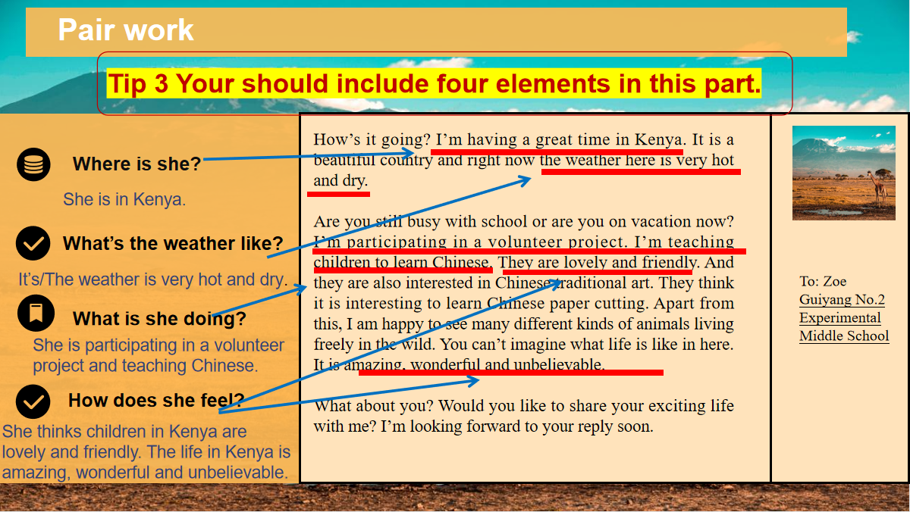
Learning Activities
Creating
Evaluating
Analyzing
Applying
Applying
Understanding
Remembering
Analyzing the content and generalizing the writing structure to build a scaffolding

Slide 42
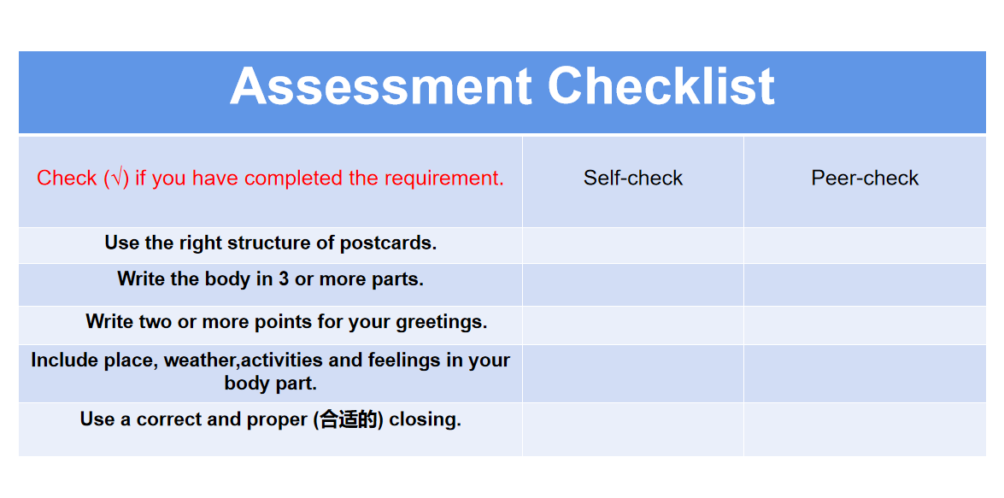
Learning Activities
Creating
Evaluating
Analyzing
Applying
Understanding
Remembering
Writing a postcard by applying the proper writing structure and useful expressions
Checking and evaluating what the students have learned in this lesson

Slide 43
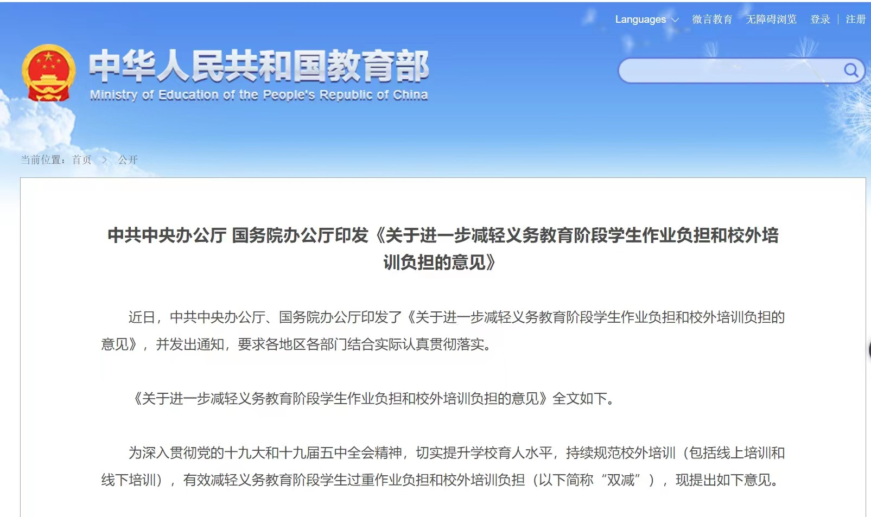
Learning Activities
Creating
Evaluating
Analyzing
Applying
Understanding
Remembering
Carrying out Double Reduction Policy
Attending to needs from students with different learning abilities

Slide 44
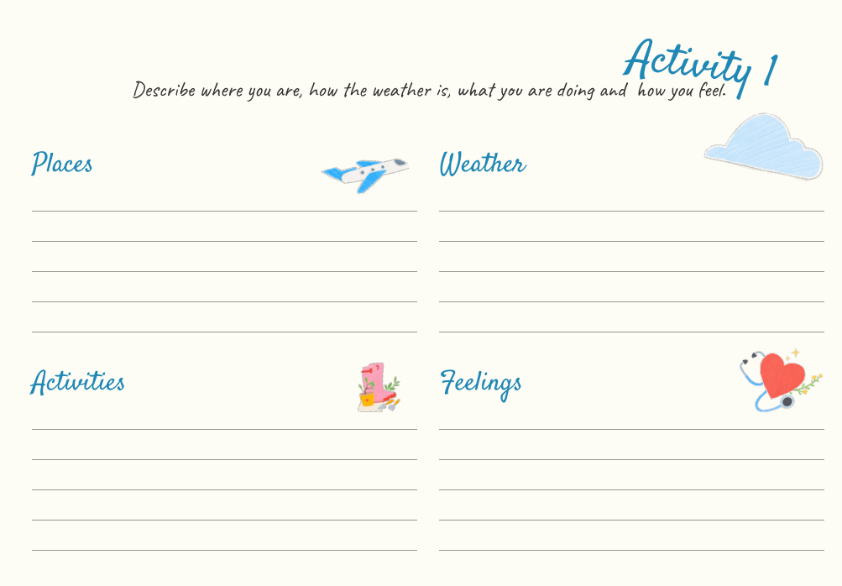
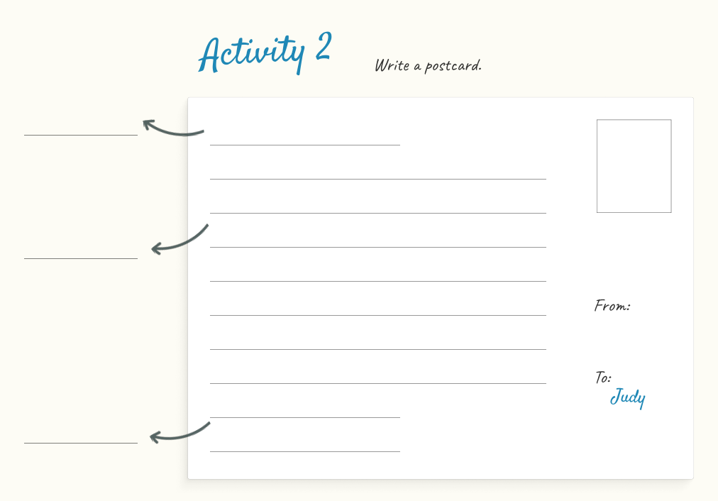
Learning Materials
Utilizing the additional materials to supplement the textbook
Creating a systematic project-like learning sequence by organizing activity chain

Slide 45
Teaching Reflection
Many linguists claim,
“Language learning is a social activity, not a mechanical drill.”
Pinpoint the scenario and choose proper language patterns
to express themselves.

Slide 46
Teaching Reflection
“The ultimate purpose of language teaching is to teach students how to mean.”
write to communicate
write to socialize
Halliday (2013)
write to reflect

Slide 47
Beautiful Quote
天街小雨润如酥，草色遥看近却无。
——韩愈
Soft rain adorns the heavenly streets with grace,
Distant grass, a verdant view, yet beyond embrace.
Han Yu

