Slide 1
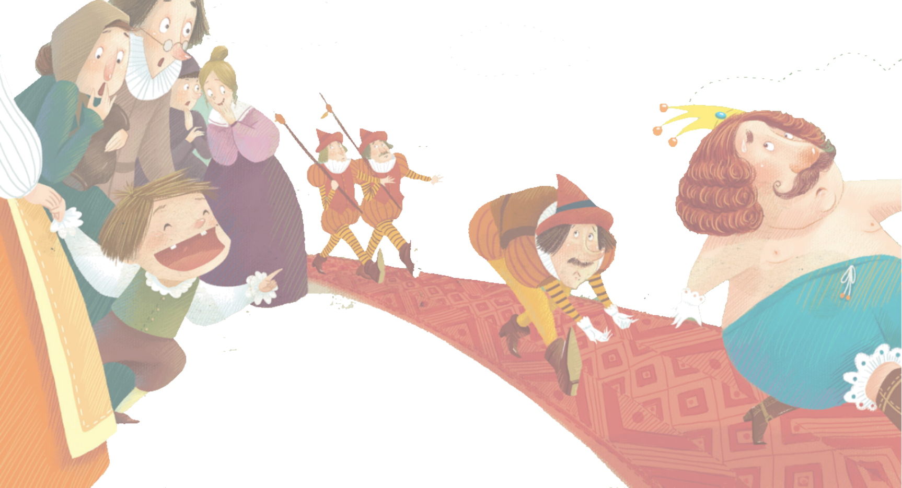
PEP Go for it！Grade 8 Volume II
Unit 6
An old man tried to move the mountains.
Period 4 Listening & Speaking
课例 5

Slide 2
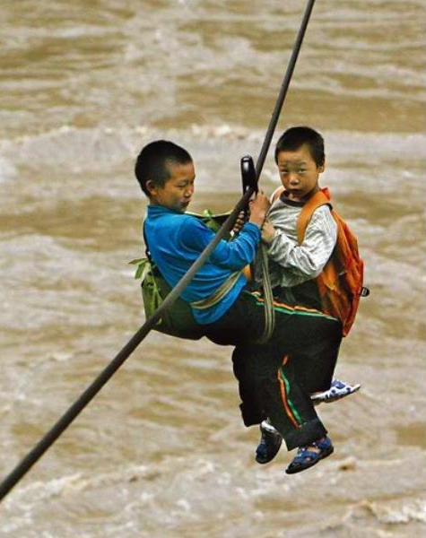
Lead-in
Hi there,
There is a beautiful bridge between our school and the village. We can go to school easily. More importantly, we have a beautiful school now. There is a new library at school. But we don’t have enough books. Can you help us?
Yours,
Liang Liang

Slide 3
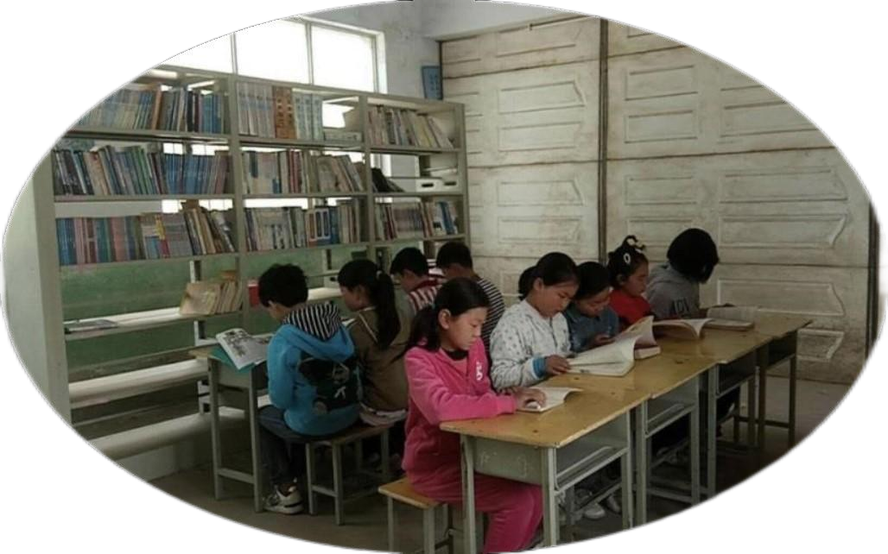
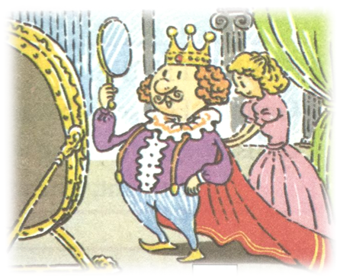
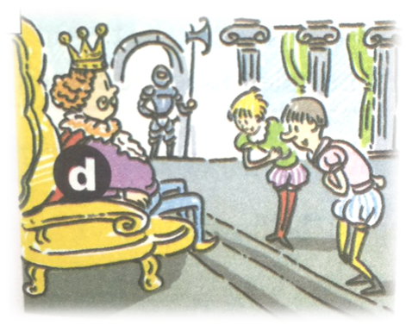
Let’s make an English picture book, the Emperor’s New Clothes, for the school.ool.

Slide 4
The Emperor’s New Clothes

Slide 5
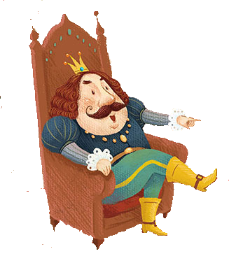
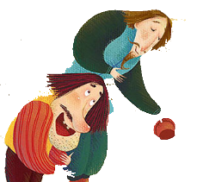
Setting(背景)
Characters(角色)
Plots(情节)
the emperor
two brothers
What
happened?
time
place
other people
many years ago
a European country
a little boy

Slide 6
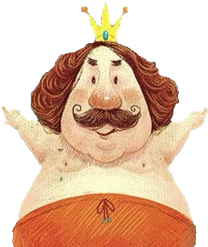
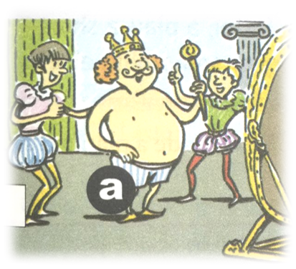
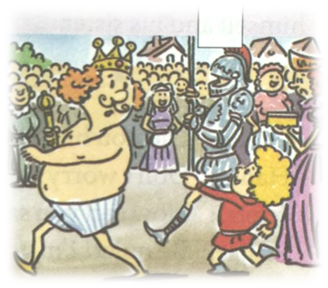
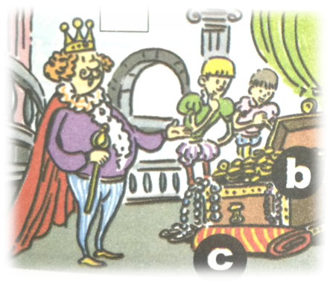
Plots
Prediction
C
A
B
D
E

Slide 7
Plots
Listen and number the pictures. [1-5]
5
4
A
3
B
C
2
1
D
E

Slide 8
Plots
Listen again and complete the story.
Scene 1
emperor
This story is about an ___________ who loved clothes.
1
Scene 2
brothers
make
Two __________ came to the city to _________ special clothes for the emperor.
2
Scene 3
silk
but
The emperor had to give them_______ and gold, _______ they kept everything for themselves and told the emperor people couldn’t see the clothes _________ they were clever.
3
unless

Slide 9
Plots
Listen again and complete the story.
Scene 4
__________ the emperor looked at himself, he only saw his _____________.
When
4
underwear
Scene 5
Nobody
So
__________ wanted to sound stupid. ______ everyone said his new clothes were wonderful. But suddenly, a young boy __________ “Look! The emperor isn’t ____________any clothes!”
5
shouted
wearing

Slide 10
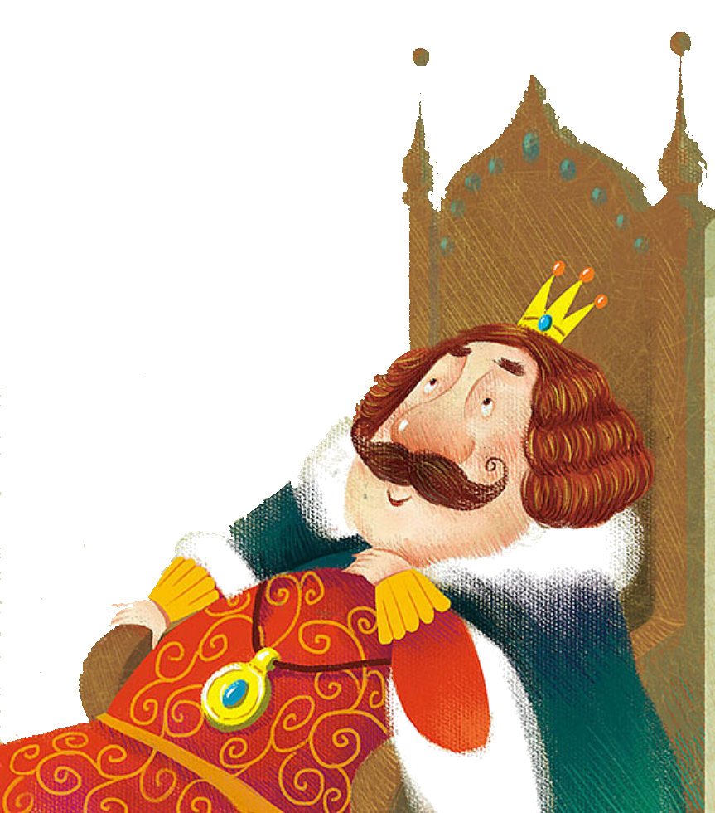
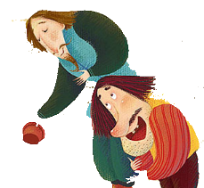
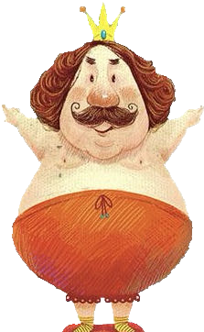
Learn and Tell
Use the key words of every scene and retell the story.
Scene 1
Scene 2
emperor
two brothers
many years ago
make
Scene 3
Scene 4
Scene 5
make
when
nobody
silk
so
but
underwear
shout
wear

Slide 11
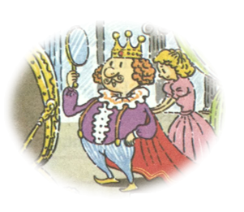
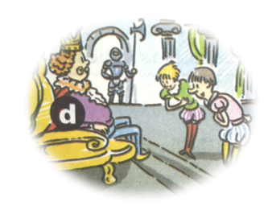
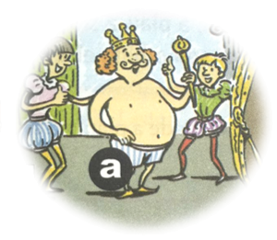
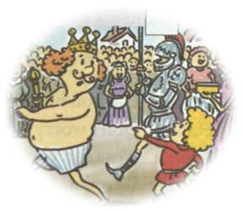
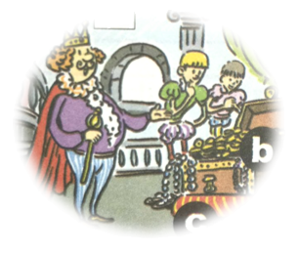
Plots

Slide 12
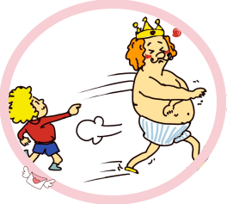
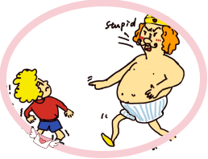
Plots
Add a falling and an ending to the story.
or

Slide 13
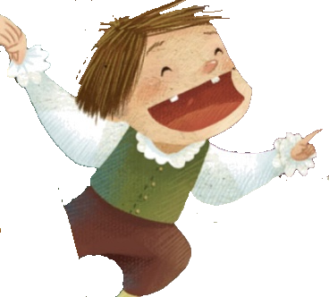
peacockish
(虚荣的)
greedy
(贪婪的)
01
02
/ ˈpiːkɒkɪʃ /
/ ˈɡriːdi /
lie
slavish
(盲从的)
03
honest
(诚实的)
04
/ ˈsleɪvɪʃ /
truth

Slide 14
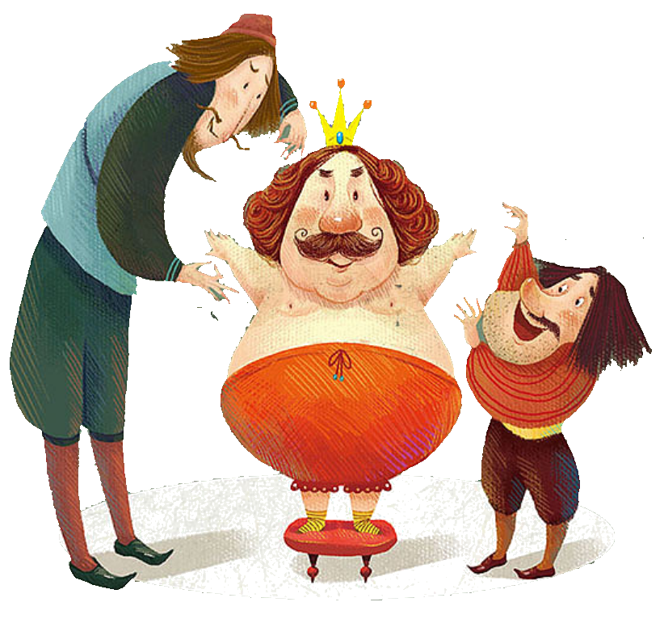
There are many sides to a story and many ways to understand it.

Slide 15
Check and score the items according to your learning.
SELF-ASSESSMENT CARD
Items | Excellent (10) | OK (8) | Just so so (6) | Not so good (4)
I can tell the story with proper conjunctions and emotional voice.
I can use the “plot diagram” to understand a story.
I know how to use the 3 story elements when telling a story.
I know that I should understand from different sides when reading a story.
I can write a reasonable (合理的) ending for a story.

Slide 16
Compulsory
Complete the story of the picture book.
Optional
Share your endings orally with classmates after class.

Slide 17
教学阐释 Teaching Interpretation
基于大观念的单元整体教学设计
Unit 6 An old man tried to move the mountains.
Period 4 Listening & Speaking
课例 5

Slide 18
CONTENTS
1. Teaching Philosophy
2. Background Information
Analysis of Teaching Contents
3. Learning Activities
Analysis of Students
Teaching Objectives
Teaching & Learning Approaches

Slide 19
Part 1
Teaching Philosophy

Slide 20
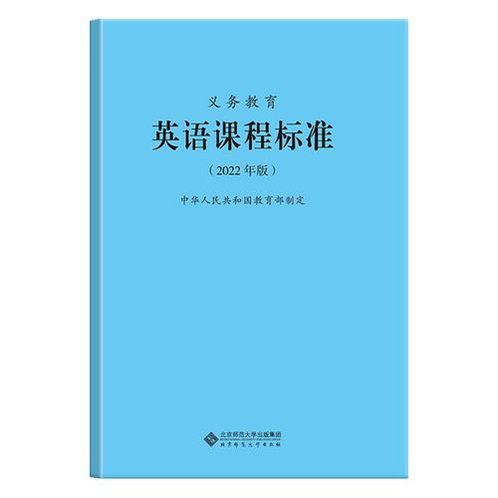
Analysis of the Teaching Philosophy
序号 | 学业质量描述
3-1 | 能听懂相关主题的语篇，借助关键词句、图片等复述语篇内容。
3-2 | 能利用语篇所给提示预测内容的发展，判断说话者的身份和关系，推断说话者的情感、态度和观点。
3-3 | 能理解多模态语篇（如广播、电视节目等）的主要内容，获取关键信息。
3-8 | 朗读相关主题的简短语篇时，连读、停顿自然，语音、语调基本正确。
3-9 | 能根据口头交际的具体情境，初步运用得体的语言形式，表达自己的情感、态度和观点。
3-10 | 能选用正确的词语、句式和时态，通过口语或书面语篇描述、介绍人和事物，表达个人看法，表意清晰，话语基本通顺。
3-12 | 能讲述具有代表性的中外杰出人物的故事，如科学家等为社会和世界作出贡献的人物，表达基本清楚。
3-16 | 善于通过多种渠道获取资料，尝试归纳学习素材中的语言和文化现象，从不同角度分析问题。
3-17 | 积极参与课堂活动，与同伴一起就相关主题进行讨论，合作完成学习任务。
表 24 三级（7〜9 年级）学业质量标准

Slide 21
Analysis of the Teaching Philosophy
用
实
应
践
认知
主题
语言和技能
语
学
方法和策略
言
语言知识
习
核心素养
综合表现
迁
文化知识
学
技
策
态度
移
行为
习
能
略
创
理
语篇
思想观念
解
新
Unit-integrated teaching under the big ideas advocated in English teaching
An activity-based approach to English language learning

Slide 22
Analysis of the Teaching Philosophy
价值取向
教
学科基础
文化意识
发展条件
心智特征
语言能力
学
思维品质
学习能力
评
A Learning-Teaching-Assessing Cycle
Cultivating students’ core competences

Slide 23
Analysis of the Teaching Philosophy
Production-oriented approach（POA）
教学理念
教学假设
学习中心说
学用一体说
全人教育说
输出驱动
输入促成
选择性学习
教学流程
驱动
（Motivating）
促成
(Enabling)
评价
（Assessing）
以教师为中介

Slide 24
Part 2
Background Information

Slide 25
Analysis of the Teaching & Learning Content
生活与学习
人与自我
做人与做事
科学与技术
历史、社会与文化
人与社会
文学、艺术与体育
社会服务与人际沟通
自然生态
环境保护
人与自然
灾害防范
宇宙探索

Slide 26
Analysis of the Teaching & Learning Content
Teaching Objectives of the Unit
Core Competences | Language Ability | 1. be able to retell orally the Chinese mythology and western fairy tales studied using the language learnt 2. be able to use appropriate tenses and language to continue the ending of a story in a reasonable manner according to the development of the story and the traits of the characters in the story
 | Thinking Quality | 1. be able to extract, organize and summarize the key messages and main content of a story 2. be able to think independently, express different views on the story and make correct value judgements
 | Cultural Awareness | 1. an understanding of Chinese folk myths and legends, telling Chinese stories and spreading Chinese culture 2. a preliminary understanding of western fairy tales and the masterpieces of Andersen and Grimm's Fairy Tales
 | Learning Ability | 1. be able to use group activities to positively communicate with other students in English and tell fairy tales 2. be able to develop imagination and creativity by making logical and character-driven sequences of stories
Ideological and Political Education | A preliminary understanding of the cultural values and appreciation of works in Chinese and foreign literary forms, and the development of students' cultural confidence and awareness of cross-cultural communication through the telling of Chinese stories and the dissemination of Chinese culture
Adopting unit-integrated teaching under the big ideas
Encouraging students to build structural knowledge

Slide 27
Analysis of the Students
Active learners with strong divergent thinking skills
The sensorimotor stage
Piaget's four-stage cognitive development
The preoperational stage
Grade 7- 9
students
7-11 years
The concrete operational stage
concrete thinking
11 years above
The formal operational stage
abstract thinking
Expressive skills: using the semantic flow and related sentence patterns to express their ideas

Slide 28
Analysis of the Teaching & Learning Objectives
学习理解
应用实践
迁移创新
Students will be able to understand the general development of the given story of “The Emperor’s New Clothes” through listening.
Students will be able to retell the story to their peers within small groups.
Students will be able to express their insights and feelings about the story in simple English and critically evaluate the characters in the story.
感知与注意
描述与阐释
推理与论证
获取与梳理
分析与判断
批判与评价
概括与整合
内化与运用
想象与创造
基于语篇
建构知识
深入语篇
转化能力
超越语篇
形成素养

Slide 29
Key Points & Potential Difficulty
Key points：
Helping students to comprehend the plot development in the story
Learning to critically evaluate the characters in the story
Potential difficulty：
Helping students accurately and confidently recount the story

Slide 30
Analysis of the Teaching & Learning Approaches
课程思政 立德树人
I. Collaborative learning approach
develops critical thinking skills
provides helpful feedback
reduces anxiety
helps
understanding

Slide 31
Analysis of the Teaching & Learning Approaches
课程思政 立德树人
II. An activity-based approach to English learning
创造
Creating
Activity 9
迁移创新
评价
Evaluating
Activity 8
Activity 6-7
分析 Analyzing
应用实践
Activity 5
应用 Applying
Activity 3-4
理解 Understanding
学习理解
Activity 1-2
识记 Remembering
The New Version of Bloom’s Taxonomy (2001)

Slide 32
Part 3
Learning Activities

Slide 33
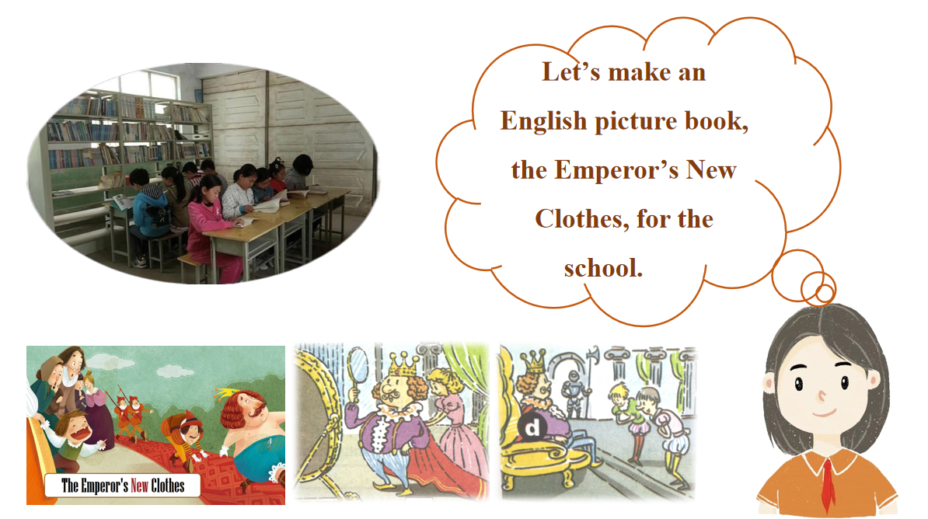
Learning Activities
Creating
Evaluating
Analyzing
Applying
Understanding
Remembering
Using the authentic texts to establish a scene and context
Recognizing and identifying the background information for storytelling

Slide 34
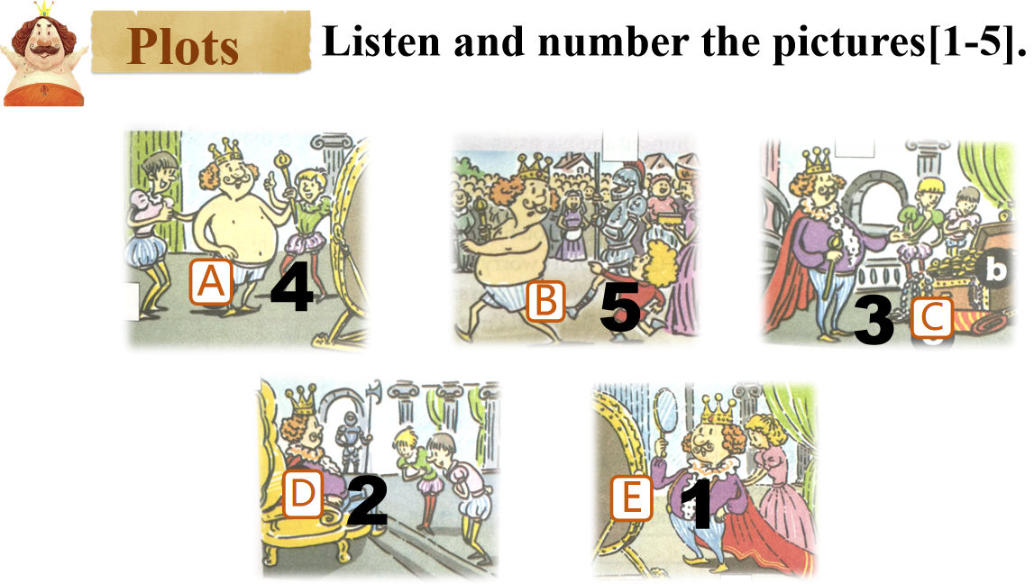
Learning Activities
Creating
Evaluating
Analyzing
Applying
Understanding
Remembering
Completing the listening activities by using the related strategies

Slide 35
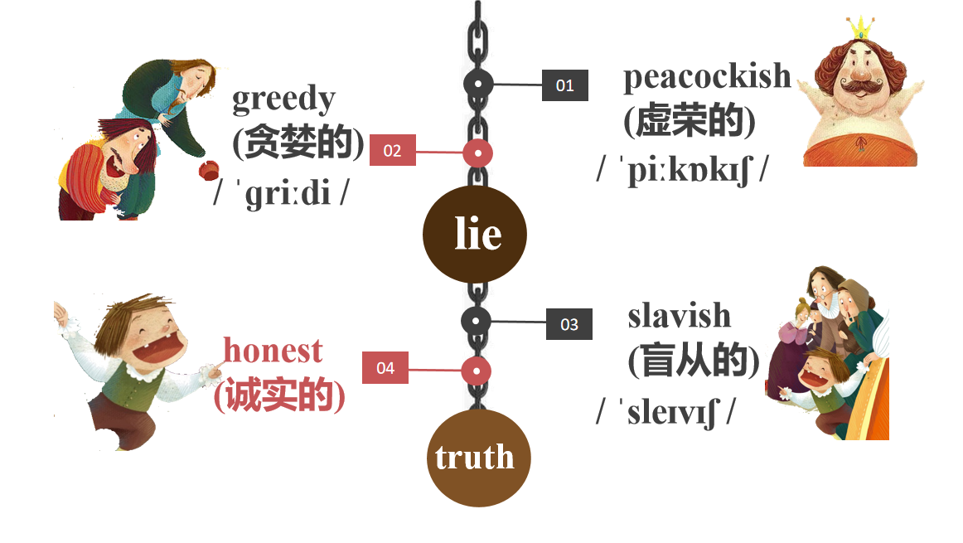
Learning Activities
Creating
Evaluating
Analyzing
Applying
Understanding
Remembering
Retelling the story, creating an ending, analyzing the different personalities of the characters, developing creative and critical thinking skills

Slide 36
Learning Activities
Creating
Evaluating
Analyzing
Applying
Understanding
Remembering
Checking and evaluating what/how well the students have learned to make a self-reflection

Slide 37
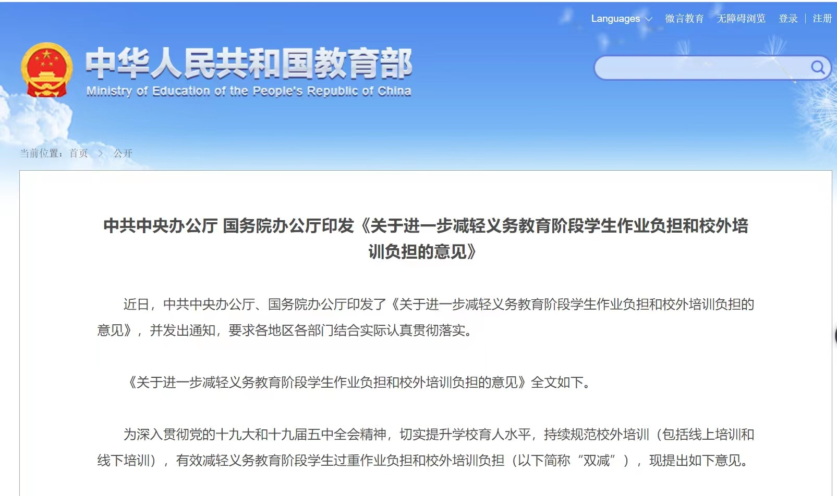
Assignment
Creating
Evaluating
Analyzing
Applying
Understanding
Remembering
Carrying out Double Reduction Policy
Attending to needs from students with different learning abilities

Slide 38
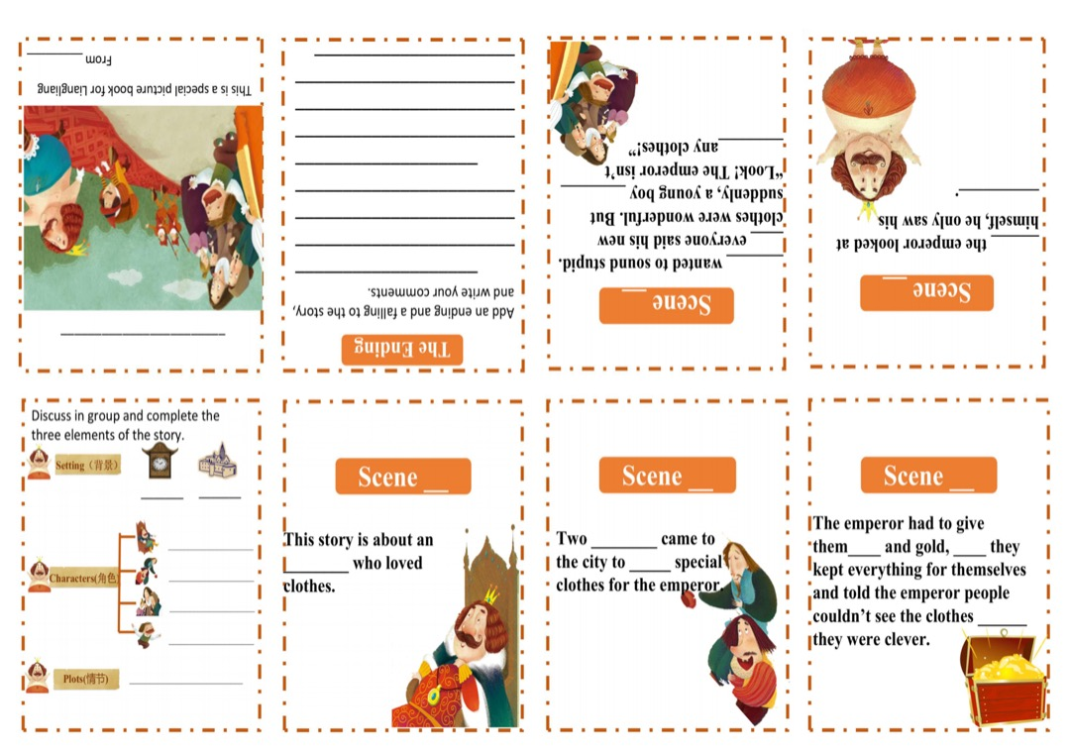
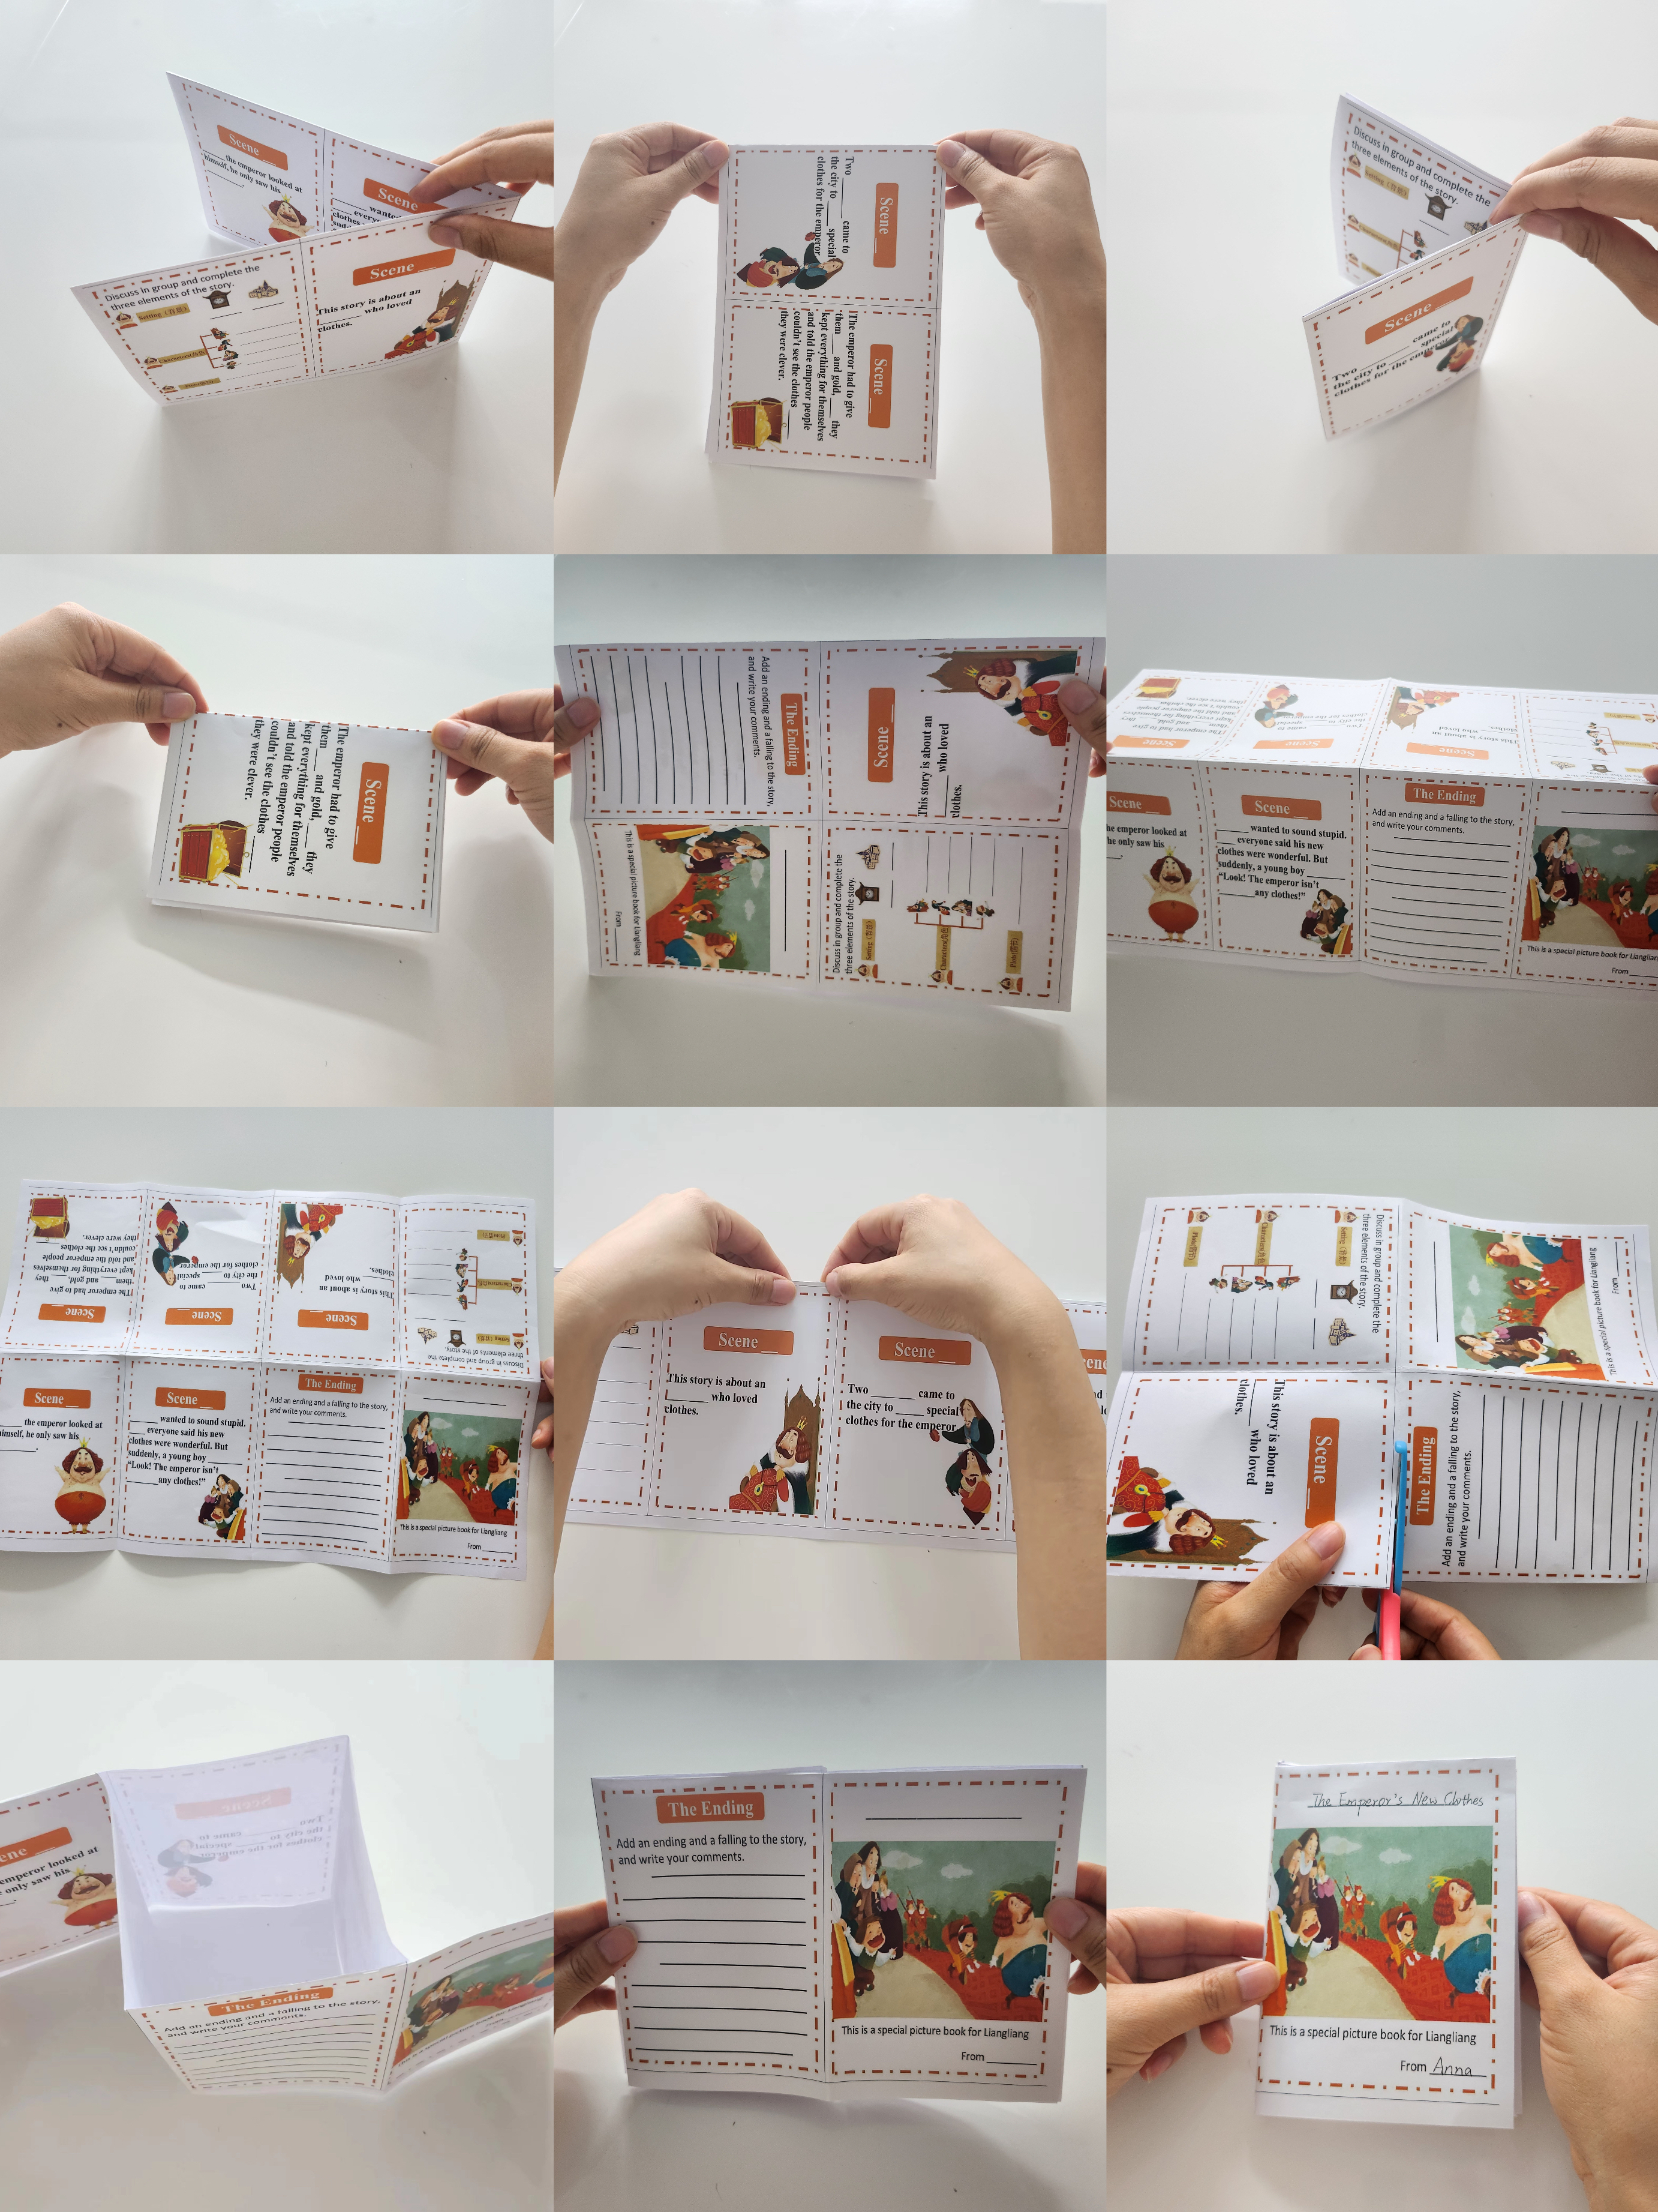
Learning Materials
Utilizing the additional materials to supplement the textbook
Creating a systematic project-like learning sequence by organizing activity chain

Slide 39
Teaching Reflection
Many linguists claim,
“Language learning is a social activity, not a mechanical drill.”
Pinpoint the scenario and choose proper language patterns to express themselves.

Slide 40
Teaching Reflection
“The ultimate purpose of language teaching is to teach students how to mean.”
listen to understand
act to negotiate
Halliday (2013)
speak to express

Slide 41
Beautiful Quote
小故事，大智慧。
Great wisdom is embedded in small stories.

