Slide 1
PEP Go for it! Grade 9
Unit 14 I remember meeting all of you in Grade 7.
The Person I Will Never Forget
Period 6 Writing

Slide 2
Learning objectives
1. Complete the profile page by using the scaffolding words or phrases;
概括描写人物的要点，填写人物卡片；
2. Analyze the structure of sample writing and create your own story to write the first draft;
提炼范文的写作框架，构思自己与难忘的人之间的故事，完成写作初稿；
3. Revise the first draft through self-evaluation, peer-evaluation and teacher-evaluation
to complete the memory card.
通过多元化评价方式分析写作初稿，形成自己的Memory Card。

Slide 5
Find the person
The Person I Will Never Forget
A stranger
who helped you
A friend
who supported you
A teacher
who you like most
A person
who is from textbooks
...

Slide 6
Describe the person
Name: __________
Relationship: ______________________
Appearance: _______________________
Personality: _______________________
The time and place we met:
___________________________________
Profile Photo
(draw or stick)

Slide 7
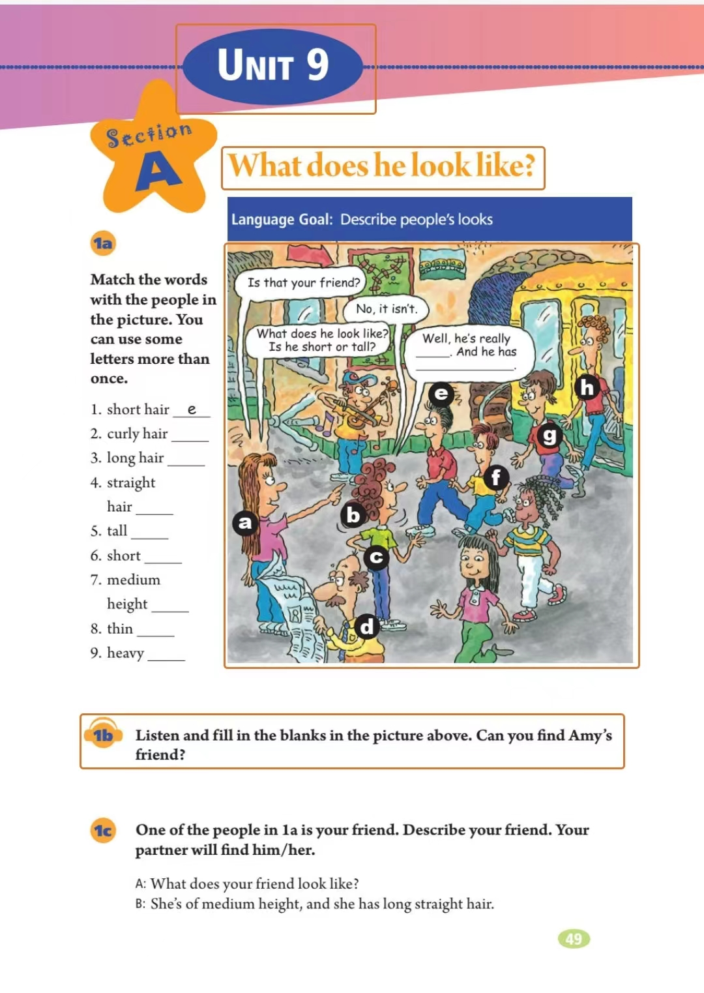
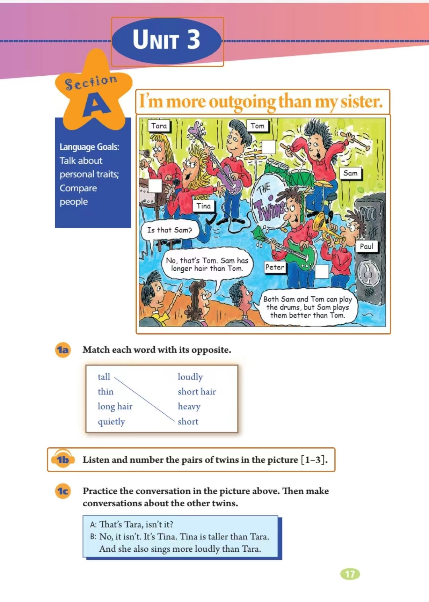
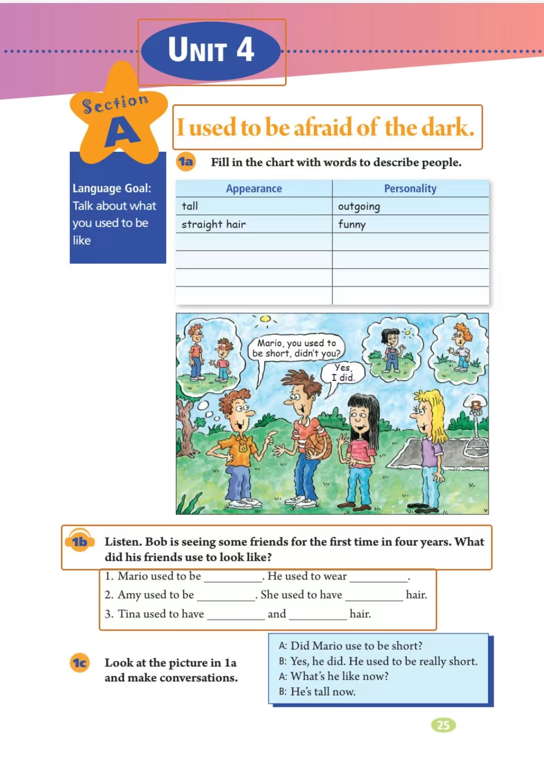
Describe the person
Appearance:
tall short be of medium height
thin heavy be of medium build
cute beautiful handsome
...
Personality:
outgoing serious humorous
creative patient strict
Grade 7:
Unit 9 What does he look like?
Grade 8:
Unit 3 I’m more outgoing than my sister.
Grade 9:
Unit 4 I used to be afraid of the dark.
...

Slide 8
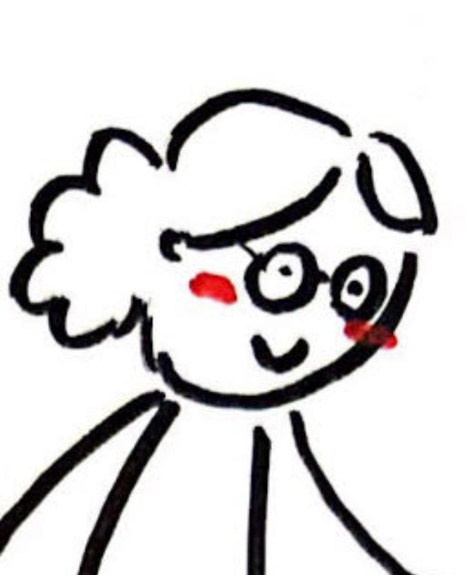
Describe the person
Name: __________
Relationship: ______________________
Appearance: _______________________
Personality: _______________________
The time and place we met:
___________________________________
Ms. Li
my English teacher
be of medium build
be patient, warm-hearted
We met in Grade 7 at the school gate.

Slide 9
Match the main idea with each paragraph.
How to write a clear story?
Read a modelling writing
When it comes to a person who impresses me the most, I always think of my English teacher, Ms. Li, from my middle school years. She was of medium build and always had a smile on her face.
One particular event that stands out in my memory is the English speaking competition. I had never dreamed of giving a speech in public, but Ms. Li saw potential in me and encouraged me to participate in. With great patience, she taught me everything about giving a speech. Most importantly, she made me more confident. On the day of the competition, despite my nervousness, I stood on that stage with determination and ended up winning it.
Through the story between Ms. Li and me, I want to stress that Ms. Li not only helped me win that competition, but also brought out the best in me.
One particular event that stands out in my memory is the English speaking competition. I had never dreamed of giving a speech in public, but Ms. Li saw potential in me and encouraged me to participate in. With great patience, she taught me everything about giving a speech. Most importantly, she made me more confident. On the day of the competition, despite my nervousness, I stood on that stage with determination and ended up winning it.
Describe
the person
Topic Sentence
Beginning of the Story
Summarize
the influence
Middle of the Story
End of the story
Tell
the story

Slide 10
Write the 1st draft
Describe
the person
Tell
the story
Summarize
the influence
The Person I Will Never Forget
__________________________________________________________________________________________________
_________________________________________________
_________________________________________________
_________________________________________________
_________________________________________________
_________________________________________________

Slide 11
Evaluate the 1st draft
Peer-evaluation Checklist (同伴互评表)
Item (指标) | Criteria (标准) | Yes/No | How to improve
Content | Is there a person and a story?
Structure | Are there three key parts?
Word | Are there precise and appropriate words?
Sentence | Are there precise and appropriate sentence patterns?
Convention | Is there any errors in language?
Voice | Is there a consistent style, tone, and personality?
Note: This Rubric is adapted from Spandel’s Six-trait writing rubric (2005).

Slide 12
Evaluate the 1st draft (Teacher-evaluation)
P
Energetic
R
owerful
esponsible
E
nergetic
Responsible
Powerful
PERSON
S
mart
N
ice
Smart
O
ptimistic
Nice
Optimistic

Slide 13
Revise the 1st draft
Evaluate yourself
Polish the expression

Slide 14
Share your 2nd draft

Slide 15
Recap takeaways
Would you like to be the person that others never forget?
Why or why not?
?
Summarize the influence
Tell the story
Describe
the person

Slide 16
As we set out on our new journey
We shouldn’t forget where we came from
The things we experienced
The persons we met
—To the Class 2 of 2024 Thank you, farewell.

Slide 17
Homework
Compulsory
Proofread your final draft and turn it into a video. Then send it to 821633719@qq.com.
Optional
Write a thank-you note to the person you will never forget.

Slide 18
Wherever we end up is where the future begins.

