Slide 1
PEP Go for it！ Grade 8 Volume II
Unit 9 Have you ever been to a museum?
Period 5 Reading
课例 7
Singapore
This guide book belongs to ________.

Slide 2
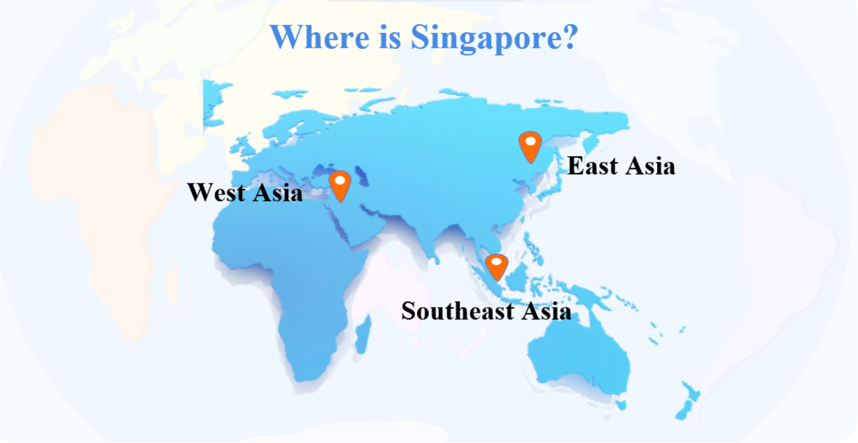
Activity 1 Circle the right location of Singapore.

Slide 3
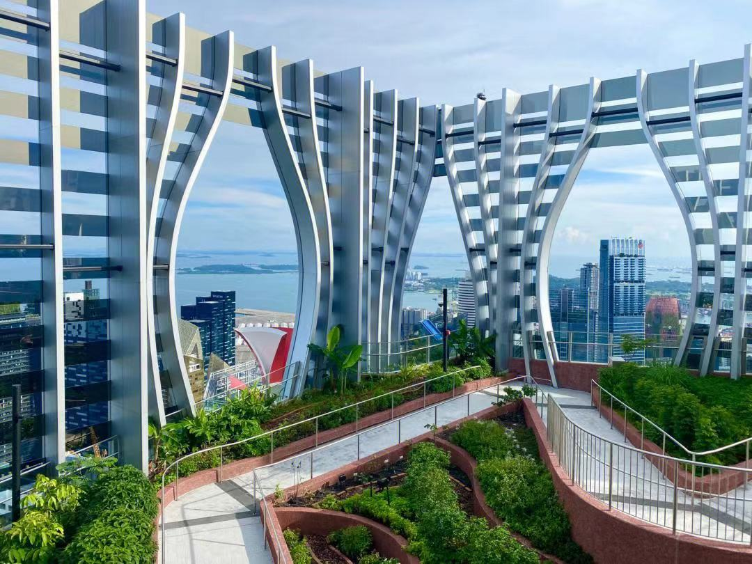
Activity 2 Read the title and fill in the blanks.
From the title,
Singapore is
a(n) ________ place.

Slide 4
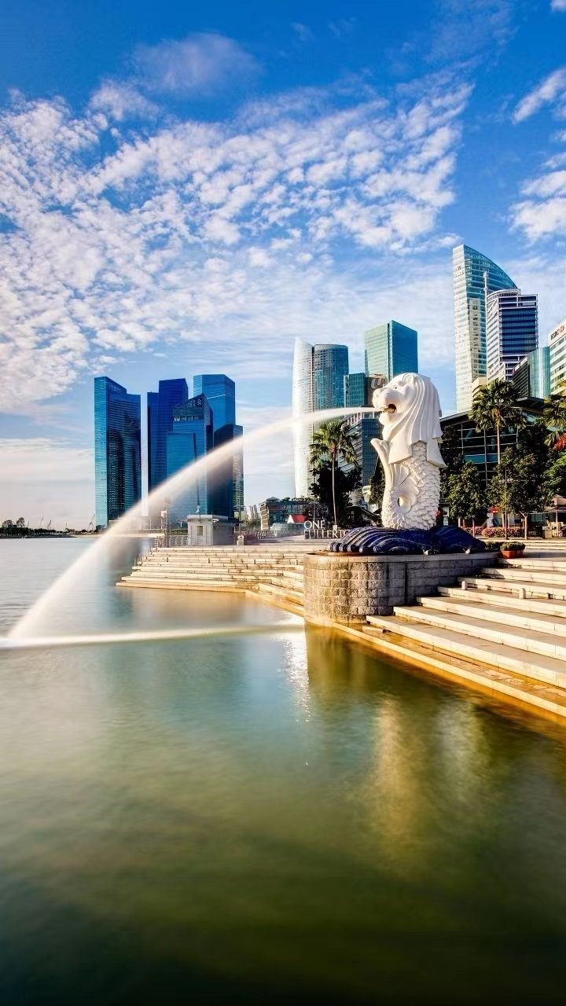
Activity 3 Read the article quickly and finish the tasks.
Find out the key words of each paragraph.
Para. 1 ___________
Para. 2 ___________
Para. 3 ___________
Para. 4 ___________

Slide 5
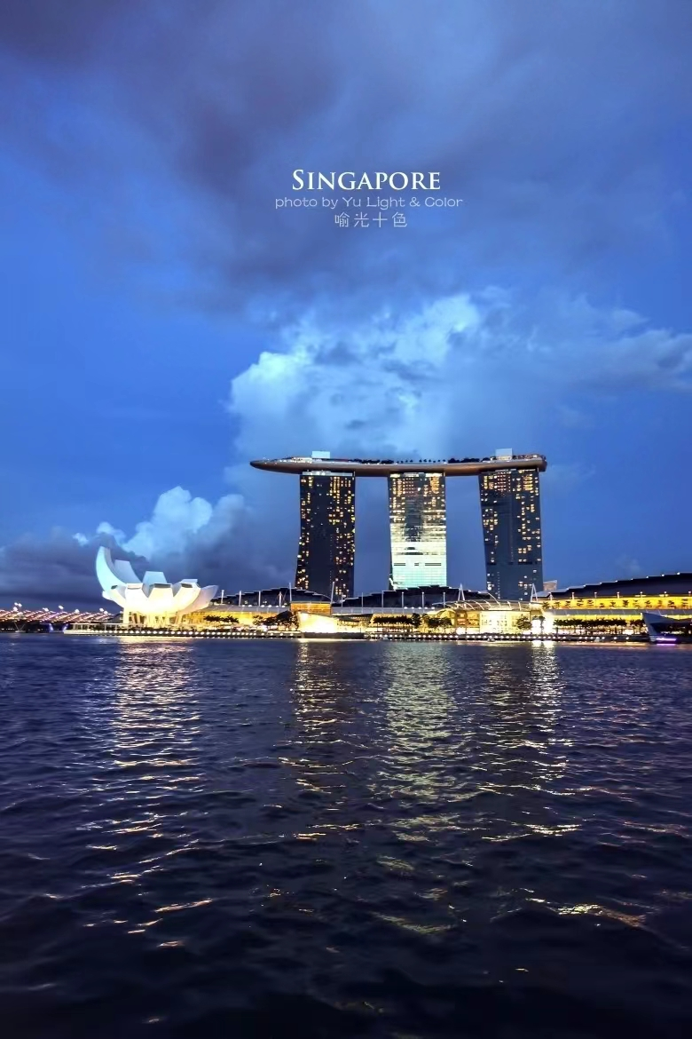
Activity 4 Read the first 3 paragraphs quickly and finish the tasks.
To attract us, the writer starts
the first 3 Paragraphs by ____.
A. telling a story
B. asking a question
C. giving an example

Slide 6
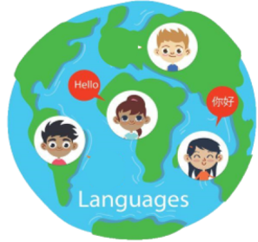
Activity 5 Read Paragraph 1 and underline the answer.
What language do people
speak in Singapore? Why?
_______________________
_______________________
_______________________

Slide 7
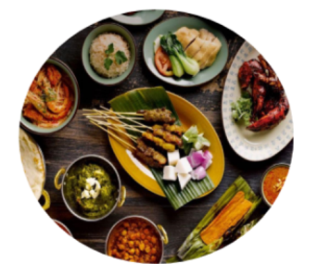
Activity 6 Read Paragraph 2 and circle the food words on your book.
What food can we eat
in Singapore?
——————————————
——————————————
——————————————

Slide 8
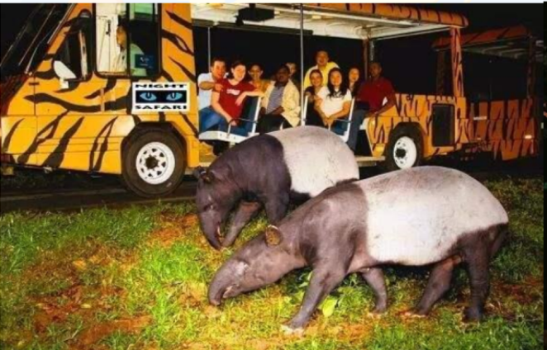
Activity 7 Read Paragraph 3 and correct the following statements.
(1) It might seem normal to go
to a zoo when it’s dark.
(2) It is better to see lions and
tigers during the daytime because
they will probably be awake.
(3)At Night Safari, people can
watch animals in a less natural
environment.

Slide 9
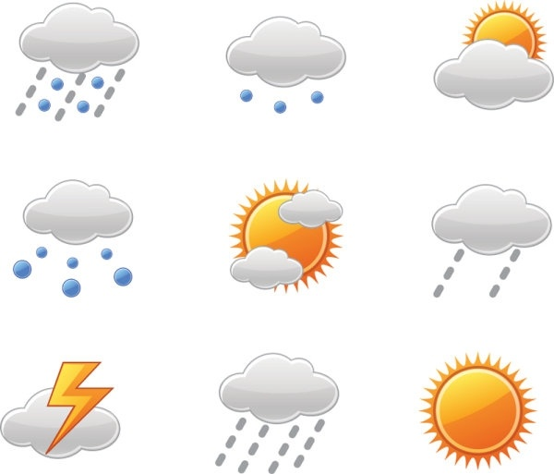
Activity 8 Read Paragraph 4 and answer the questions.
(1) What’s the weather like
in Singapore? Why?
_____________________
_________________________
_________________________
(2) What’s the best time to
visit Singapore? Why?
______________________
_________________________
_________________________

Slide 10
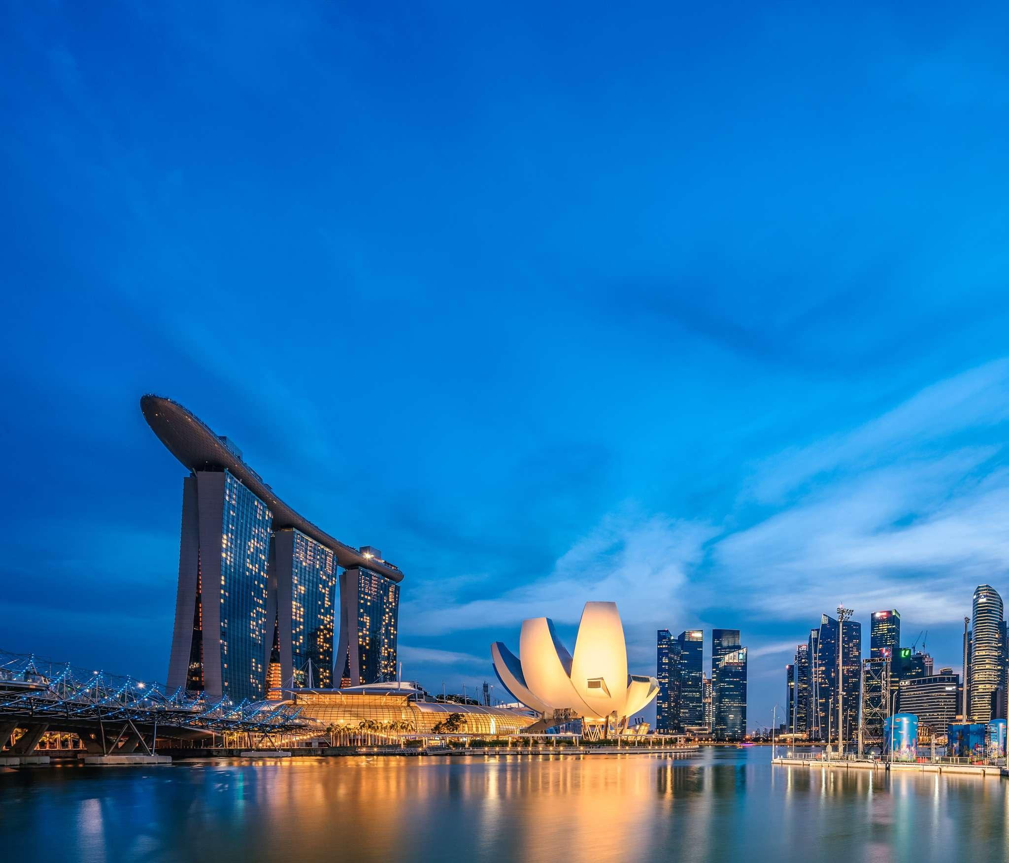
Activity 9 Write down at least three reasons for visiting Singapore.
———————————
————————————
————————————
————————————
————————————
————————————
————————————
————————————
————————————

Slide 11
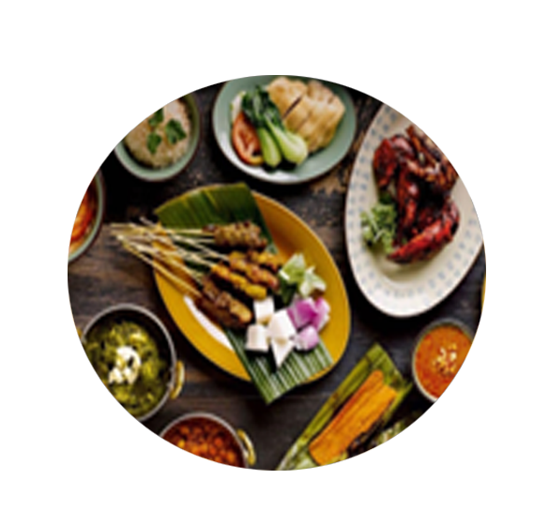
Activity 10 Work in groups.
Make an ad and list the reasons for
visiting our hometown.

Slide 12
