Slide 1
PEP Go for it！ Grade 7 Volume I
Unit 4 Where’s my schoolbag? Period 1 Listening & Speaking 课例1
This study handout belongs to
__________________

Slide 2
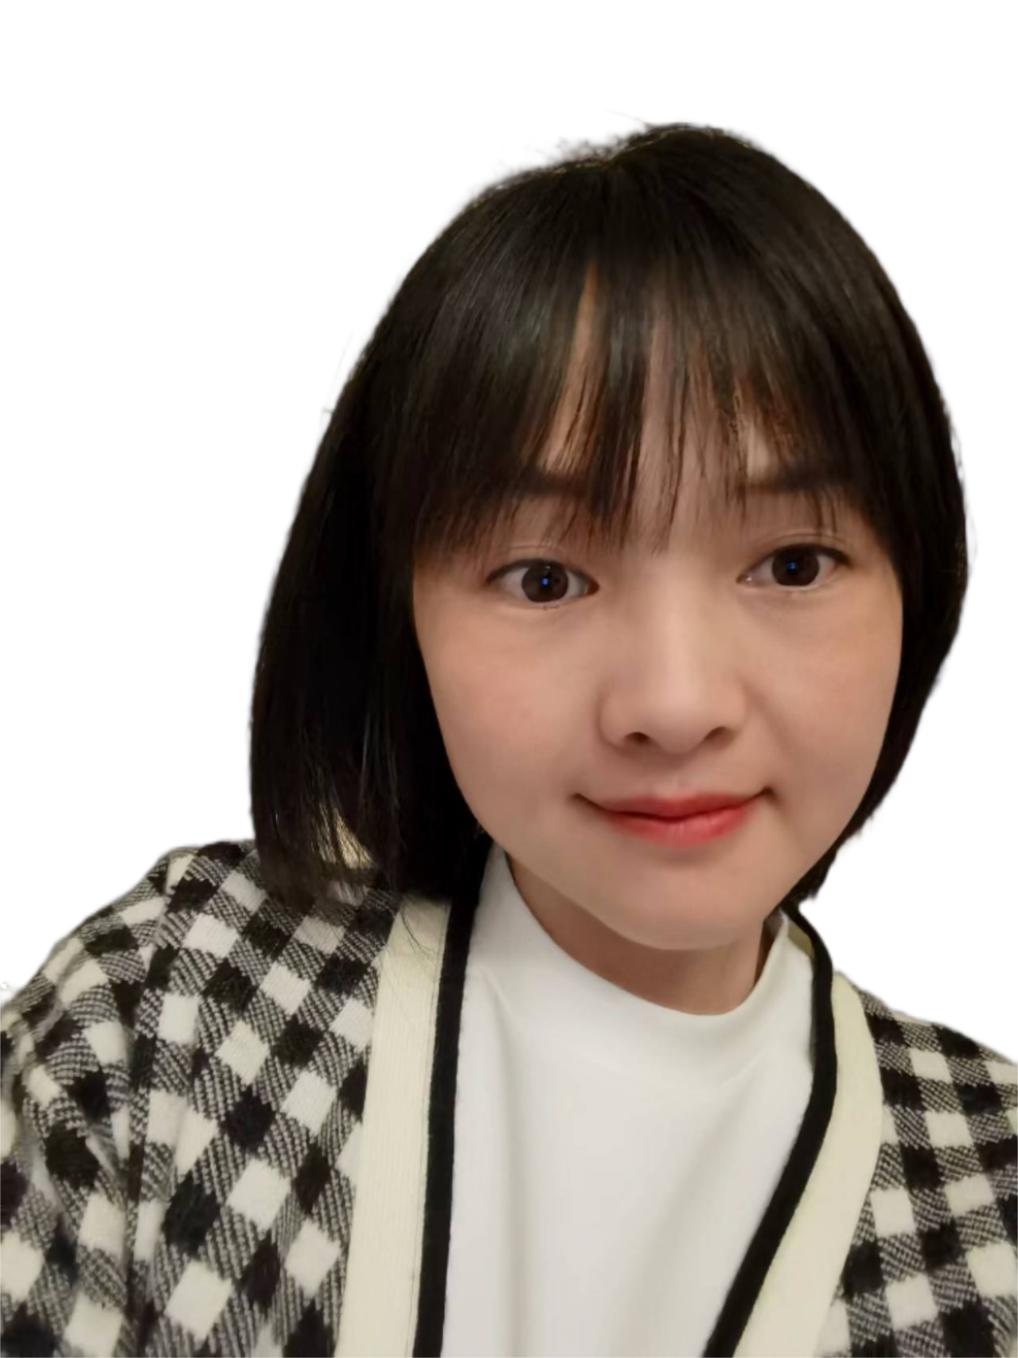
Part 01
Warmer
1

Slide 3
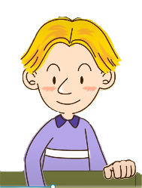
Activity 1
Watch a video and answer the question.
Where is Tom’s cap?
It’s______________.
2

Slide 4
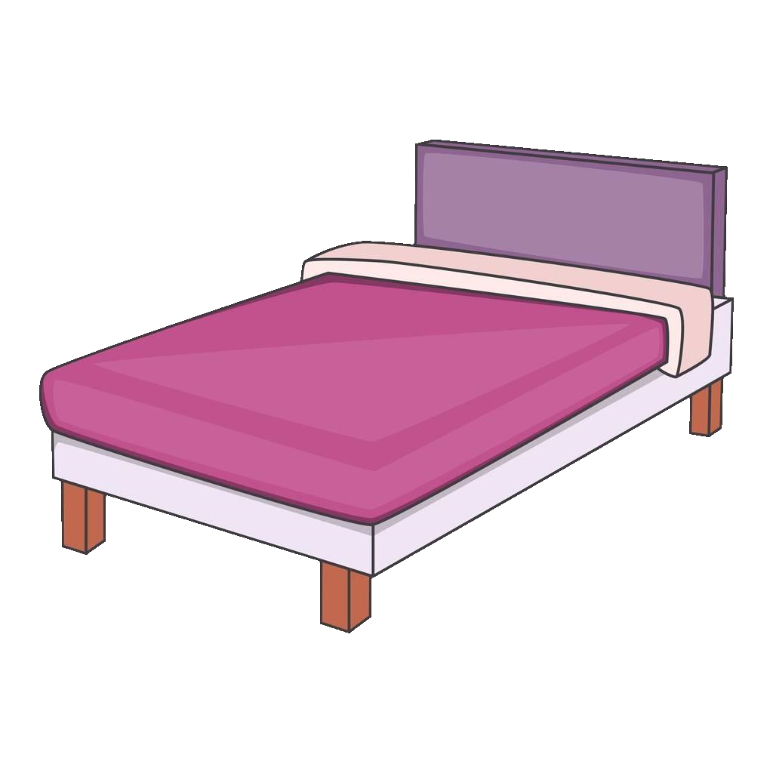
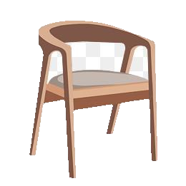
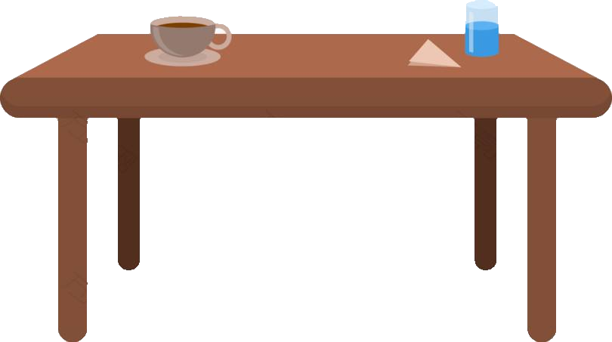
Activity 2
Read the following new words aloud.
sofa
bed
/'səʊfə/
/bed/
bookcase
/'bʊkˌkeɪs/
table
/'teɪbl/
chair
/tʃeə/
3

Slide 5
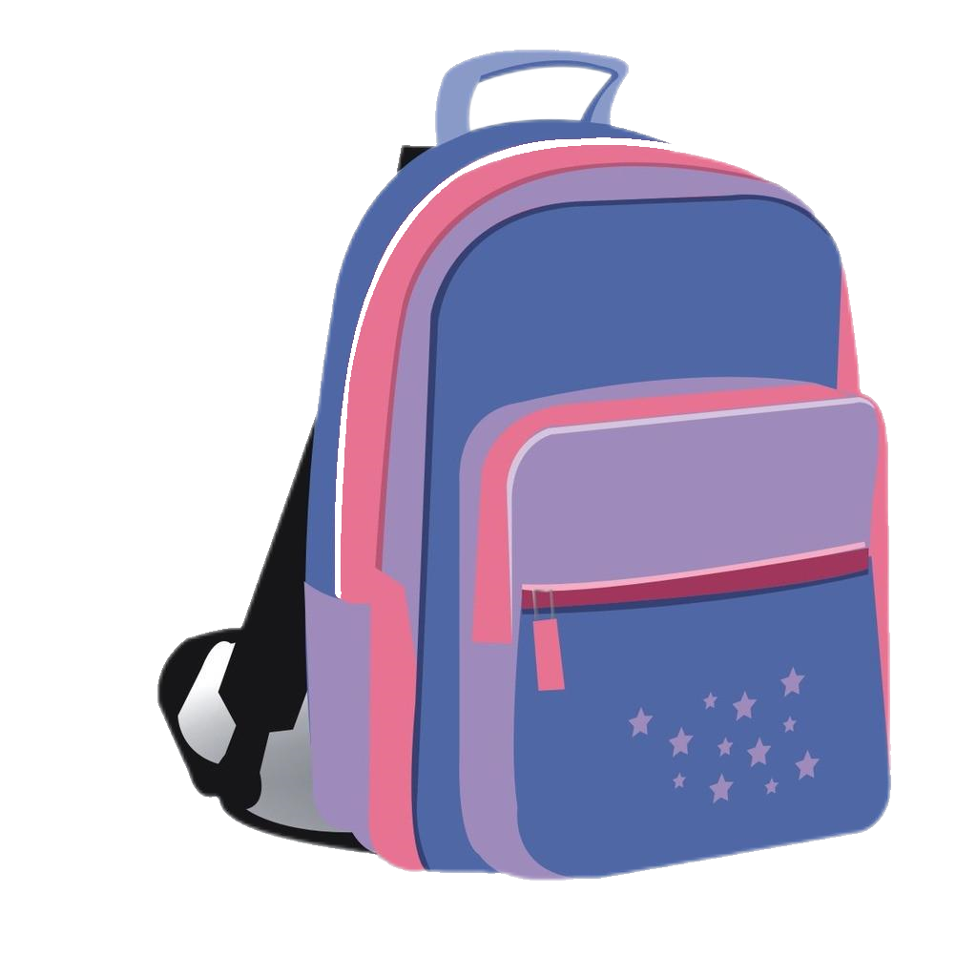
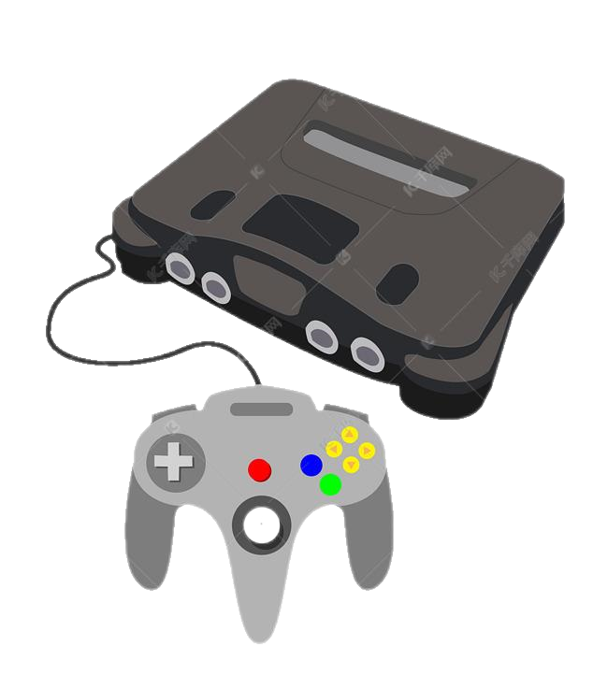
Activity 3
Make the conversations.
Where is _______________?
It’s___________________.
Where are ______________?
They are________________.

Slide 6
Part 02
Filler
5

Slide 7
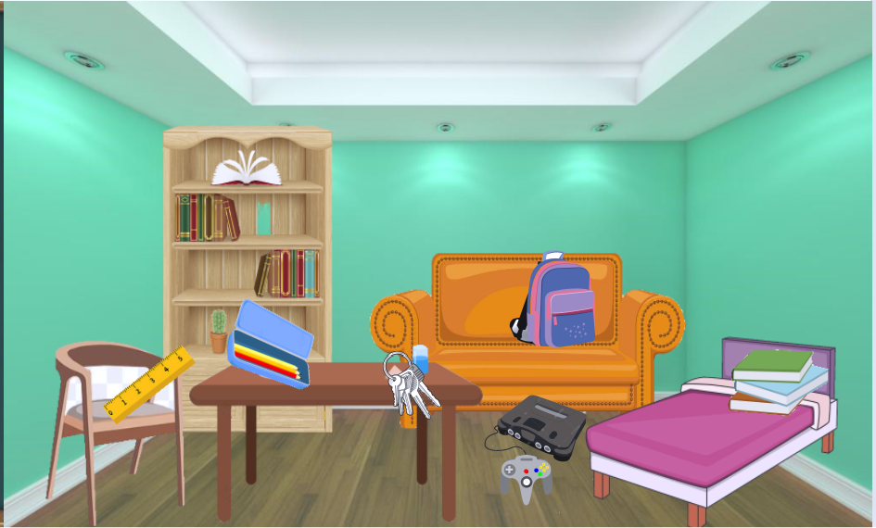
Activity 4
Listen and circle the things Tom is looking for.
6

Slide 8
Activity 5
Listen again and circle the right prepositions.
1. The computer game is on/in/under the bookcase.
2. The books are on/in/under the chair.
3. The pencil box is on/in/under the sofa.
4. The schoolbag is on/in/under the table.
5. The ruler is on/in/under the chair.
6. The keys are on/in/under the table.
7

Slide 9
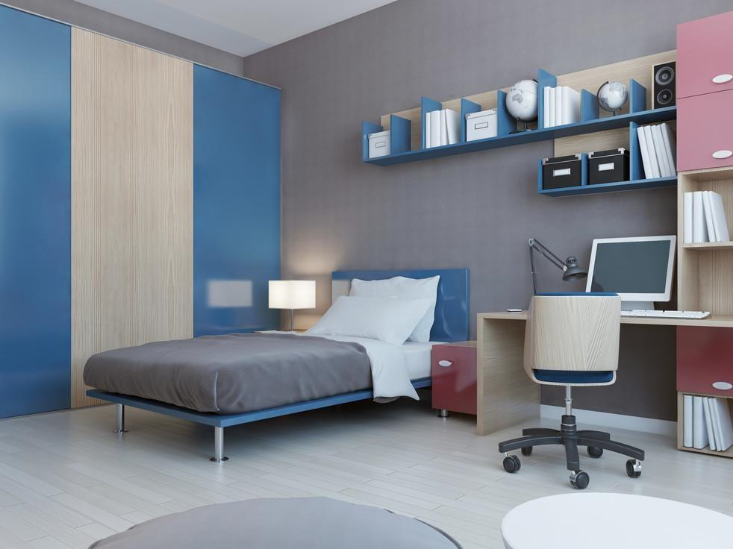
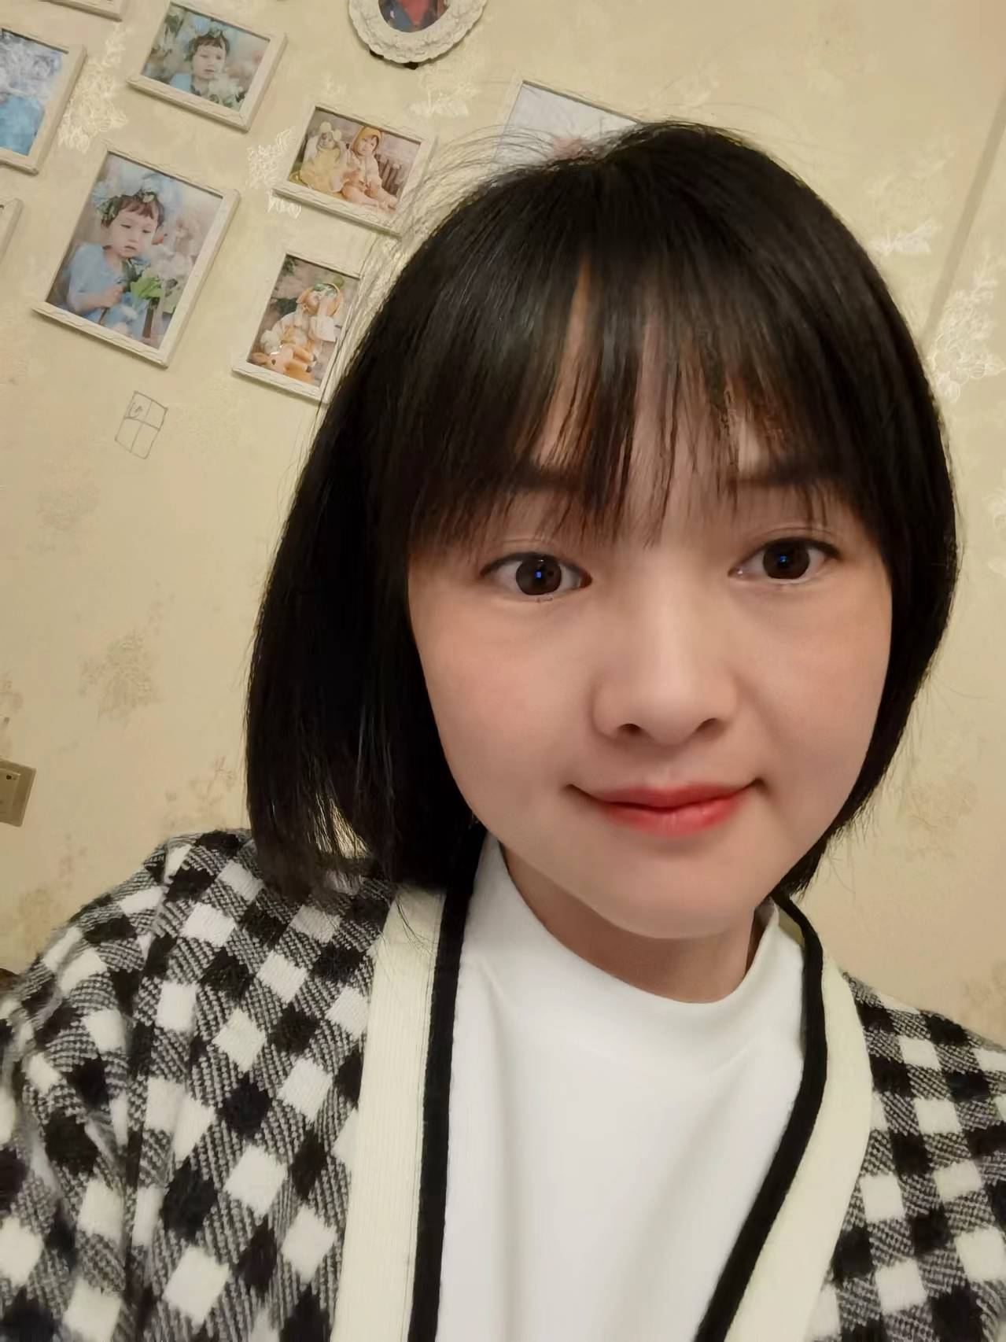
Part 03
Cooler
8

Slide 10
Activity 6
Make a conversation in proper tone.
--Is my ______ in the bookcase?
--Yes, it is. / No, it isn’t.
--Where is it?
-- It’s________.
--Are my ____ in the bookcase?
-- No, they aren’t.
--Where are they?
--They’re________.
9

Slide 11
Activity 7
Draw your nice room and share with classmates.
10

Slide 12
Activity8
Check what you have learned in this lesson.
内容 | 完成情况
我能运用on/in/under来描述 物体的位置 | A. 比较容易 | B. 略有困难 | C. 比较困难
我能够理解听力材料并完成 听力任务 | A. 可以顺利完成 | B. 完成不太顺利 | C. 不能完成
我能根据自己的喜好布置房间，并向他人描述房间物品位置 | A. 准确运用语言 | B. 能说出一些句子但不准确 | C. 很难说出完整的句子
11

Slide 13
Homework
You have to do:
Practice the dialogue on Page 81 with your partner with the proper tone.
You can choose to do:
Introduce your dream room to your family and record a video and send it to 25370664@qq.com.
12

Slide 14
少成若天性，习惯如自然。
—— 孔子
A child’s character and habits formed in youth are as innate as nature itself.
Confucius

