Slide 1
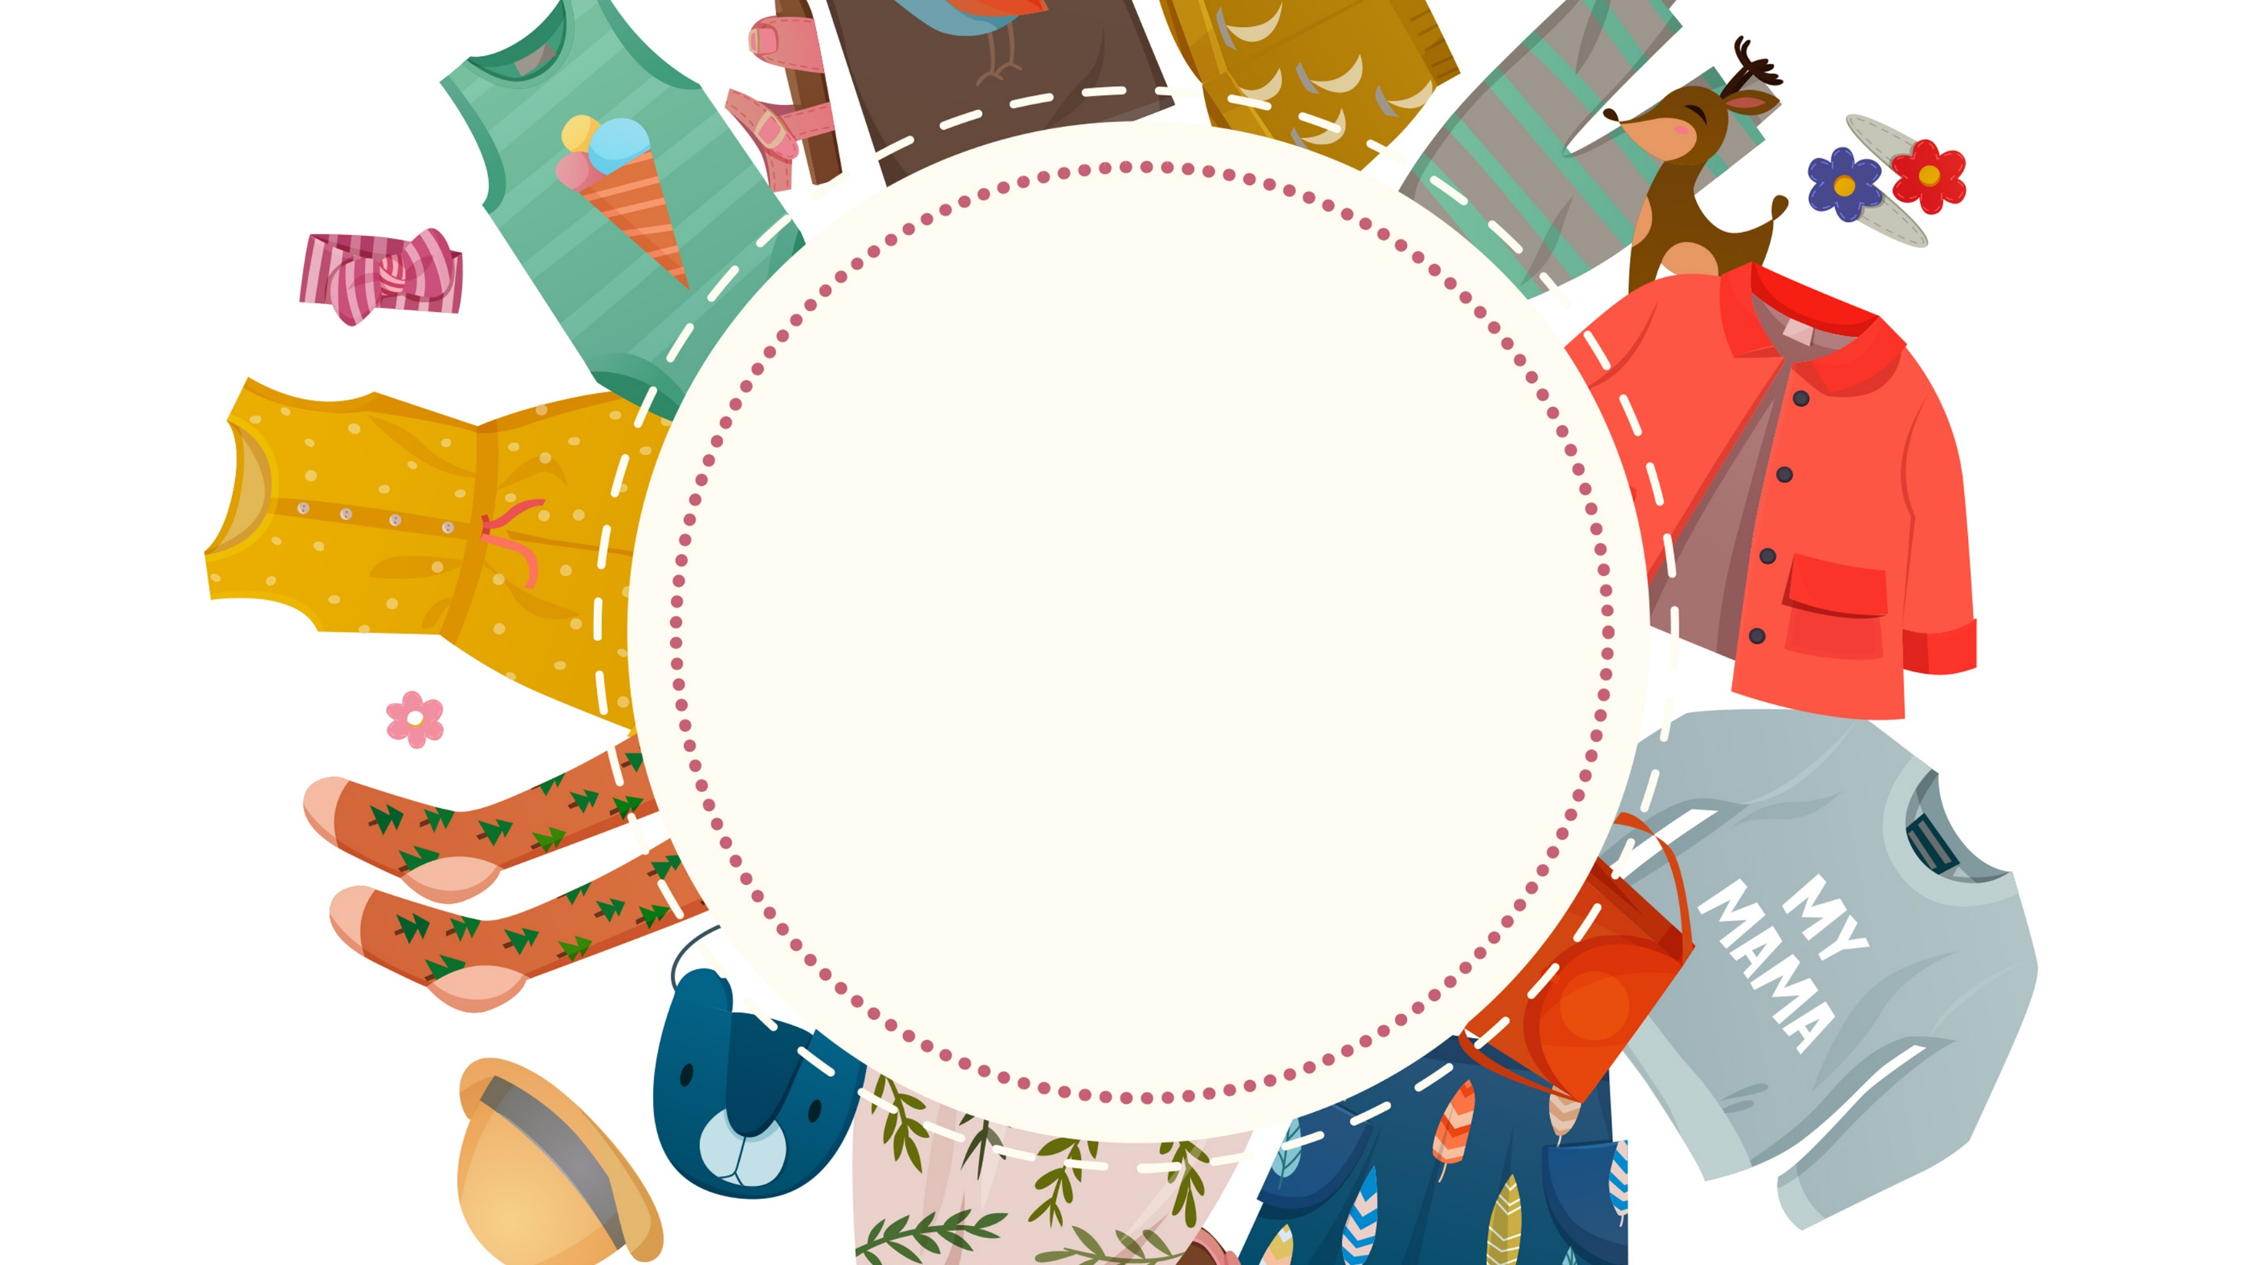
PEP Go for it!
Grade 7 Volume I
Unit 7
How much are these socks?
Period 1 Listening & Speaking
21号选手
课例2

Slide 2
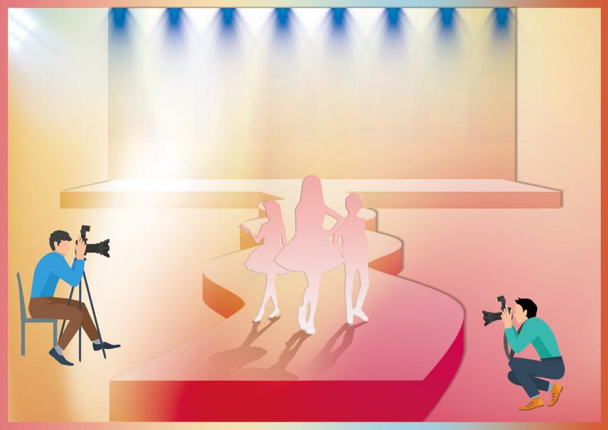
Activity 1 We are going to join in our school’s
International Fashion Show during the art week!
/ɪntəˈnæʃənəl/
国际的
International
Fashion
Show

Slide 3
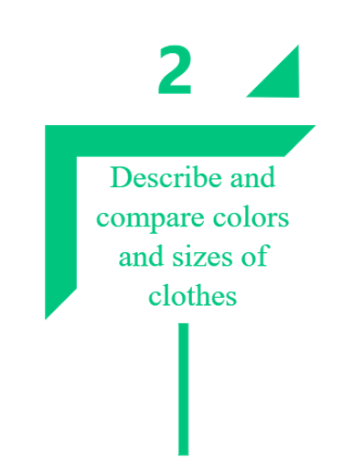
Learning Objectives

Slide 4
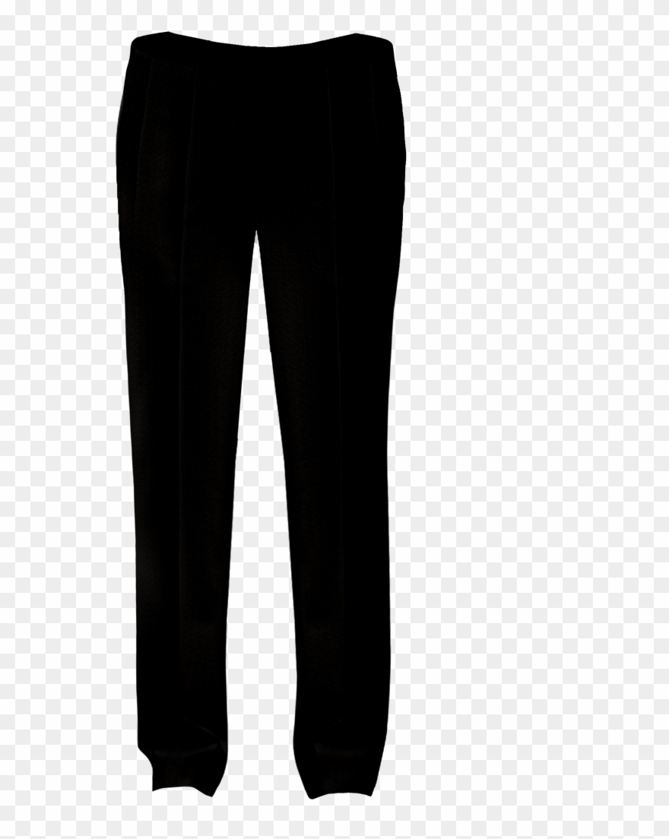
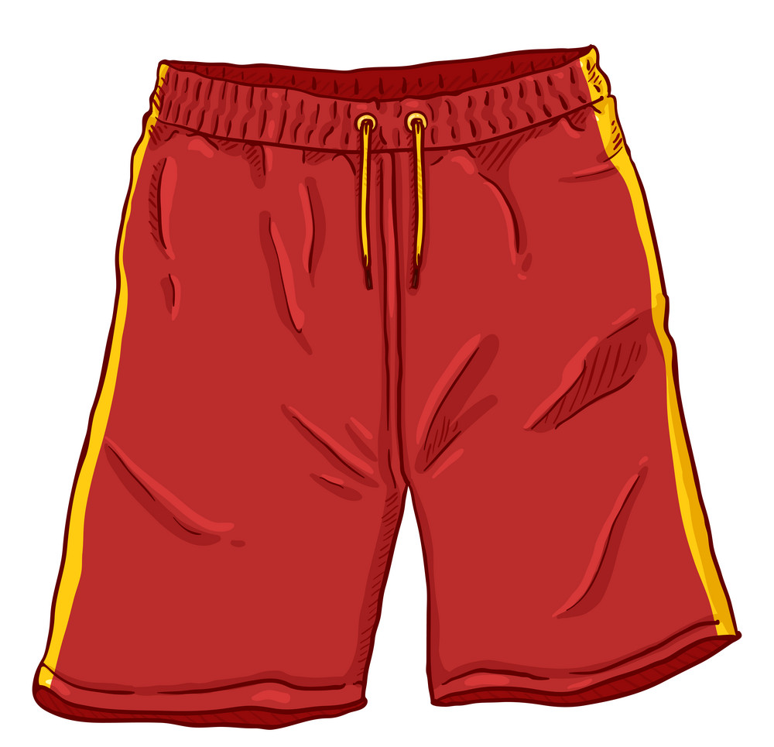
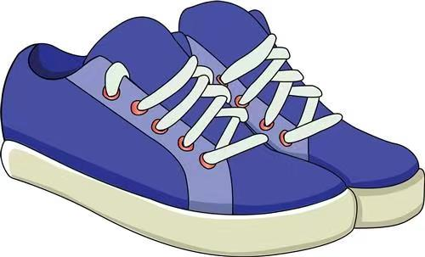
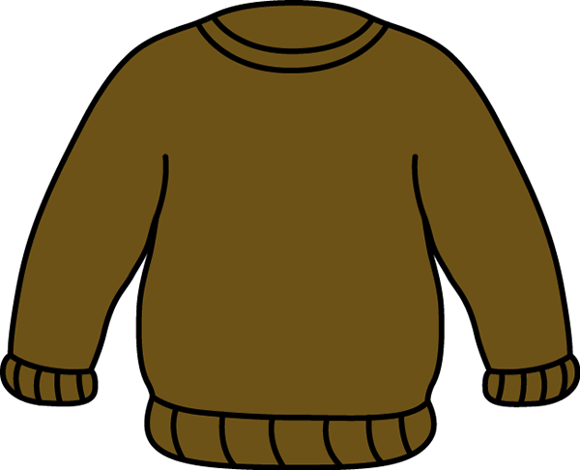
Activity 2 Match the clothes with their names.
sweater
shoes
/ˈswetər/
/ʃuːz/
T-shirt
socks
/ˈtiːʃɜːt/
/sɒks/
hat
trousers
/hæt/
/ˈtraʊzəz/
skirt
shorts
/skɜːt/
/ʃɔːts/

Slide 5
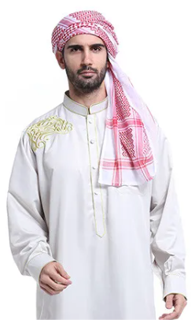
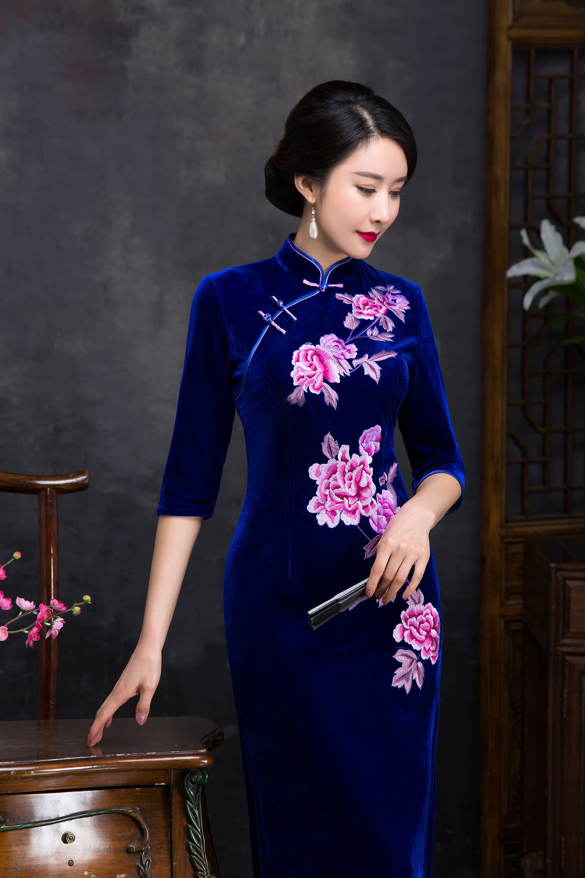
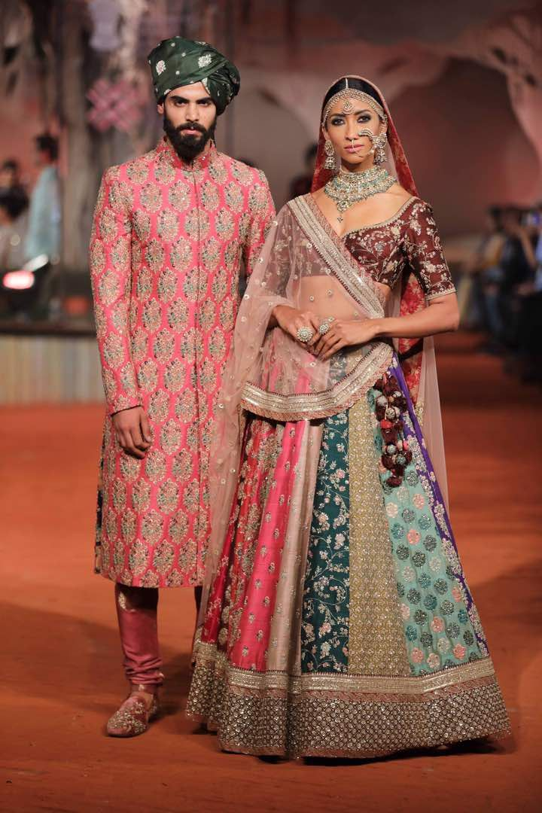
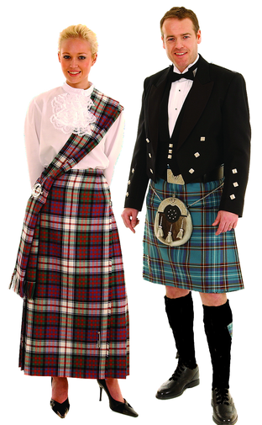
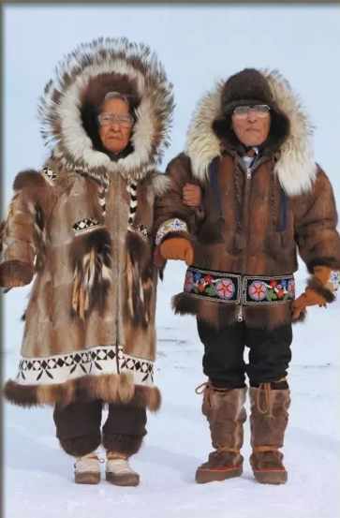
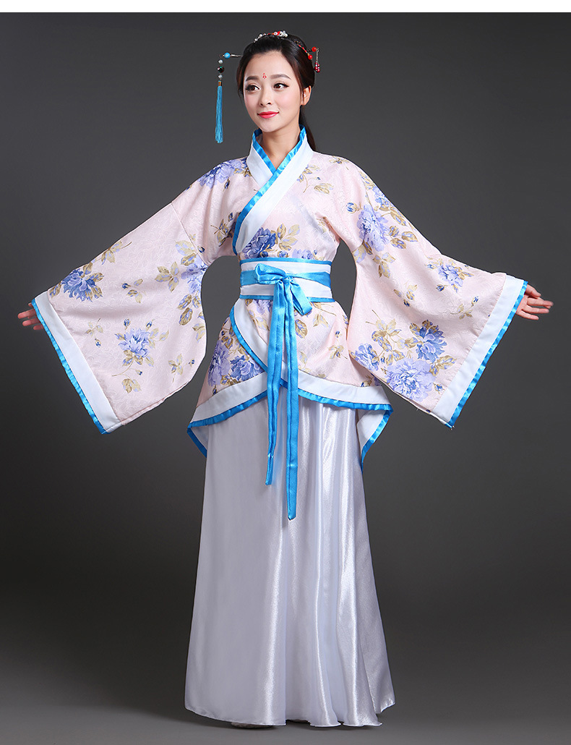
Clothes in China.
Clothes around the world.
China 中国
India 印度
Saudi Arabia 沙特
Mexico 墨西哥
Scotland 苏格兰
Canada 加拿大
Korea 韩国
China 中国

Slide 6
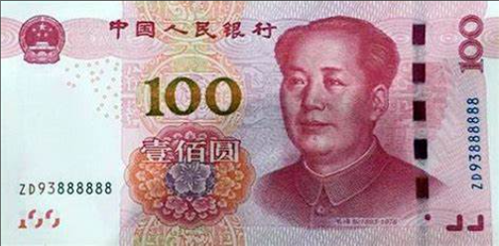
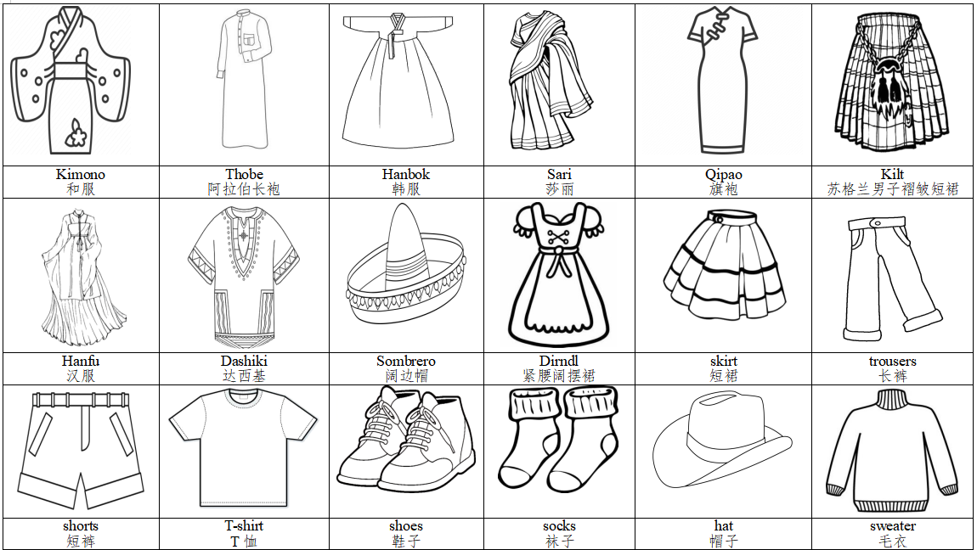
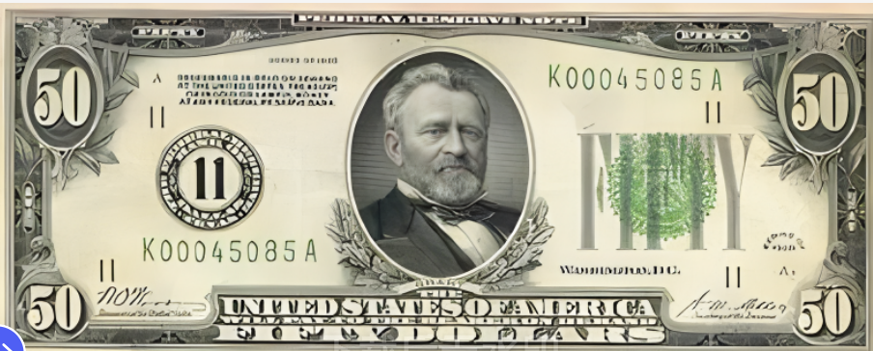
Activity 3 Choose your clothes for the show.

Slide 7
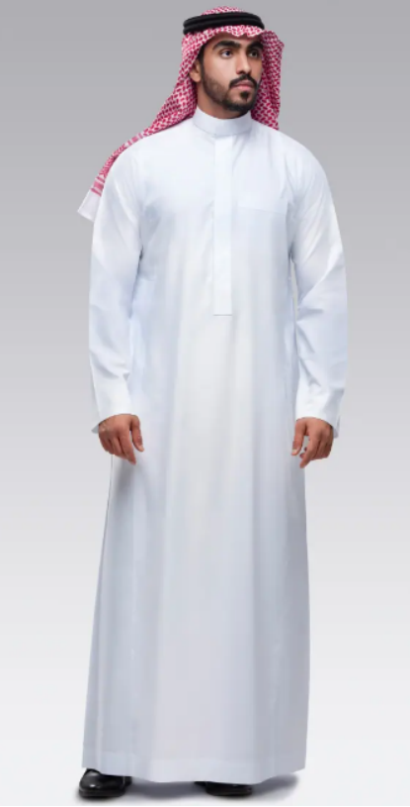
How do they choose their clothes?

Slide 8
Activity 4 Choose colors and sizes of your clothes.
black
white
red
green
blue
yellow
brown
purple
small
short
long
big

Slide 9
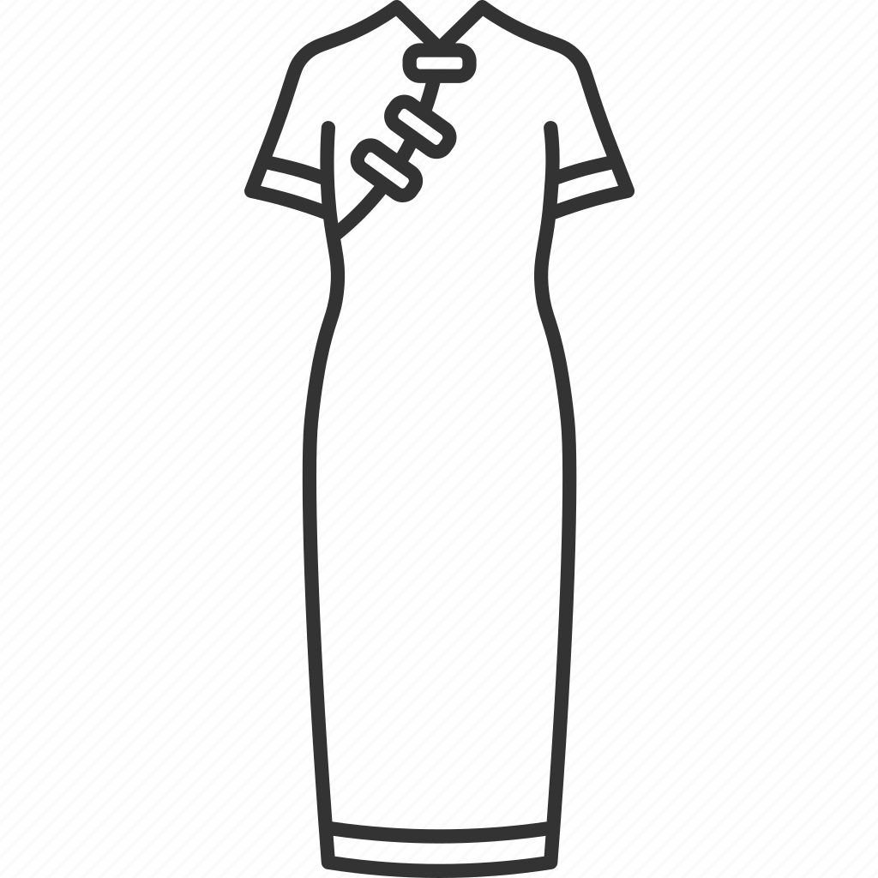
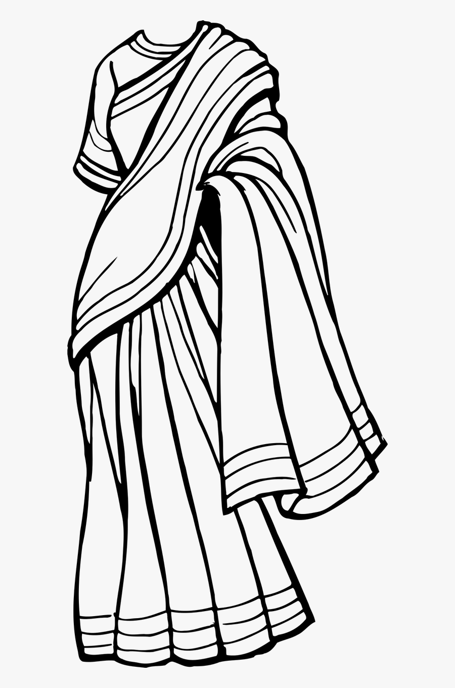
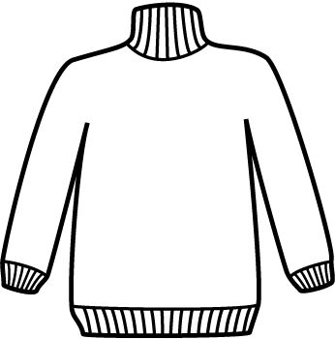
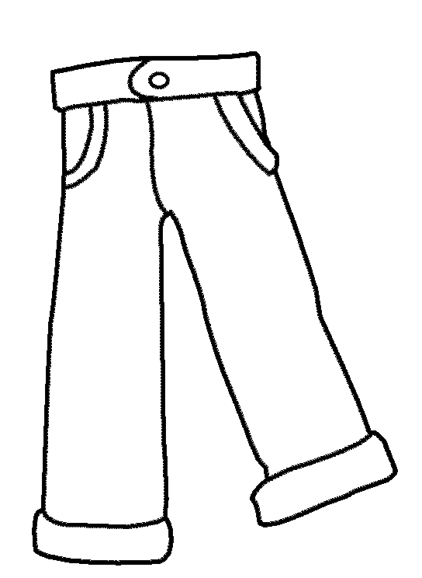
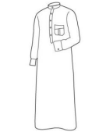
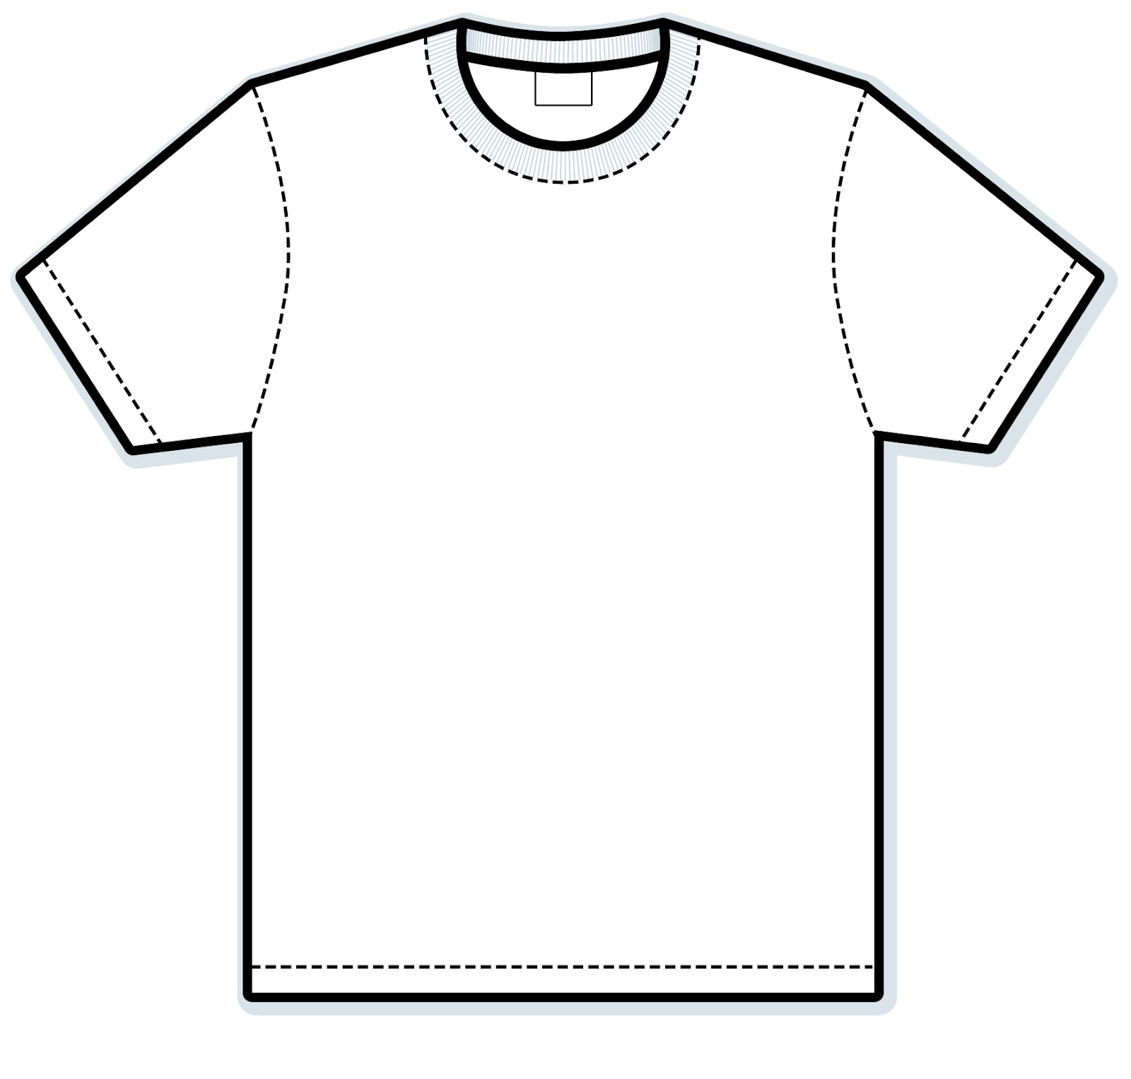
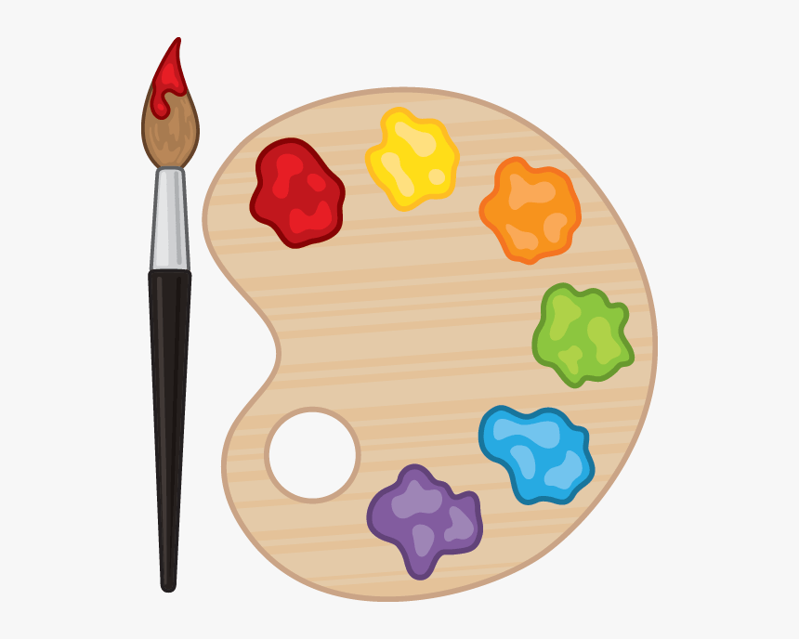
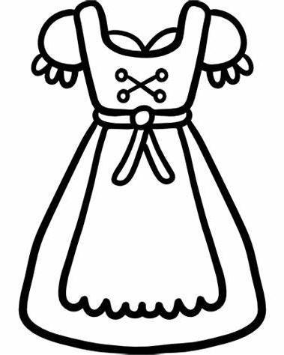
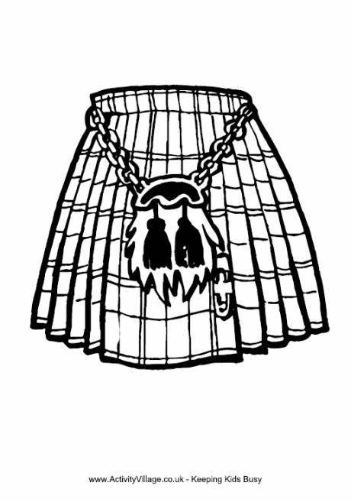
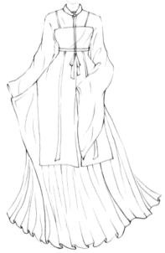
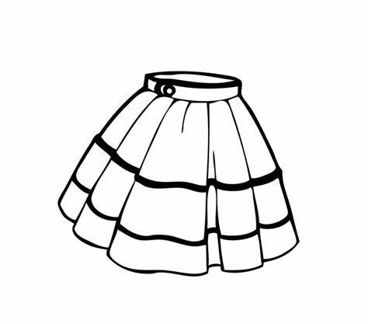
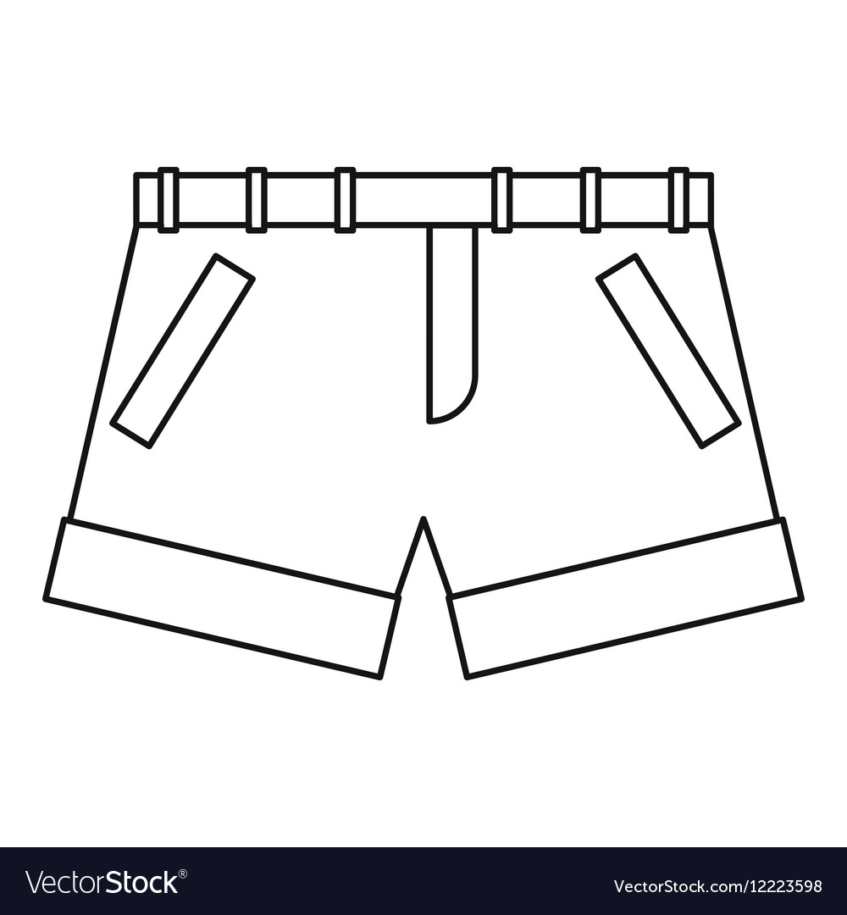
Activity 5 Color the clothes you chose in Activity 2.

Slide 10
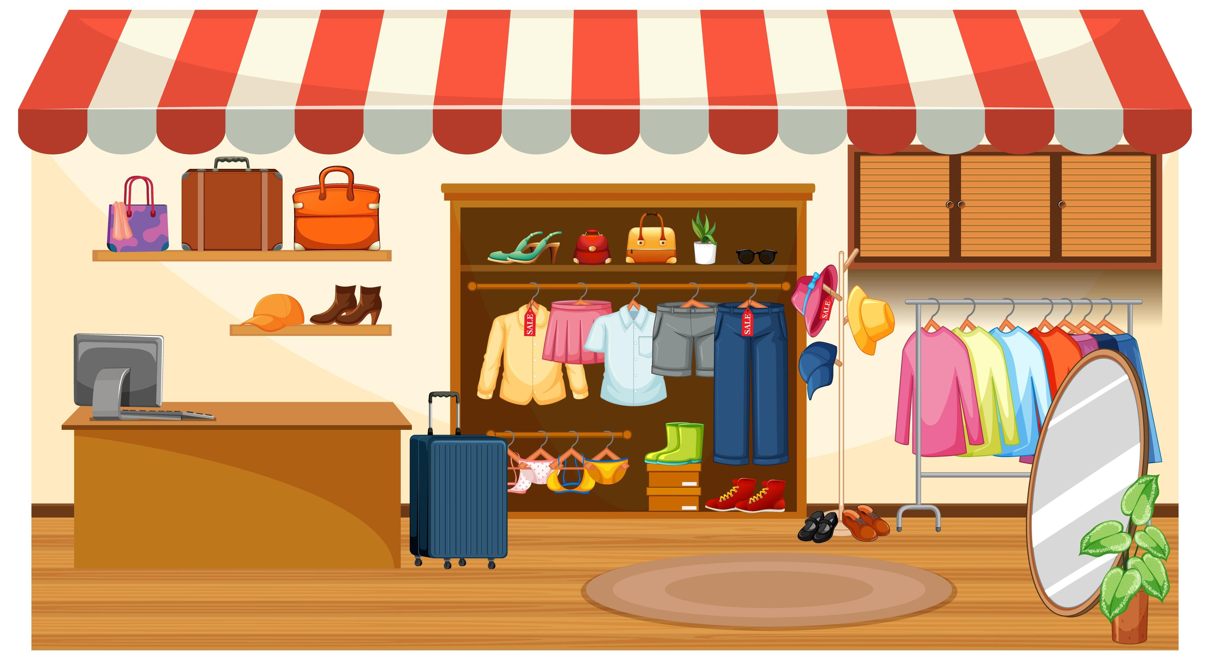
Let’s go shopping for the show!
Shopping website (购物网址):
https://eclothes.com/b/Fashion/bn_7000259856

Slide 11
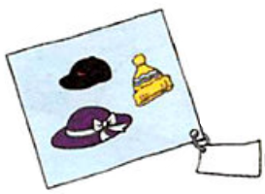
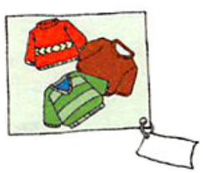
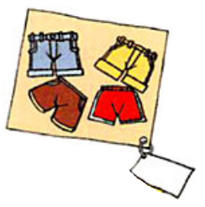
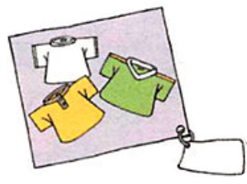
Activity 6 Circle the clothes and write down the prices.
＄5
＄8
＄6
＄2
＄9
＄7

Slide 12
Activity 7 Rehearse (彩排) the dialogue for buying clothes.
: Hi! How are you?
How can I help you today?
: I want to buy a pink Hanfu?
Do you have one?
: Let me see. Yes, we do.
: How much is it?
: It’s ___ yuan.
: Thank you.
: Hey! Can I help you?
: I’d like to buy a pair of shorts?
: What color do you want?
: Anything nice would be okay.
: Let me see. How’re these ones?
: Good. How much are they?
: They’re ___ dollars.
: I’ll take them.

Slide 13
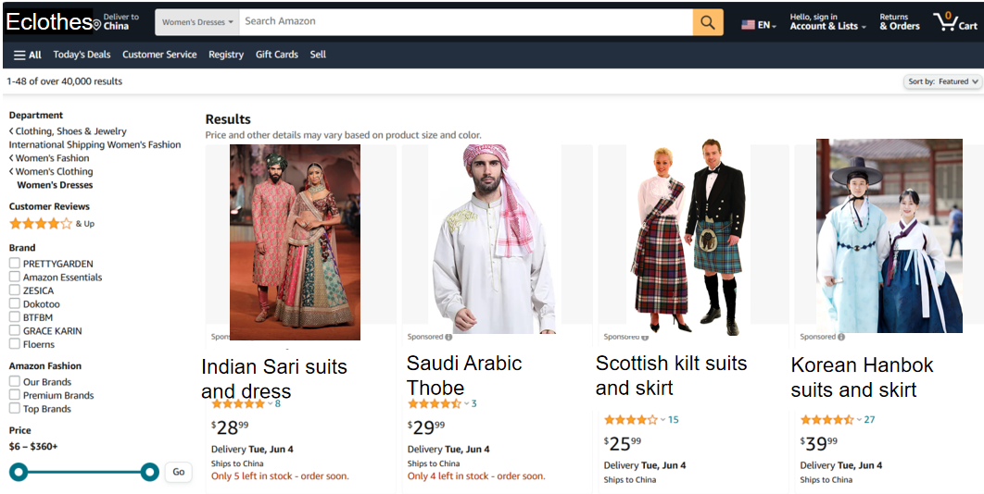
How much _______?

Slide 14
Activity 8 Perform on your stage in groups.
International Fashion Show
Work in groups of 3.
One works as a writer.
One works as a model.
One works as a reporter.

Slide 15
Activity 9 Rate others’ performance.
Assessment for Learning
Loudness
Accuracy
Fluency
Introduction
Organization
Creativity

Slide 18
Summary
red black pink
blue yellow ...
Respect the clothes.
Respect the culture.
Protect your customer rights.
Qipao
Dashiki
Thobe
Sari
...
How much is it?
How much are they?
Summary
(总结)
They are all very important.
Talk to the shop assistants.
Call 12315.
Don’t waste money.
Only buy the things that you do need.

Slide 19
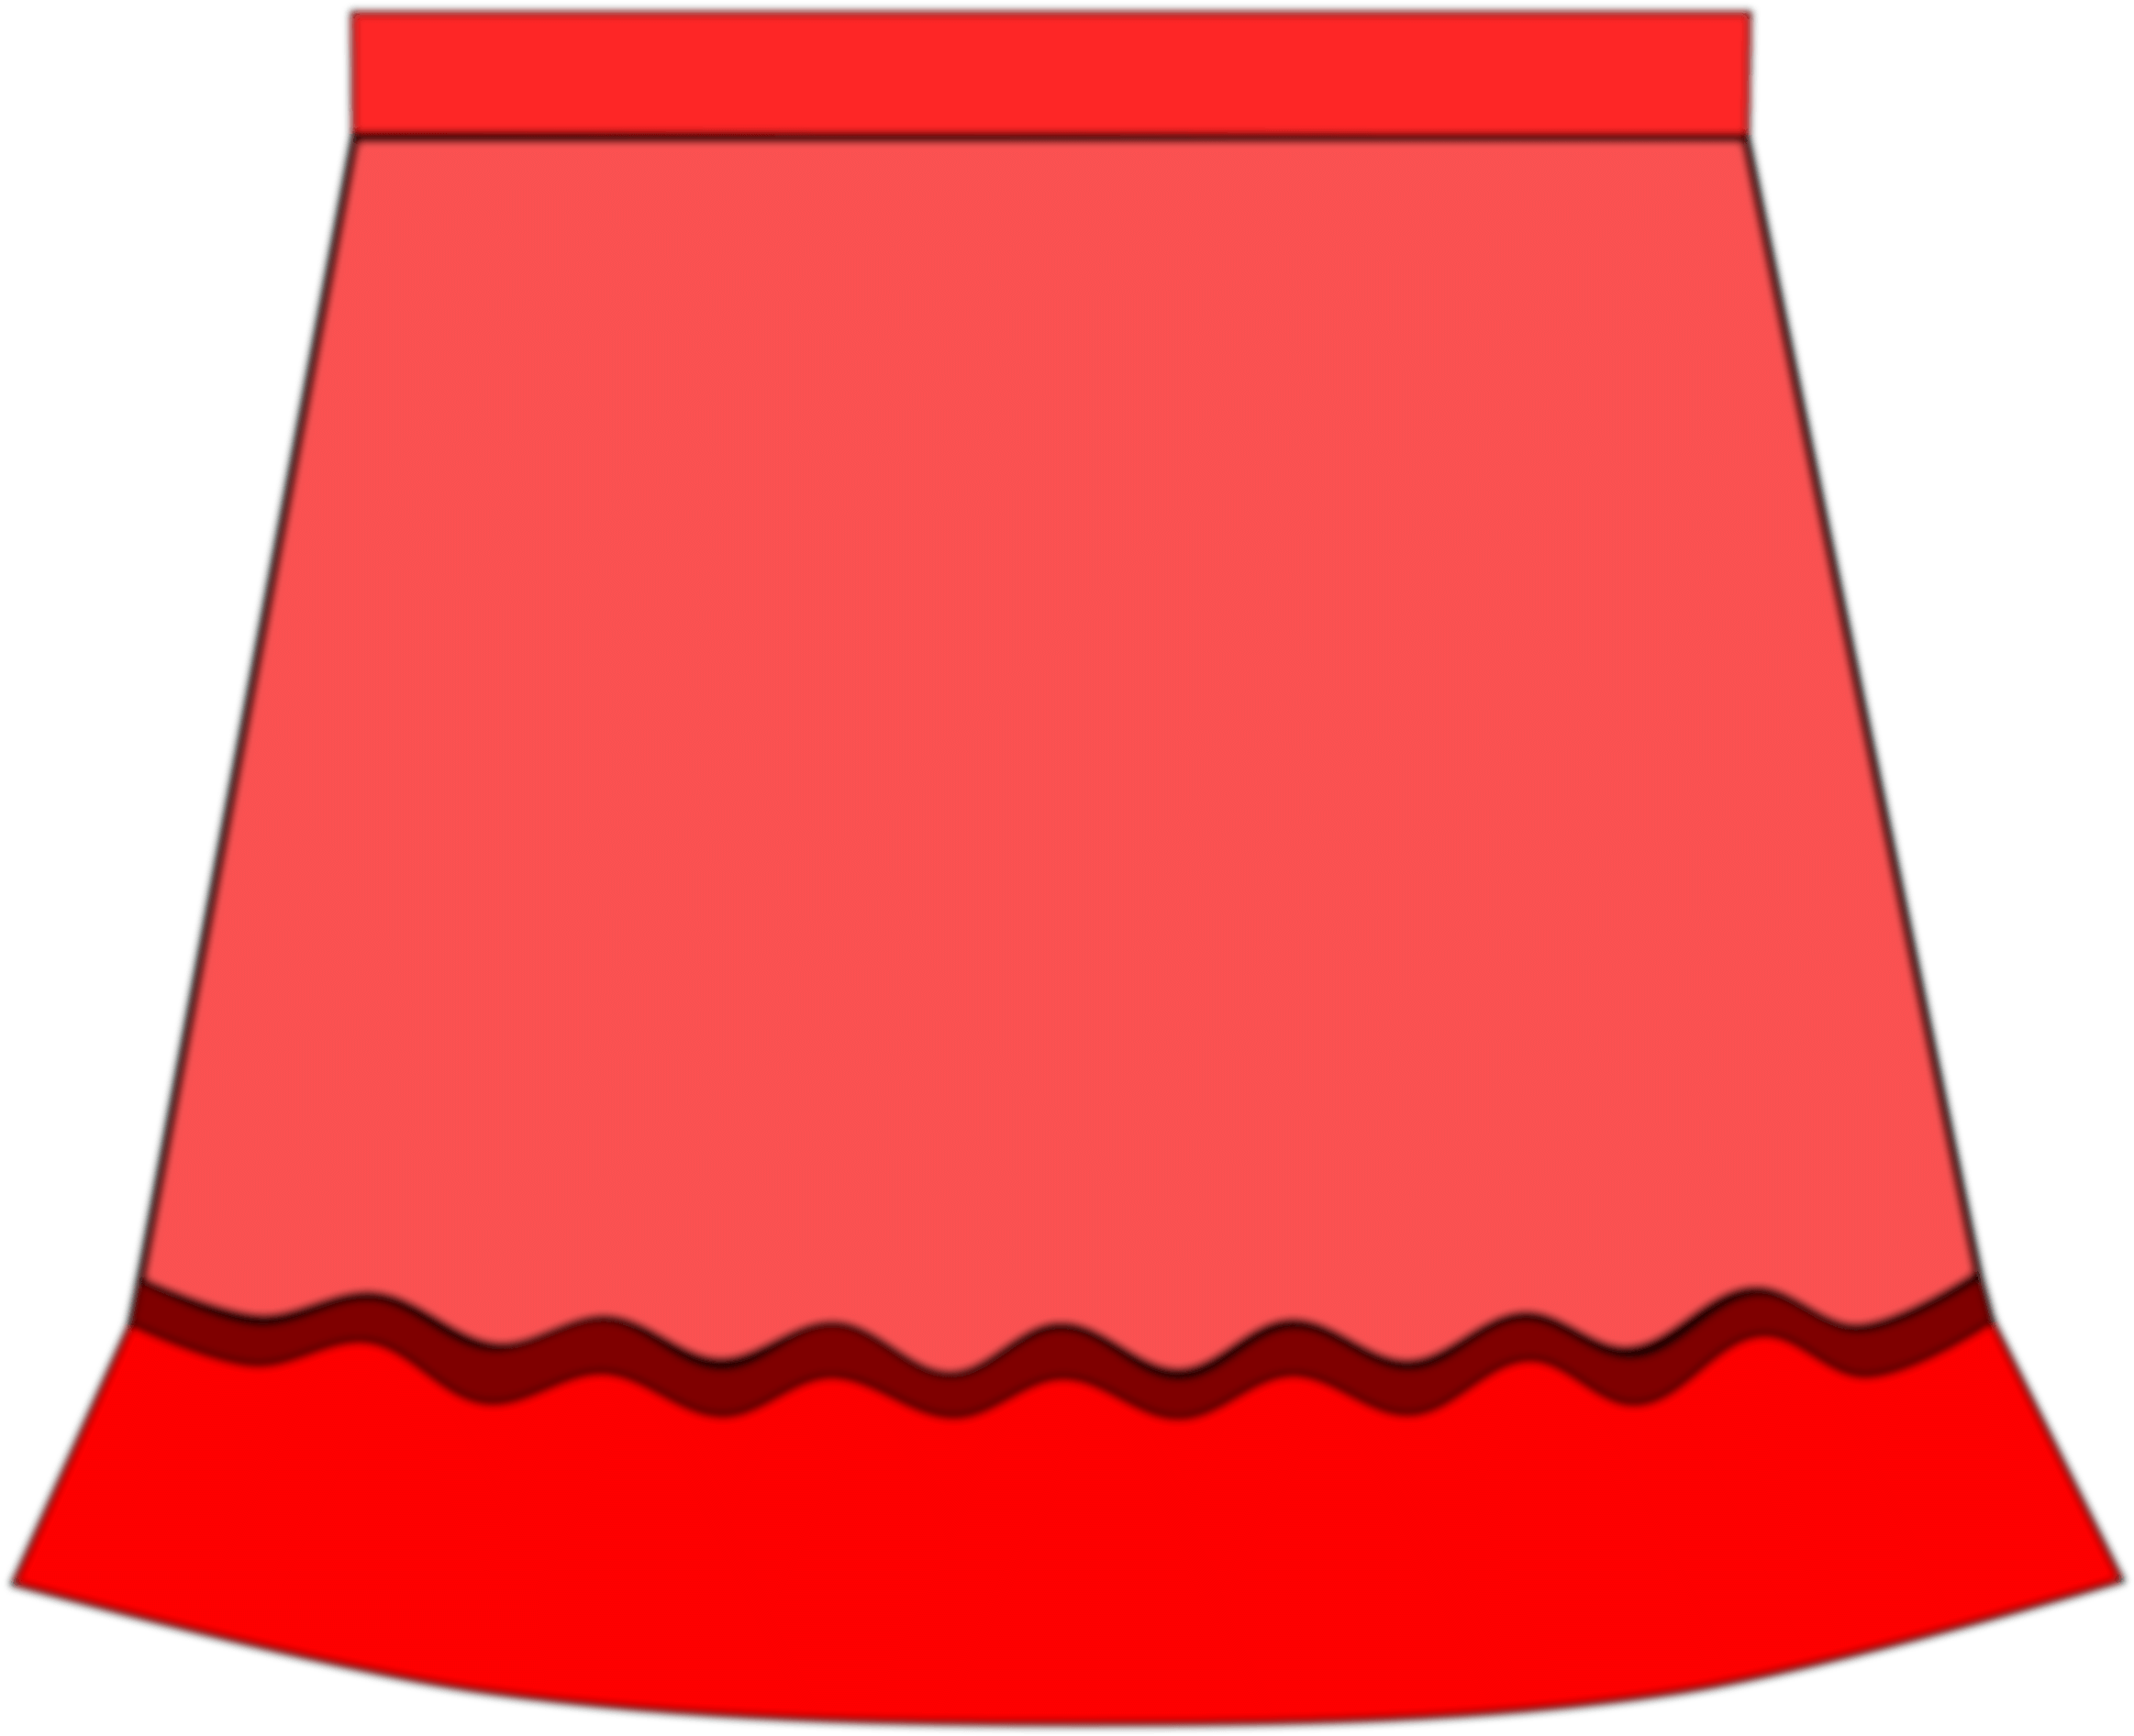
Activity 10 Homework: apply for real-life shopping.
Compulsory
Optional
经与商家沟通得知，你们小组为国际服装展演活动选的衣服已经停产，须另行选择。
与组内同学讨论之后重新选择展示服装并模拟打电话向厂家进行咨询和购买的情境。
自己设计一件展示服装发给组内同学，图文并茂向他们阐述衣服的设计理念、颜色选用及预估制作价格。
采访三位同学，询问他们最喜欢的一件衣服及喜欢的原因或衣服背后的故事（如：购买的时间、价格等）。
A
B

Slide 20
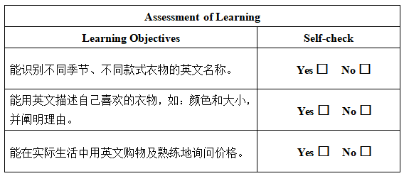
Activity 11 Evaluate your learning.

Slide 21
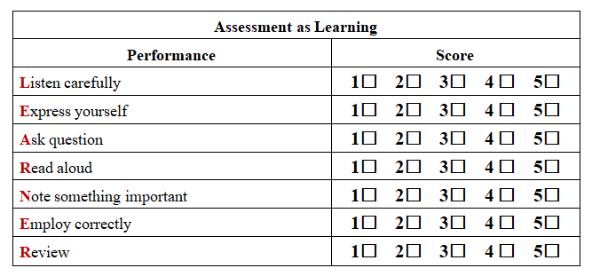

Slide 22
衣贵洁,不贵华。 —— 《弟子规》
I value clean clothes
over extravagant ones.
Standards for Being
a Good Student and Child

