Slide 1
Unit 2 How often do you exercise?
PEP Go for it! Grade 8 Volume Ⅰ
Period 4 Section B Reading (2a-2e)
21号选手 课例5

Slide 2
Learning Objectives
Evaluate
a pie chart
(品图)
Create
a pie chart
(制图)
Analyze
a pie chart
(解图)
Describe
a pie chart
(读图)
Through intergroup learning community and mutual evaluation, students will critically analyze each other's completed survey reports and created graphs. This process will help them develop a preliminary awareness of viewing the world objectively and scientifically.
By surveying the frequency of extracurricular activities among their peers in the group, students will collaborate to create a pie chart. They will then refine their conclusions based on the obtained data, cultivating higher-order thinking skills that involve observing, analyzing facts, and forming their own viewpoints.
Through classroom discussions, students will be able to interpret the data in the pie chart using target English vocabulary and grammatical structures. They will also be able to decipher the author's ideas in the text based on the information provided in the pie chart.
By reading and decoding the text, students will be able to use appropriate frequency adverbs and percentages to describe the numerical information in the pie chart. They will also gain a preliminary understanding of the composition of a pie chart.

Slide 3
Predict
2a Rank these activities according to how often you think your classmates do them.
watch TV
go to the movies
play computer games
exercise or play sports
use the Internet
go camping in the country

Slide 4
Predict
2a Rank these activities according to how often you think your classmates do them.
1
exercise or play sports
1=most often
2
go camping in the country
3
go to the movies
4
play computer games
5
watch TV
6=least often
6
use the Internet

Slide 5
2b Read the article and complete the pie charts on the next page.
Describe a pie chart(读图)

Slide 6
2b Read the article and complete the pie charts on the next page.
Describe a pie chart(读图)
15
20
20
45

Slide 7
2b Read the article and complete the pie charts on the next page.
Describe a pie chart(读图)
10
90

Slide 8
2b Read the article and complete the pie charts on the next page.
Describe a pie chart(读图)
13
2
85

Slide 9
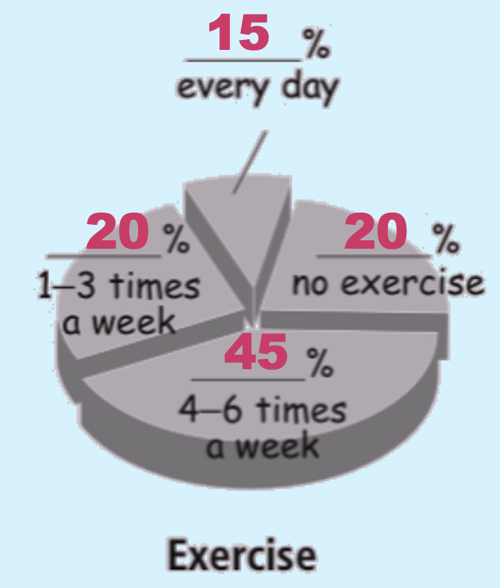
Analyze a pie chart(解图)
Read paragraph 2 and order these sentences.
We found that
4
And twenty percent do not exercise at all!
2
Twenty percent exercise only one to three times a week.
1
Only fifteen percent of our students exercise every day.
3
Forty-five percent exercise four to six times a week.

Slide 10
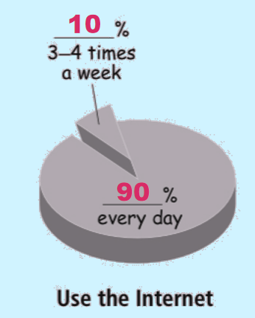
Analyze a pie chart(解图)
Read paragraph 3 and answer these questions.
Are you surprised at the result of using the Internet? Why or why not?
What do the most students use the Internet for?

Slide 11
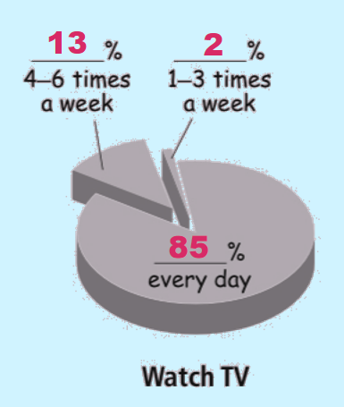
Analyze a pie chart(解图)
Read paragraph 4 and answer these questions.
How often do most students watch TV?
Most studemts watch TV every day.
What do they usually watch?
They usually watch the game shows.

Slide 12
Analyze a pie chart(解图)
Read paragraph 5 and answer the question.
opinion
comment
旧习难改
conclusion
What does the writer think is the best way to relax? Why?
The writer thinks _______________________________________
______________________________________________________
the best way to relax is through exercise.
Because it’s healthy for the mind and the body.

Slide 13
Analyze a pie chart(解图)
Do you think the students at No. 5 are healthy?
Why or why not?
I think _____________________________________________________________________
15
10
13
2
20
20
45
90
85

Slide 14
Ask your groupmates how often they do this activity and make a pie chart. Show the pie chart to your class.
Create a pie chart(制图)
Group Work
Step 1
Collect the data.
（完成问卷）
Step 2
Analyze the data.
（分析数据）
Step 3
Draw a pie chart.
（绘制图形）
Step 4
Write a report.
（填写报告）

Slide 15
Create a pie chart(制图)

Slide 16
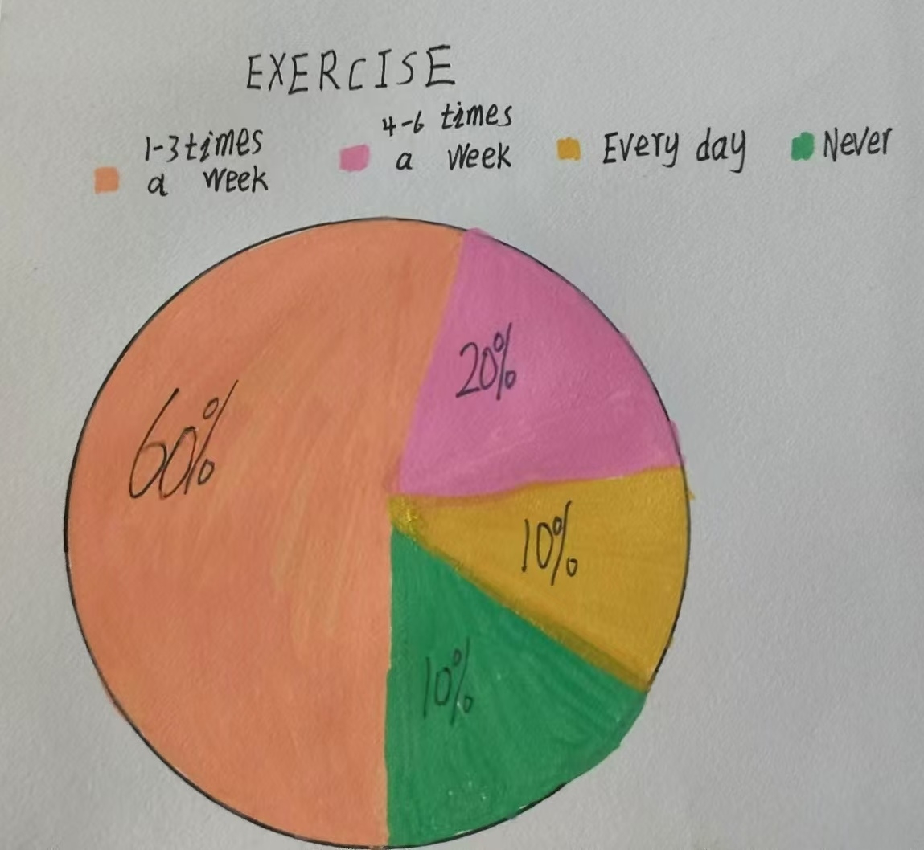
Create a pie chart(制图)

Slide 17
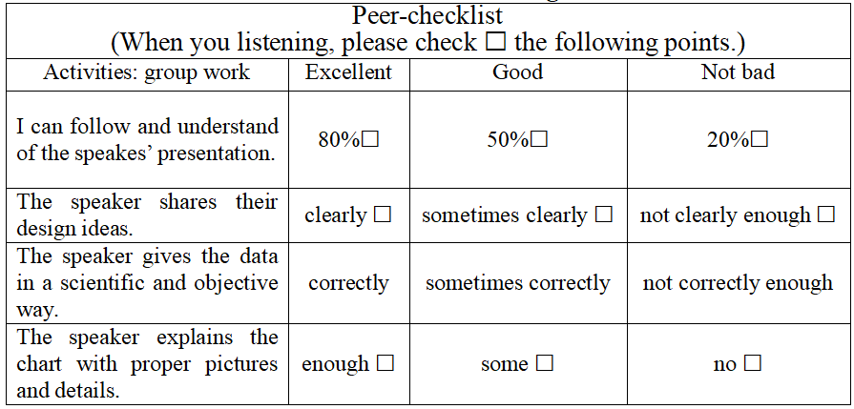
Assessment for group report
Evaluate a pie chart(评图)

Slide 18
Summary
DESCRIBE
（读图）
EVALUATE
（品图）
pie chart
ANALYZE
（解图）
CREATE
（制图）

Slide 19
World
It creates a better world in a scientific and objective way.
大展宏图
Why should we use the pie chart?
Country
It helps us to understand each other better.
励精图治
Individual
It makes ourselves clear.
图文并茂

Slide 20
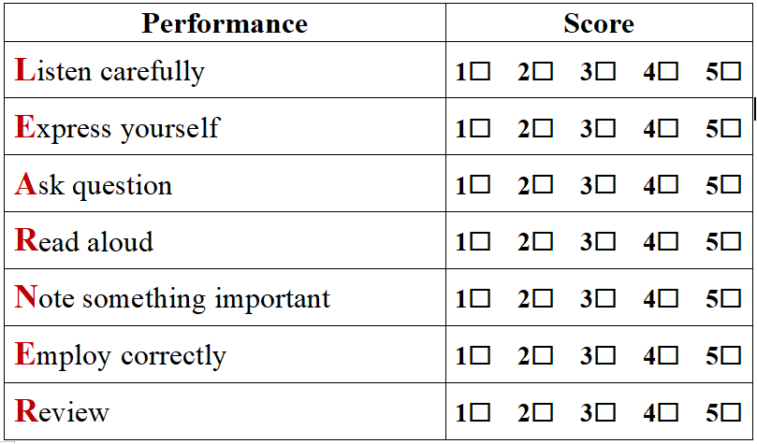
Assessment as learning

Slide 21
Homework
Compulsory
Optional
Make a video based on your report and send it to 312941643@qq.com.
Finish 2d on Page 14.

Slide 22
Math is as useful and beautiful as language. Data is sometimes worth a thousand words.

Slide 23
Thank you!

